Slide 1
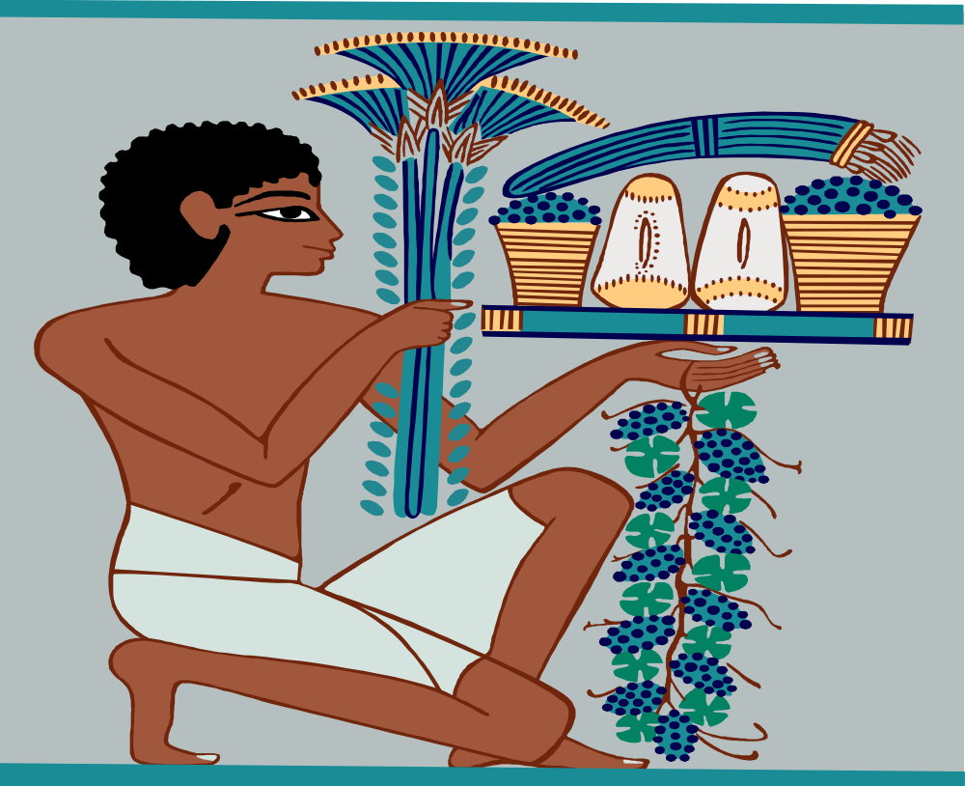

Key Stage 2 History
Ancient Egypt
What can we learn about ancient Egypt from what has survived?

Slide 2
History Interactive
Teaching and Learning Resources
These are sample slides.
There are no audio, document links or internet links in this sample.
See all of our resources at
www.historyinteractive.co.uk
History Interactive Teaching and Learning © 2013

Slide 3
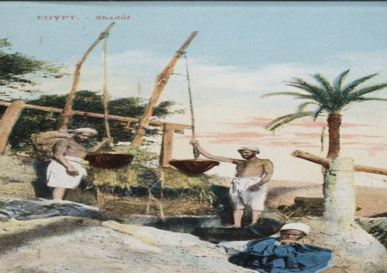
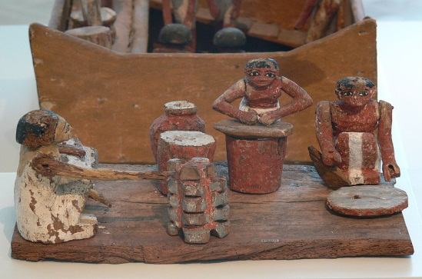
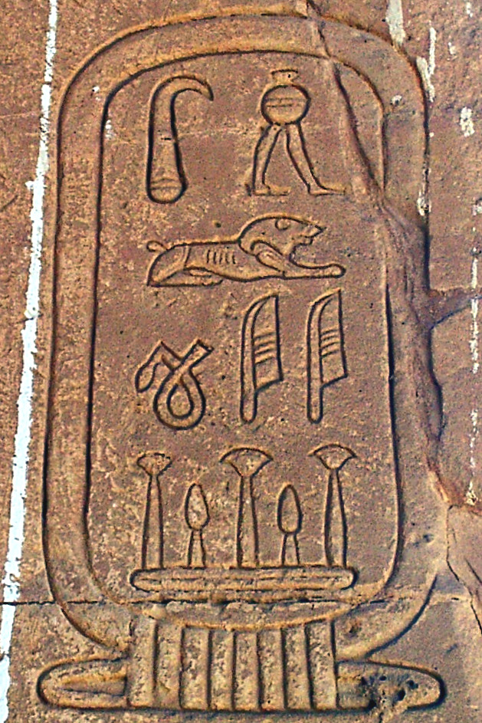
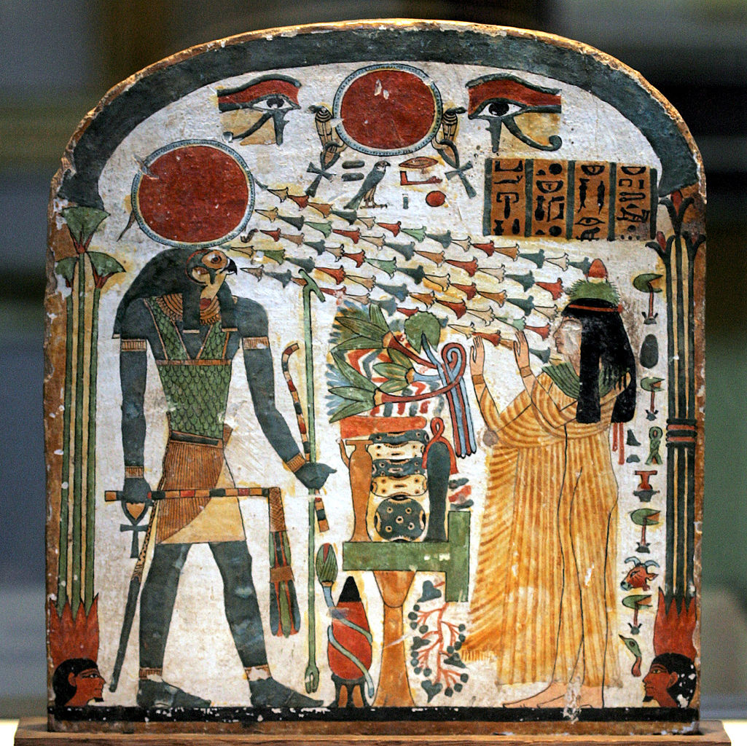
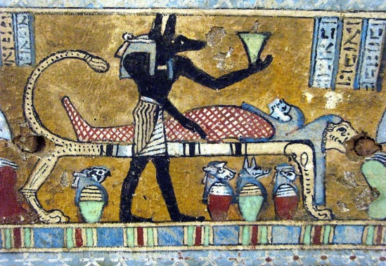
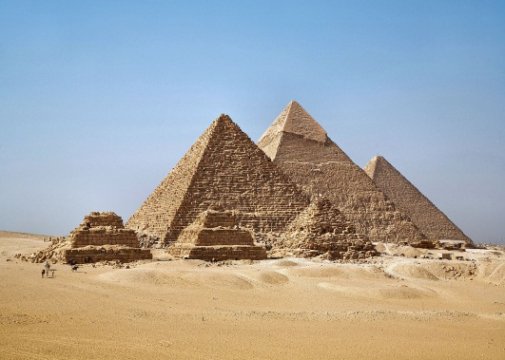



Ancient Egypt
2
Who were the Egyptians?
Daily life in ancient Egypt
Hieroglyphics
Content Slides
Gods, Temples and Pharaohs
Pyramids and Tombs
Life after death
Print Activity Booklet
Watch Video
Do the end of topic test

Slide 4
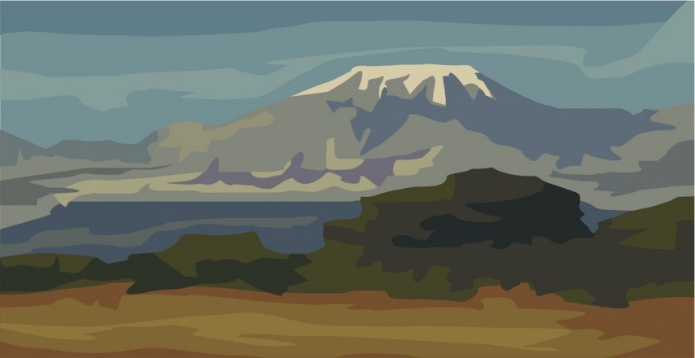
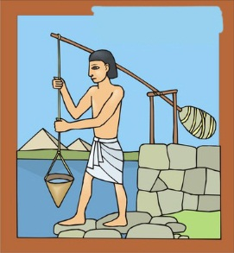
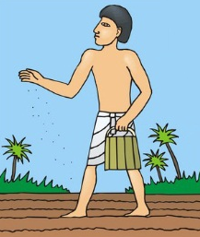
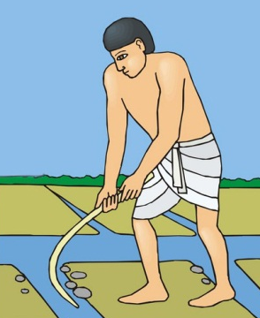
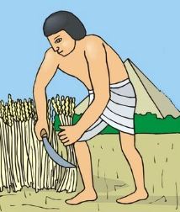
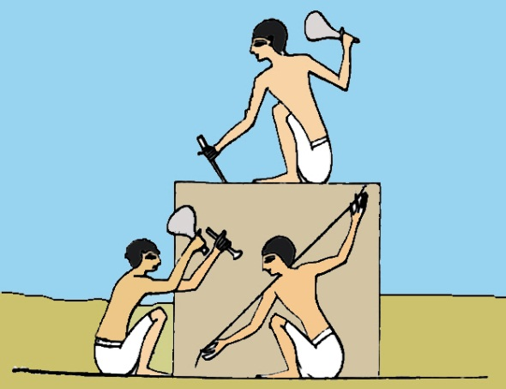
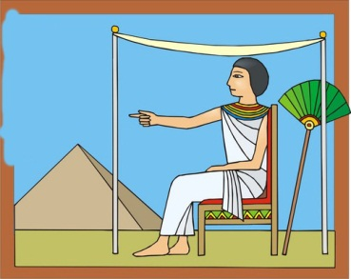
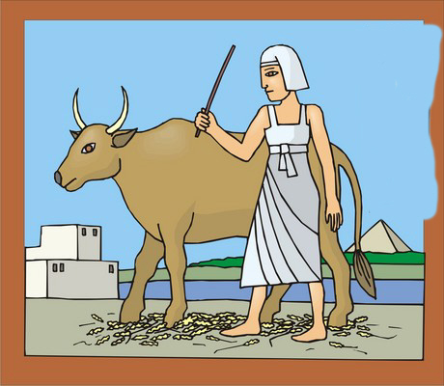
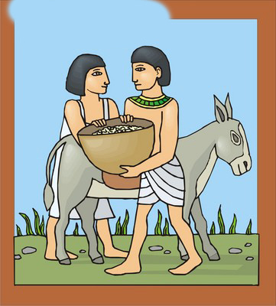

Farming in ancient Egypt
This was the dry season. A shaduf was used to lift water from the river onto the land. When the crops ripened, they were harvested.
The flood waters arrived by the middle of July. The farmers could not work on their land so they worked for the pharaoh building pyramids and temples.
This was the time for preparing the land, ploughing and planting the crops. Animals were used to press the seeds firmly into the ground.
17
SEASON 2
November – February
Planting Crops
SEASON 3
March – June
Harvesting
The Egyptians spent time improving the
irrigation canals beside the river.
SEASON 1
July – October
The Floods
Farming in ancient Egypt
The ancient Egyptians were farmers. Farming provided a lot of the food they needed. They grew wheat for bread and barley for beer. This diagram shows the Egyptian three farming seasons.
A shaduf.
Preparing the land and planting the crops.
Digging water canals.
Cutting the crop with a sickle.
Working for the pharaoh.
The Ancient Egyptians History Interactive©

Slide 5
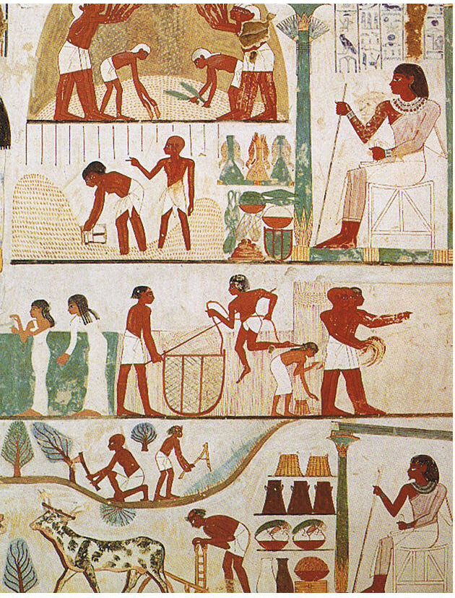
Winnowing
1
18
How do we know about ancient Egyptian Farming?
This is an ancient Egyptian wall painting.
It shows farming jobs like
preparing the land, ploughing, reaping, winnowing and grain storage.
Which job is which and how do you know?
2
Storing the grain
Winnowing
4
Reaping
Preparing the land
Preparing the land
5
Reaping
3
Storing the grain
Ploughing
Ploughing

Slide 6
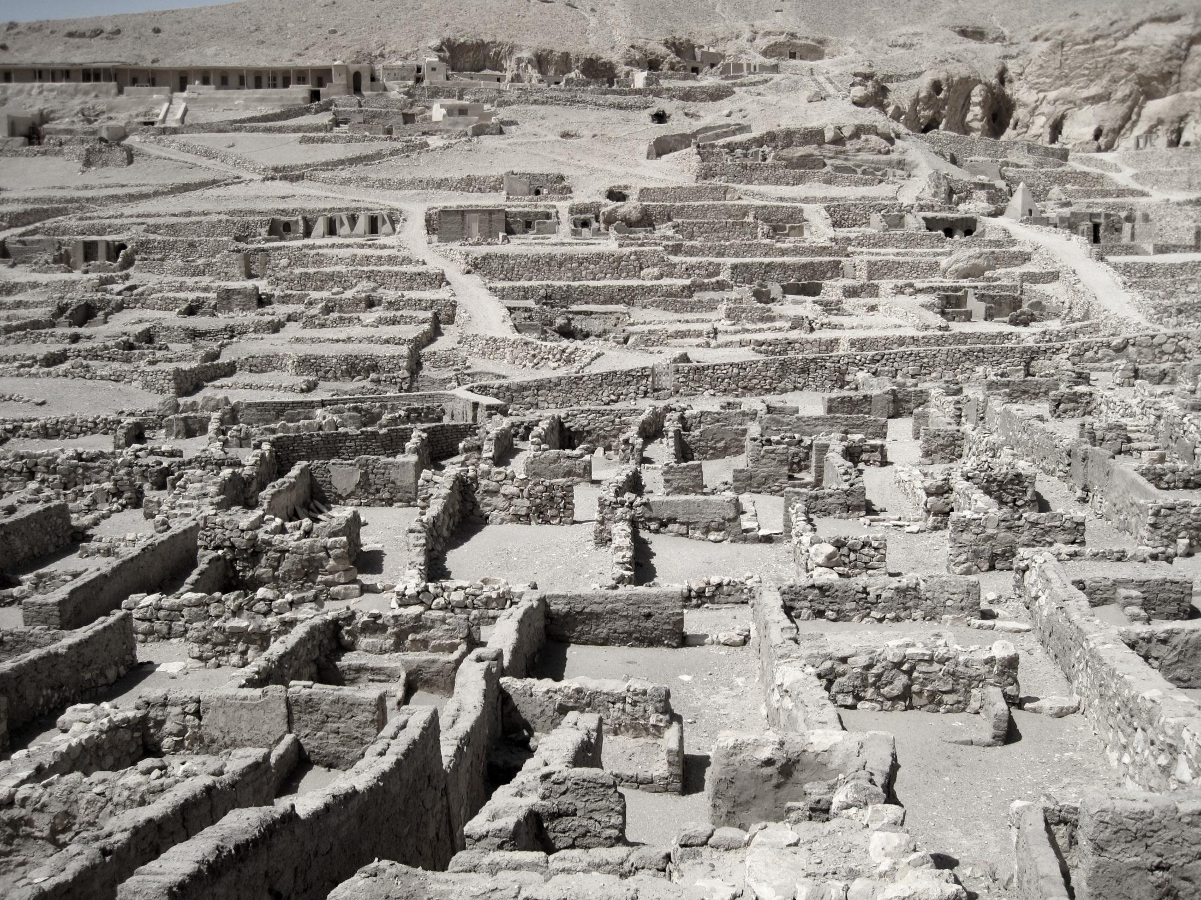
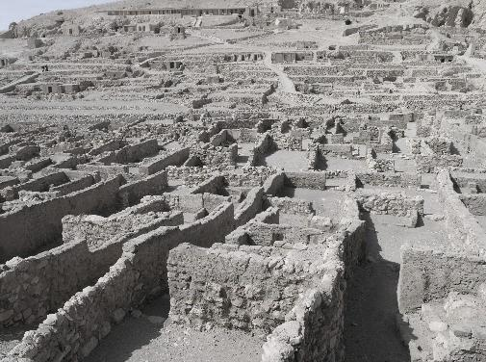
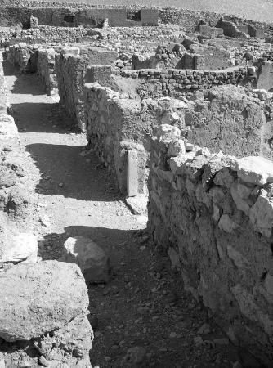

The Egyptian town of Deir el-Medina
Houses
24
Can you see the following?
Mud bricks
Stone floors
Wall
Street
Entrance to a house
One house
Street
How do we know about Egyptian houses?
Archaeologists found the ancient Egyptian town of Deir el-Medina. They discovered that some ordinary Egyptian houses were painted white inside and had wooden doors and shutters.
Each house had four rooms.
Mud Bricks
Wall
Stone Floors
Entrance
One house
Street

Slide 7
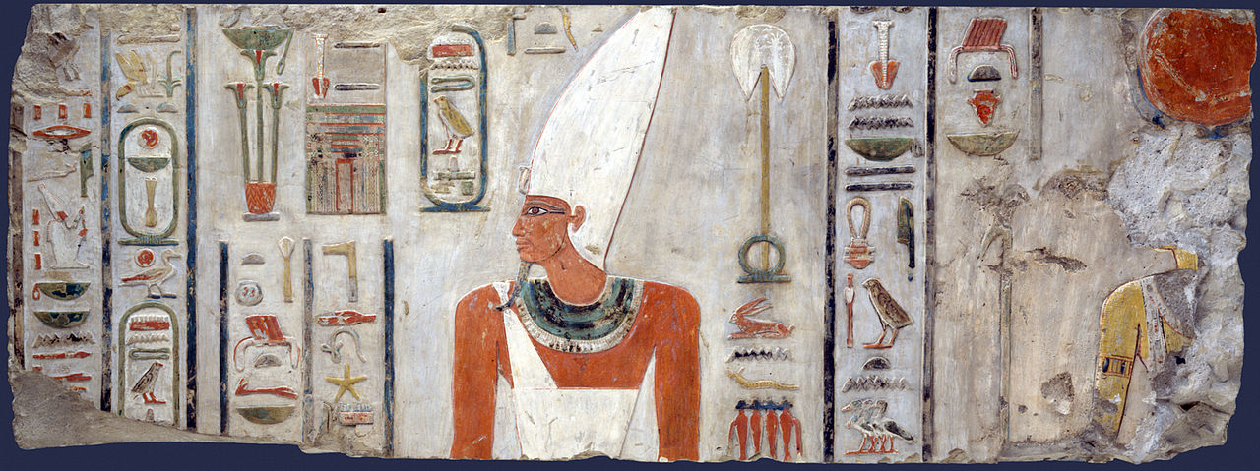
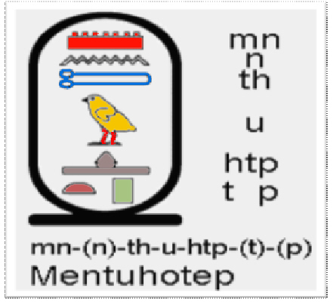
Hieroglyphics
The Egyptians believed that hieroglyphics were magical. They used them mostly in temples and tombs of pharaohs.
30
There are different ways of writing hieroglyphics and this makes it difficult to read. One or two symbols could be used for a letter or sound. Egyptians also did not use vowels in their hieroglyphics.
This picture is from the tomb of Pharaoh Mentuhotep II.
Pharaoh Mentuhotep II.
The Ancient Egyptians History Interactive©

Slide 8
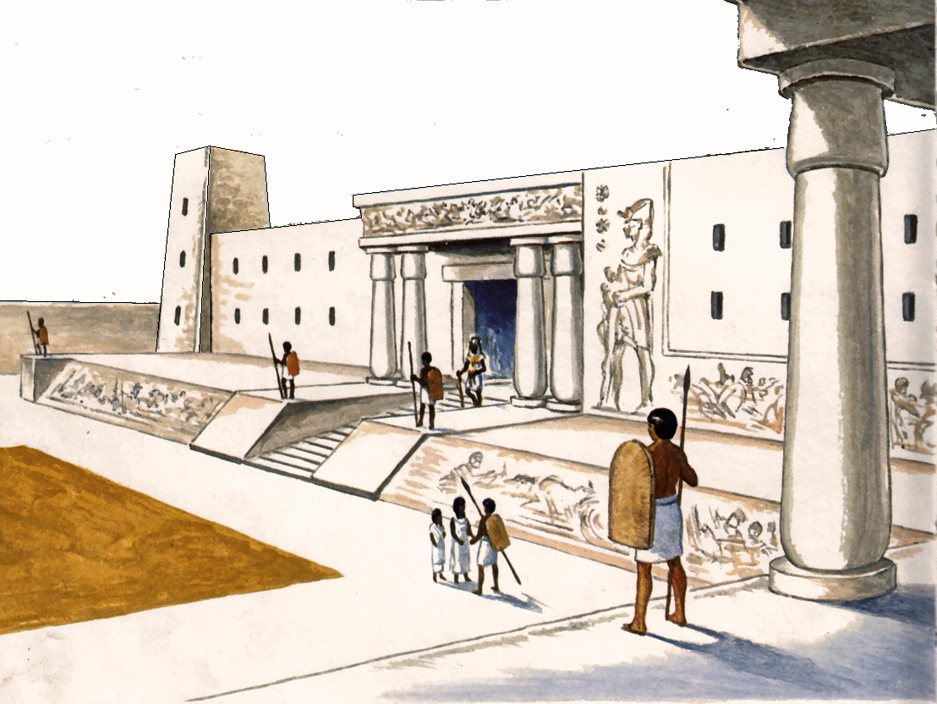
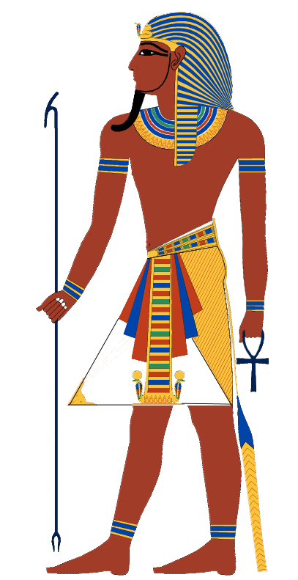
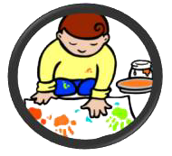
Egyptian Pharaohs
Uraeus
6
5
Nemes
41
The most famous Egyptian pharaoh is Tutankhamen.
2
Pharaohs were the king or queen of Egypt.
The Pharaohs
The pharaoh lived in a beautiful palace surrounded by his family, noble lords and ladies and a large number of officials and servants. The pharaoh could have many different wives but only one could be queen.
1
Beard
Crook
The ancient Egyptians believed that their pharaoh was the god Horus.
Most pharaohs were men but some well-known pharaohs, such as Nefertiti and Cleopatra, were women.
What symbols are carried or worn by an Egyptian pharaoh?
3
Ankh
Pharaohs often had several wives but only one was queen.
The first Pharaoh of all Egypt ruled around 3100 BC.
4
Flail

Slide 9
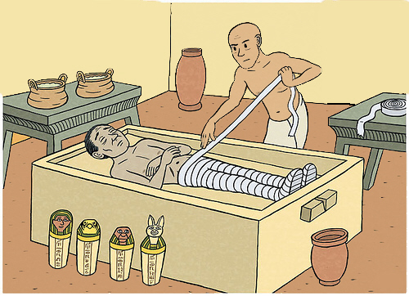
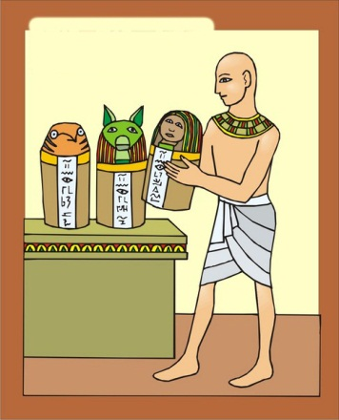
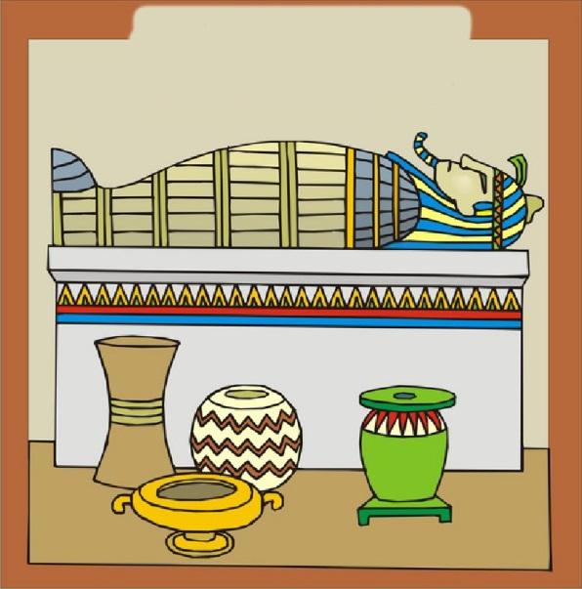
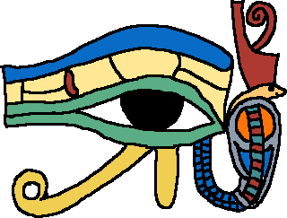
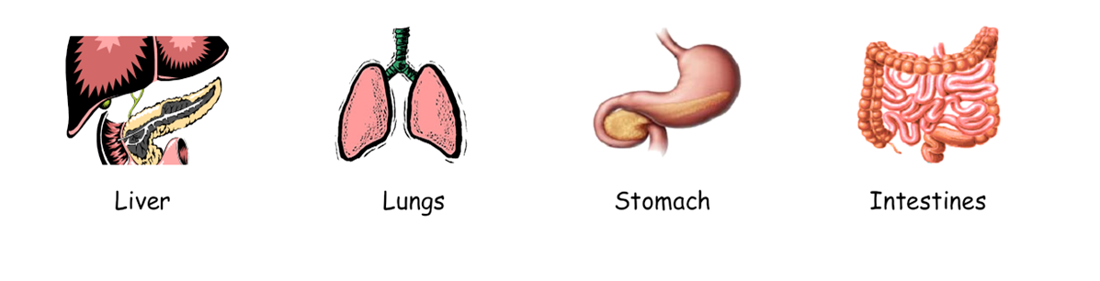
❷ Then the body was covered with salts and left to dry for up to 40 days.
Removing the organs
❺ An amulet was placed with the mummy for good luck.
45
The ancient Egyptians did not remove the heart. This was left inside the body because it was necessary for the judgement in the afterlife.
Mummification involved the drying out of the body. Organs that might stop the body drying were removed and mummified separately. Four important organs; the liver, intestines, lungs, and stomach were placed in their own jars for burial in the tomb. Today, we call these canopic jars.
Making a mummy
So that they could reach the afterlife, the ancient Egyptians believed that the body must be preserved as well as possible. For this reason, the Egyptians developed mummification as a way of preserving the body in the most lifelike manner. It took 70 days to make a mummy.
Special salt called natron
❹ The body was carefully wrapped in linen bandages.
Canopic jars
❸ The body was then stuffed, washed in spiced wine and perfume was added.
❶ First, they took out the person’s insides and put them in canopic jars.
Liver Lungs Stomach Intestines
The Ancient Egyptians History Interactive©

Slide 10
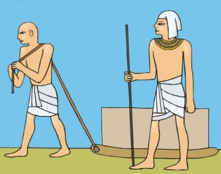
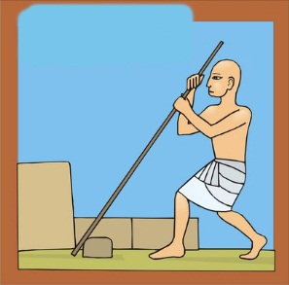
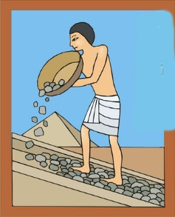
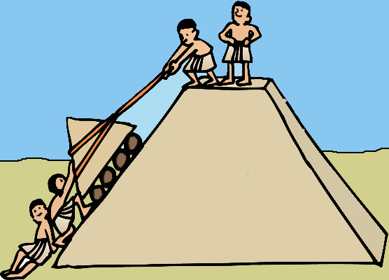
How the Pyramids were made
51
How the Pyramids were made
Pyramids took about 20 years to build so pharaohs started building them early. A plan of the pyramid was put together and shown to the pharaoh. The plan would have to change if the pharaoh didn't like it. If the pharaoh liked the plan, he gave permission for the pyramid to be built.
Granite and limestone blocks were cut into the right size and shape.
Stones transported on wooden sledges dragged across the ground.
The workers started to build the pyramid by making the base first.
Ropes and ramps were used to push the blocks into place.
After many years of hard work, they put the last stone on top.
The pharaoh would visit and watch the pyramid being built.
The Ancient Egyptians History Interactive©

