Slide 1
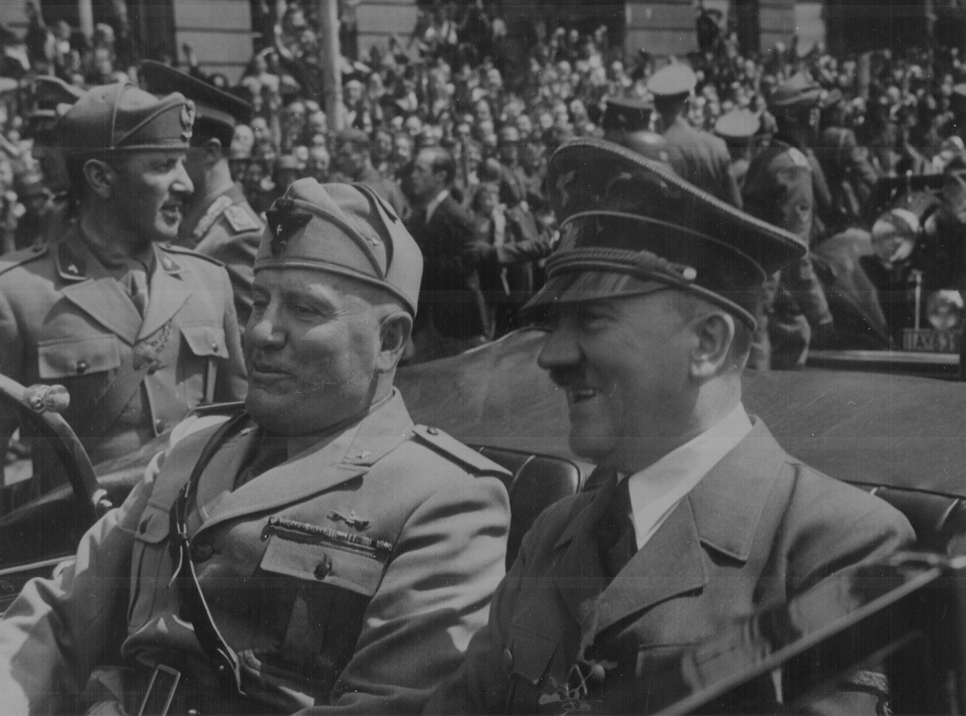

GCSE MODERN WORLD HISTORY
INTERNATIONAL RELATIONS 1918-1945
CAUSES OF THE SECOND WORLD WAR
INTERACTIVE
WHO OR WHAT WAS RESPONSIBLE FOR THE SECOND WORLD WAR?

Slide 2
History Interactive
Teaching and Learning Resources
These are sample slides.
There are no audio, document links or internet links in this sample.
See all of our resources at
www.historyinteractive.co.uk
History Interactive Teaching and Learning © 2013

Slide 3
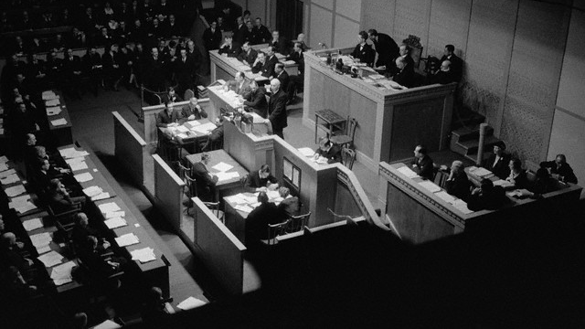




REARMAMENT 1934
11
Why did countries fail to disarm?
Countries like France and Germany did not trust each other.
Some countries reduced unemployment by building up their army.
The Depression made countries feel less secure.
Hitler withdrew from the Disarmament Conference in 1933.
It was important for Hitler to build up his armed forces to achieve his foreign policy aims.
The Steps in German Rearmament
In October 1933 Hitler withdrew from the Disarmament Conference.
In May 1934 German military budget showed substantial increases indicating Germany was rearming.
In March 1935 the existence of the Luftwaffe was announced and general conscription was reintroduced.
ANGLO-GERMAN NAVAL AGREEMENT JUNE 1935
This was an arms limitations agreement between Britain and Germany. There was no attempt to stop German rearmament. This agreement allowed Germany to build a navy up to 35% of the size of the British navy. Britain seemed to accept that it was unfair for Germany to be the only country not allowed to rearm.
There were attempts between 1930 and 1933 to get countries to disarm but these attempts failed. Hitler pulled out of the Geneva Disarmament Conference in 1933.
The 1932 Geneva Disarmament Conference in Session.
GCSE Modern World History Causes of the Second World War

Slide 4
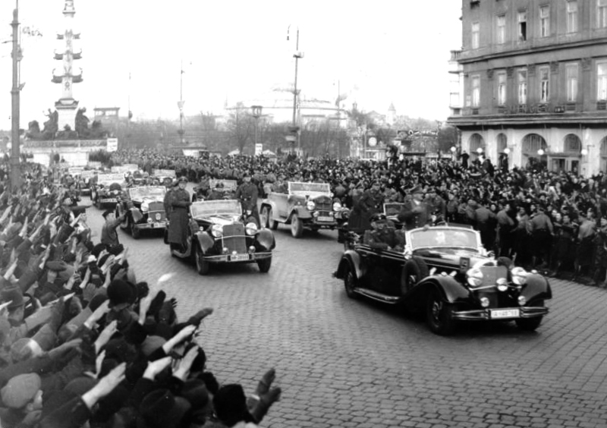
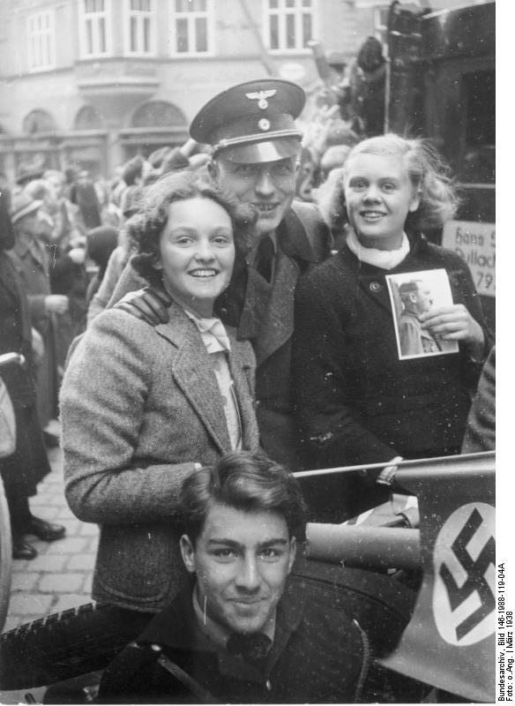
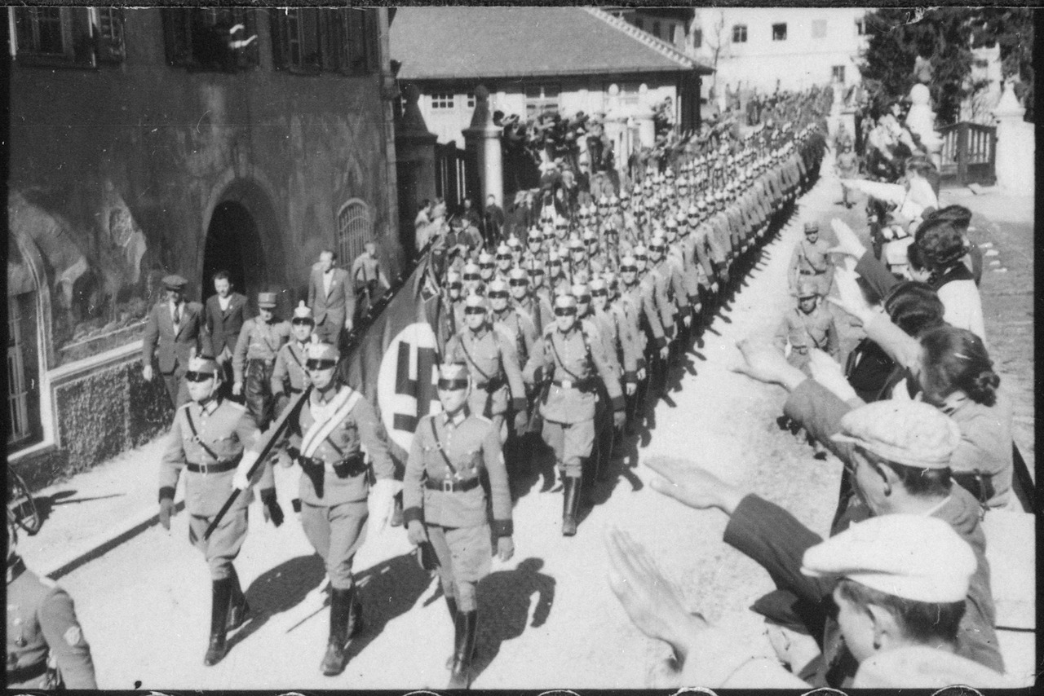
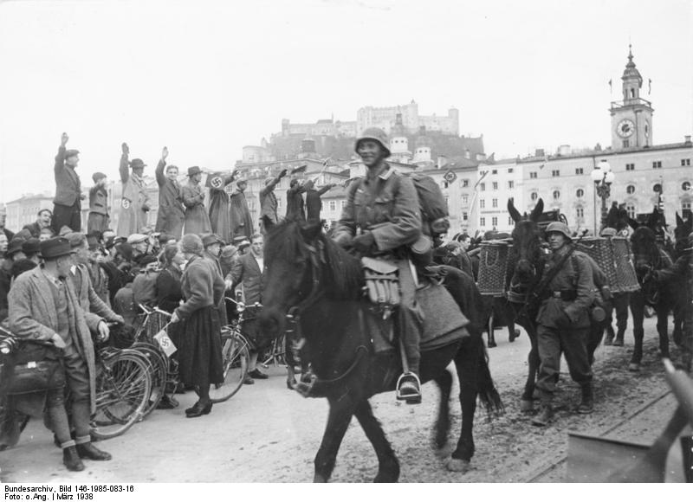
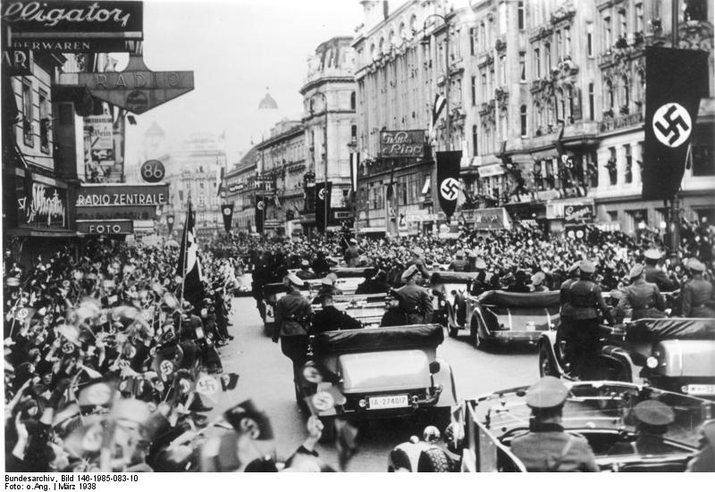
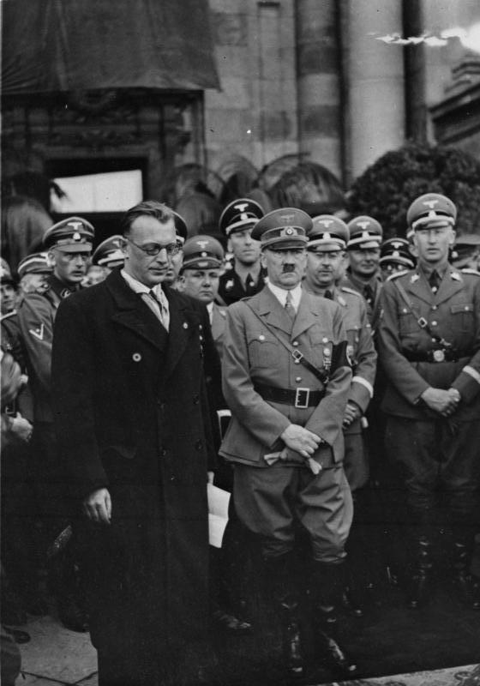
ANSCHLUSS WITH AUSTRIA
More celebrations as Hitler’s motorcade reaches the centre of Vienna in March 1938.
The German army moves into the city of Salzburg in Austria March 1938.
Hitler drives into Vienna in March 1938 greeted by an enthusiastic crowd.
The German army marches through the streets of Vienna in March 1938.
20
Young Austrians celebrate the Anschluss with a soldier from the German army in March 1938.
Did the Austrian
people support
the Anschluss?
The Treaty of Versailles had forbidden a union between Germany and Austria. (Anschluss). Hitler threatened to take over Austria. He bullied Austrian Chancellor Schuschnigg, who came under increasing pressure to make an agreement with Hitler. Schuschnigg was summoned to Germany and forced to put two leading Nazis into his government. When he returned home he decided to hold a plebiscite so that the Austrian people could decide whether Austria should remain independent .
Hitler tried to stop this by moving German soldiers to the Austrian border in March 1938. Hitler ordered the Austrian Nazi party to begin a campaign in Austria for self- determination and Anschluss with Germany. Riots and demonstrations followed. No plebiscite took place. Schuschnigg resigned and Seyss-Inquart, a leading Nazi who Hitler had forced Schuschnigg to put in charge of the Austrian police, invited the German army into Austria to ‘restore order’. The Anschluss was now complete.
Hitler said the Austrians supported the Anschluss. In a vote, 99.75 per cent of Austrians then voted to be united with Germany. Britain and France took no action.
Seyss-Inquart, the Austrian Nazi and Hitler meet in Vienna, the Austrian capital after the Anschluss in March 1938. It was Seyss-Inquart who invited the German army into Austria ‘to restore order’.
Look at the photographs that follow. They were all taken in March 1938 after Austria and Germany were united.
GCSE Modern World History Causes of the Second World War

Slide 5
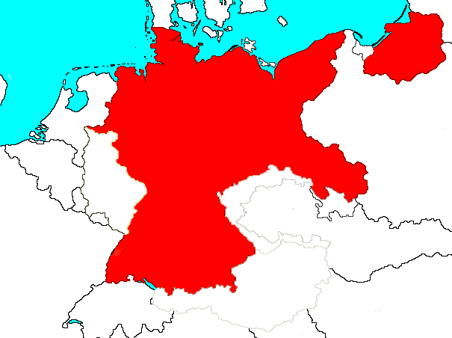





Anschluss with Austria 1938
21
Germany reoccupied the Rhineland in 1936.
Britain and France again did no more than protest and Czechoslovakia could now be attacked from the south as well as from the west and north. All was set for Hitler to demand the Sudetenland.
How successful was Hitler in achieving his foreign policy aims by 1938?
Hitler was very successful in achieving his aim of destroying the Treaty of Versailles. By 1938, Germany had rearmed, occupied the Rhineland and united with Austria. This was partly achieved because of Britain’s policy of appeasement.
Poland
Germany
Rhineland
France
Czechoslovakia
Germany gained the Saar coalfields in 1935.
Germany achieved the Anschluss with
Austria in 1938.
Austria
GCSE Modern World History Causes of the Second World War

Slide 6
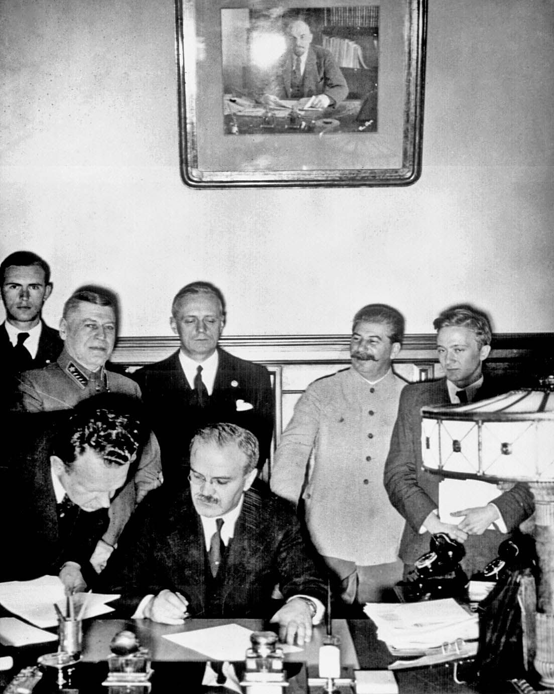
The Nazi-Soviet Pact
THE NAZI SOVIET PACT
33
Ribbentrop
Stalin
Why did Hitler sign it?
The Pact with the USSR meant Germany would not have to fight a war on two fronts.
The agreement over Poland meant that Germany was free to invade the Polish Corridor.
Why did Stalin sign it?
Stalin did not think Britain and France could stand up to Hitler.
Stalin knew that Hitler wanted to invade but the USSR was not ready for war.
As expected, in 1939 Hitler began to demand the port of Danzig and the Polish corridor from Poland. Some British politicians argued that Poland could not be defended without help from Russia. Stalin was concerned that if Hitler invaded Poland it would open the way for a German attack on Russia. British, France and Russia started to negotiate a military alliance but negotiations broke down in July 1939. Stalin instead turned for help to the man he trusted least: Hitler. They signed an agreement not to fight each other if there was a war in Poland. In secret, they also promised to divide Poland between them after it was conquered. This agreement was called the Nazi-Soviet Pact. The world was shocked.
Only a week after the Nazi-Soviet Pact, the German army invaded Poland. Britain and France now honoured their promise to Poland and declared war on Germany and its ally, Italy. The Second War began on 1 September 1939.
The Nazi-Soviet Pact
Soviet Foreign Minister Molotov signs the Nazi-Soviet non-aggression pact with German Foreign Minister Ribbentrop. It was a 10 Year Non-Aggression Pact. Josef Stalin looks on in the background, 23 August 1939.
Molotov
GCSE Modern World History Causes of the Second World War

