Slide 1
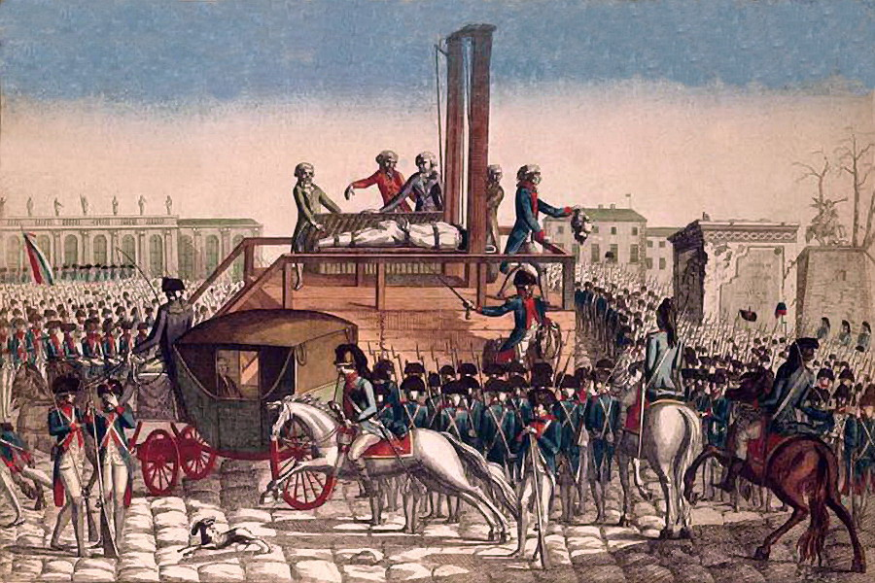

NATIONAL CURRICULUM HISTORY
THE FRENCH REVOLUTION AND NAPOLEON
INTERACTIVE
What caused the French Revolution and what had the Revolution achieved?

Slide 2
History Interactive
Teaching and Learning Resources
These are sample slides.
There are no audio, document links or internet links in this sample.
See all of our resources at
www.historyinteractive.co.uk
History Interactive Teaching and Learning © 2013

Slide 3
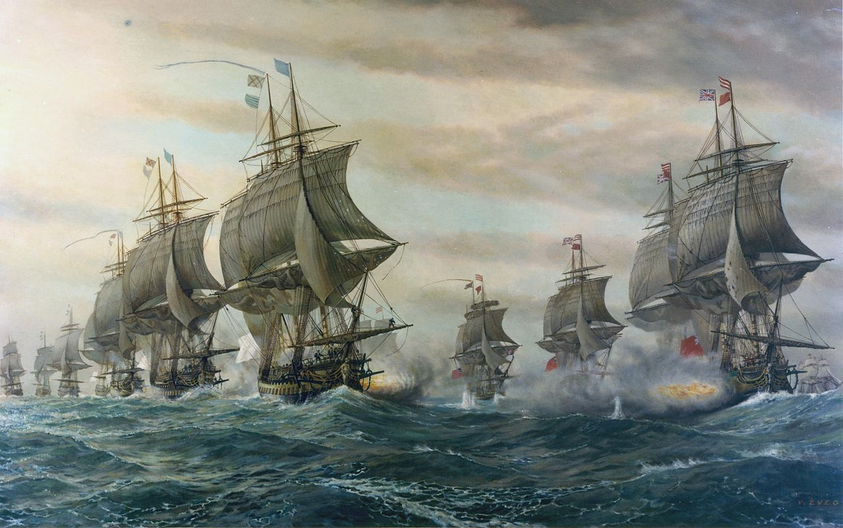
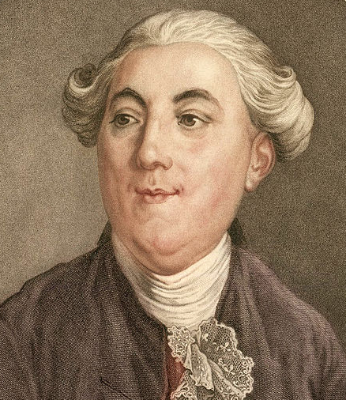


Reasons for the French Revolution
Cause 3: War and Money
France had many money problems
It was 4000 million livres in debts. Banks refused to lend Louis any more money.
Corrupt tax collectors did not hand over all the money to the government.
Louis and Marie-Antoinette continued to spend lavishly on palace luxuries.
France at war
Louis XVI’s biggest problem was money. He had left France deeply in debt. One of the main reasons for this was that France had spent a lot of money fighting wars but had nothing to show for it. France had supported America in their War of Independence against the British.
Jacques Necker was Louis’s finance minister. He was too slow to sort out Louis’s money problems.
British and French ships at the Battle of Virginia Capes during the American War of Independence.
Key Stage 3 History The French Revolution
11

Slide 4
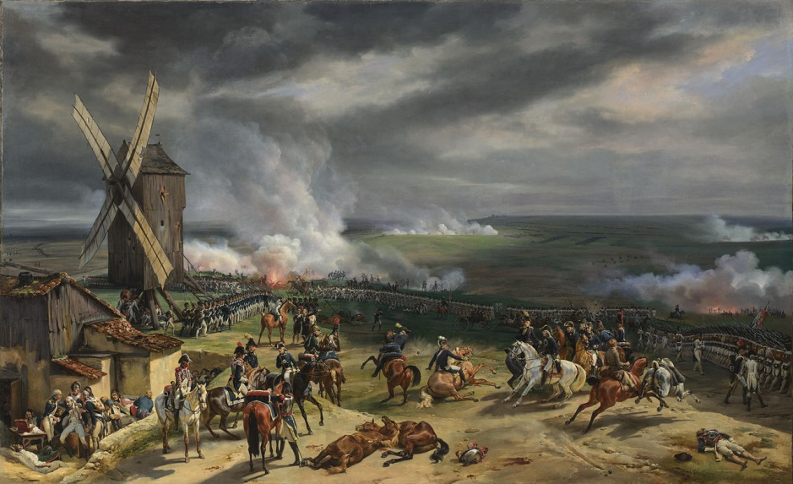
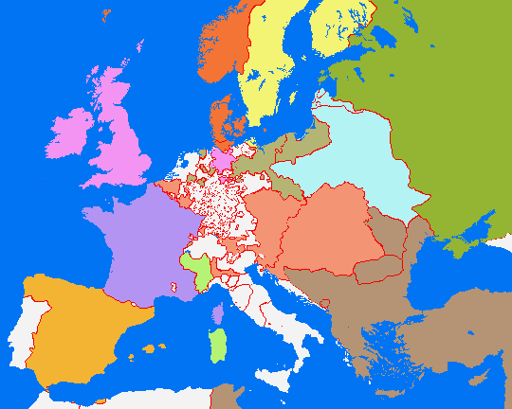

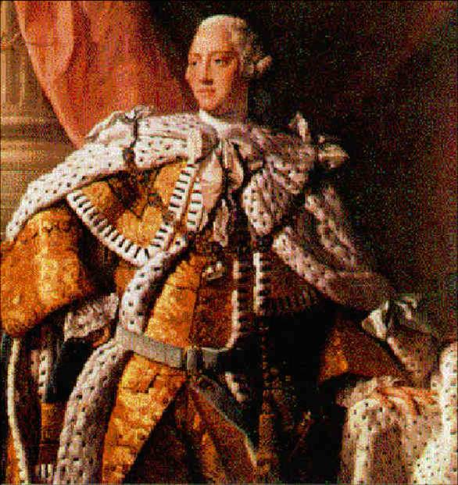
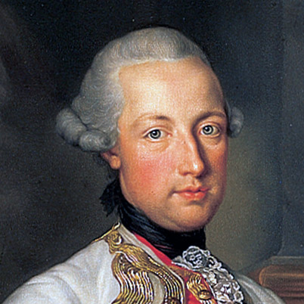
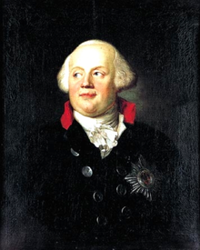
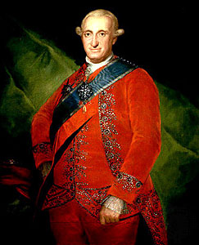
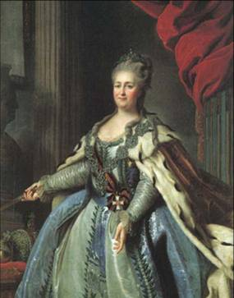
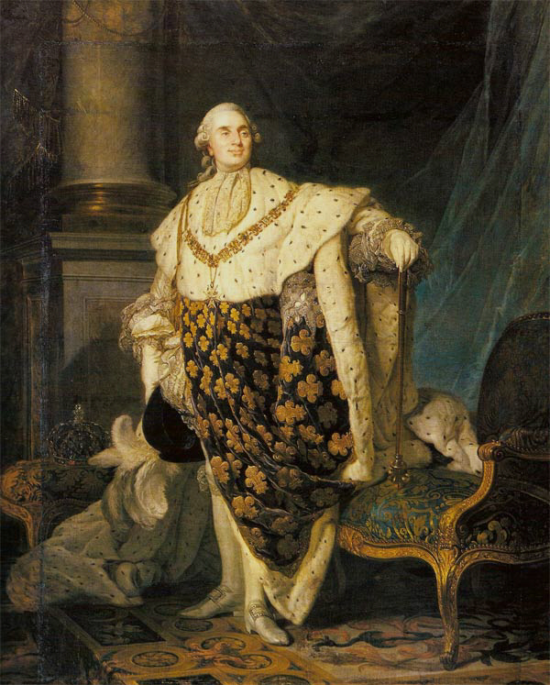
The Battle of Valmy 1792
French army won a stunning victory against the Austrians and Prussians at the Battle of Valmy.
Europe in 1789
The Prussians threatened to destroy Paris if the
revolutionaries harmed any member of the royal family.
King George III
Constitutional Monarch
King Joseph II
Absolute Monarch
King Joseph II
Absolute Monarch
King F. William II
Absolute Monarch
King Charles IV
Absolute Monarch
Catherine the Great
Absolute Monarch
King Louis XVI
Absolute Monarch
Prussia
Russia
Ruler: Frederick-William II
Allied with Austria.
Britain
How serious was the threat to France?
Fear from foreign powers led the National Assembly to take more drastic measures to protect France. They demanded the return of the émigrés, took away their land in France and stripped King Louis’s brother of the right to inherit the throne. Another problem for France was that at the start of the Revolution, many army officers had left France.
180 million people lived in Europe in 1789. Almost all countries were ruled by absolute monarchs like Louis XVI of France. Absolute monarchs had almost total control of their country and did not have to listen to a parliament. Britain had a constitutional monarch and their king had limited powers.
Prussia
Poland
Britain
Holy Roman Empire
Paris
France
Ruler: Joseph II, brother of Marie-Antoinette.
Allied with Prussia.
Austria-Hungary
France
Austria
Austria
27 million people.
Made up of many different nationalities.
Britain
15.5 million people.
Vast colonies and leading
world trading country.
Prussia
9 million people.
Rival with Austria. One of strongest armies in Europe.
Holy Roman Empire
12 million people.
Many different states. Controlled by Austria.
Spain
10 million people.
Fallen into decline.Was now a minor power.
Russia
40 million people.
Largest country in Europe but many internal problems.
France
28 million people.
No longer the most powerful country in Europe.
At the start of the Revolution, France was ruled by the National Assembly. They suspected that Louis was trying to get help from Austria.
Many nobles had fled France and escaped to Austria. [Émigrés]. They hoped to undo the Revolution and restore the Ancien Regime.
Spain
Key Stage 3 History The French Revolution
21
Notes:
[Note to trainer: To do the practice sessions, people need a video card, sound card, and speakers on their computers.
For detailed help in customizing this template, see the last slide. Also, look for additional lesson text in the notes pane of some slides.]

Slide 5
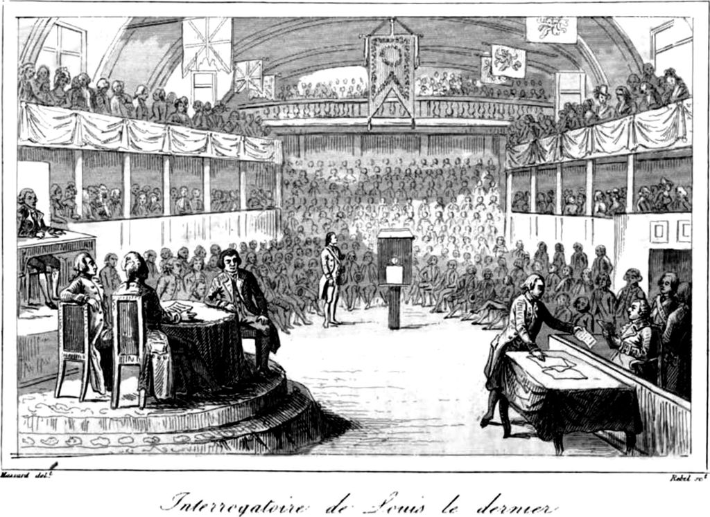
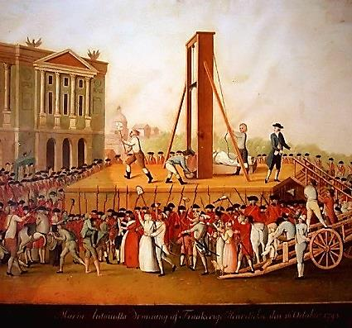
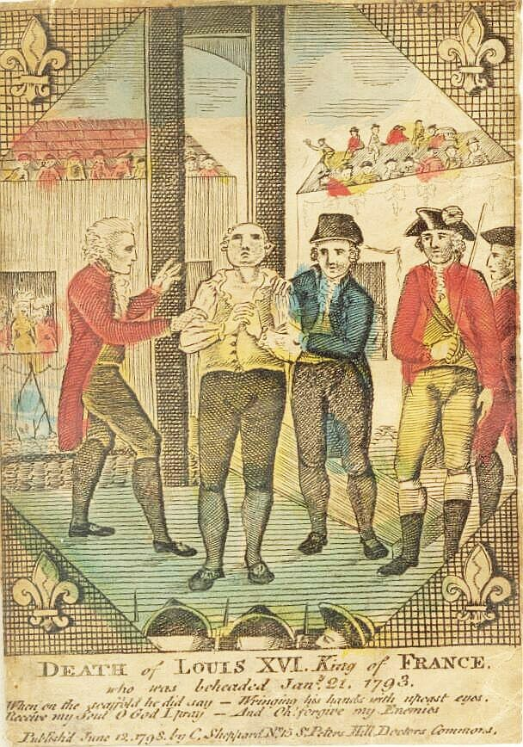

The execution of Marie-Antoinette soon followed in October 1793.
Victims of The Terror
The King and Queen
The Death of Louis XVI King of France from an English engraving, published 1798. Louis was executed in January 1793.
Why were Louis and Marie-Antoinette executed?
They had tried to escape.
They could not be trusted.
Marie Antoinette was very unpopular.
Austria could try to rescue them.
The Revolution had turned to terror.
Louis XVI put on trial
When the Convention took power in France in 1792, they abolished the French monarchy and declared France a republic. It was only a matter of time before a decision had to be made about King Louis. On 3 December 1792, Louis was made to stand trial in front of the Convention. After a vote, 380 to 310 voted for his execution. Louis was sentenced to death.
The interrogation of Louis XVI by the National Convention.
Key Stage 3 History The French Revolution
25

Slide 6
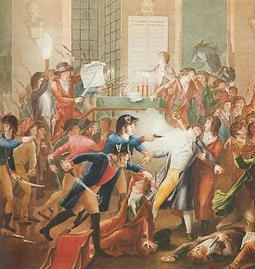
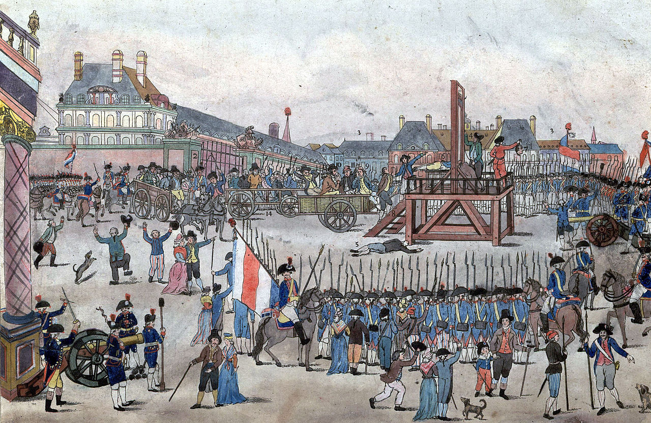
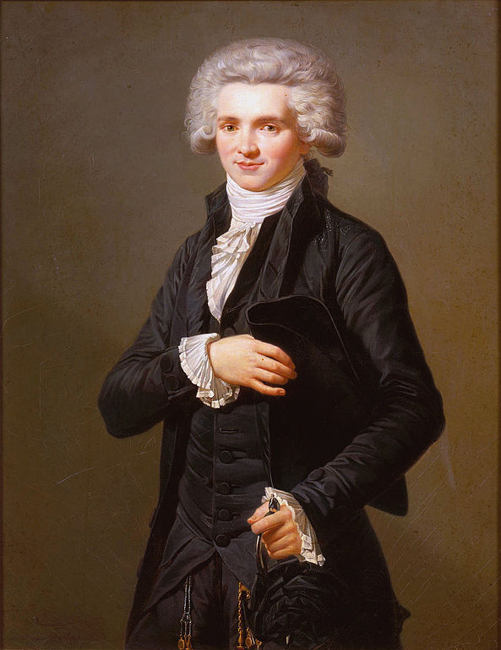
The Arrest of Robespierre
As he resisted arrest, he was shot. His younger brother jumped out of the window, trying to escape.
Victims of The Terror
Maximilien Robespierre
The execution of Robespierre and his supporters on 28 July 1794.
❶ The beheaded man is not Robespierre, but Couthon.
Robespierre is shown sitting on the cart, dressed in brown, wearing a hat, and holding a handkerchief to his mouth.
❸ His younger brother Augustin is being led up the steps to the scaffold.
Robespierre led the bloody Reign of Terror. Many people admired him for strictly following his ideals of liberty and equality to make France a republic. Many thought he was a monster. By 1794, with the power to get rid of anyone who opposed him, Robespierre was almost in control of the Revolution. But things had gone too far for many. When Robespierre started to turn on his own people, his friends plotted against him. The Convention voted for his arrest and execution.
1
2
3
Maximilien
Robespierre
Key Stage 3 History The French Revolution
28

Slide 7
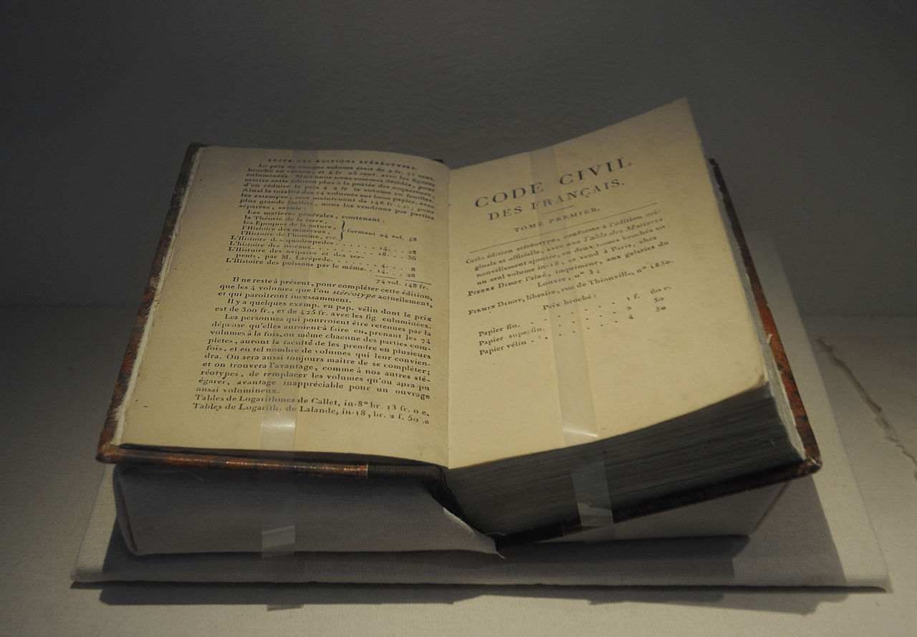
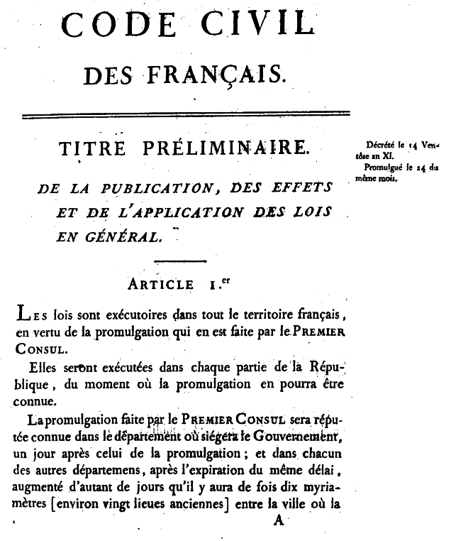
What did Napoleon do for France?
3: The Napoleonic Code
What was positive?
The Code said that everyone should be treated equally.
There were no longer special privileges for rich people.
What was negative?
A secret police force would spy on people and arrest them.
Napoleon tried to control newspapers and freedom of speech.
Before the Revolution France did not have a single set of laws. In 1804, the Napoleonic Code introduced a set of clear laws. The Code was also introduced into other parts of Europe conquered by Napoleon, like Italy, Spain and some parts of Germany. The Napoleonic Codes kept most of the gains of the Revolution but the rights of some people were restricted.
The first page of the Napoleonic Code. The Code is still used as the basis of French law today.
A copy of the Napoleonic Code. They were a set of laws for governing France and Napoleon’s Empire.
Key Stage 3 History The French Revolution
36

Slide 8

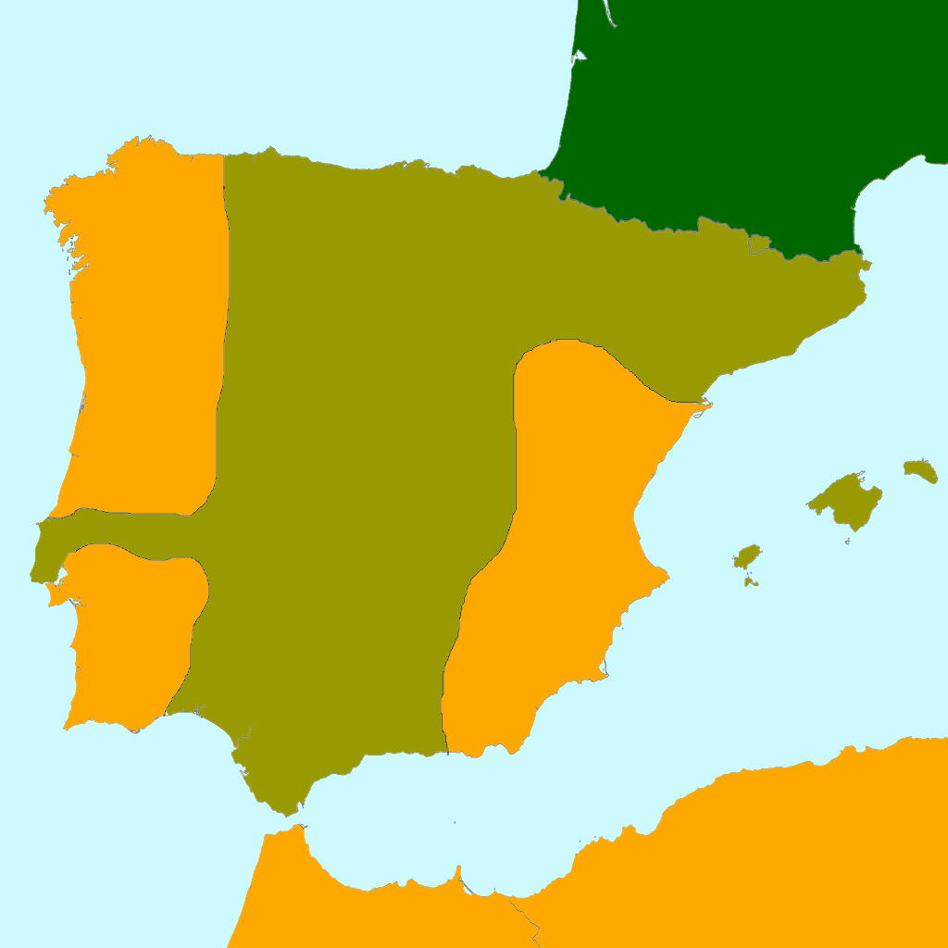
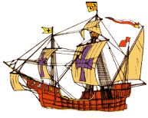
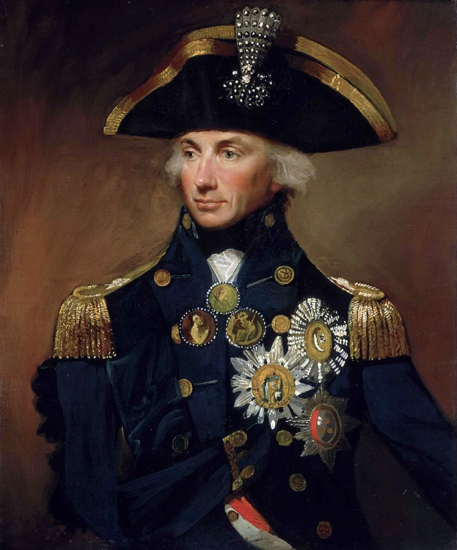
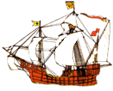
The Battle of Trafalgar 1805
Admiral Lord Nelson
France
Nelson was born in Burnham Thorpe, the sixth of 11 children, in 1758.
❶ Nelson sets sail from England in HMS Victory and arrived off Cadiz.
Atlantic Ocean
Spain
As a Captain at 20, he was known for his bravery and bold tactics in war.
❷ Nelson tries to draw the combined Spanish and French fleets out.
English
Fleet
He lost the sight in his right eye and right arm in previous naval battles.
Cadiz
❹ The British fleet followed. Both sides prepared for battle.
❸ Napoleon ordered fleet to sail into the Mediterranean Sea.
Mediterranean Sea
Spanish-French
Fleet
Nelson’s task was to defeat the French navy to stop Napoleon invading Britain.
Mediterranean Sea
The French Empire
Controlled by
France
Admiral Nelson
Trafalgar
Africa
Key Stage 3 History The French Revolution
41

Slide 9
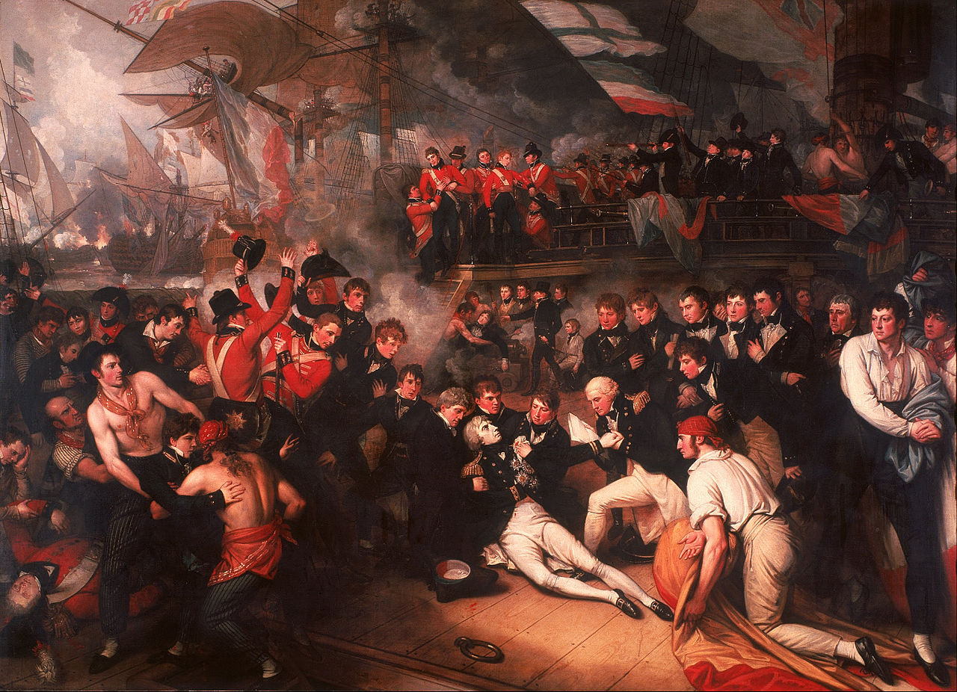
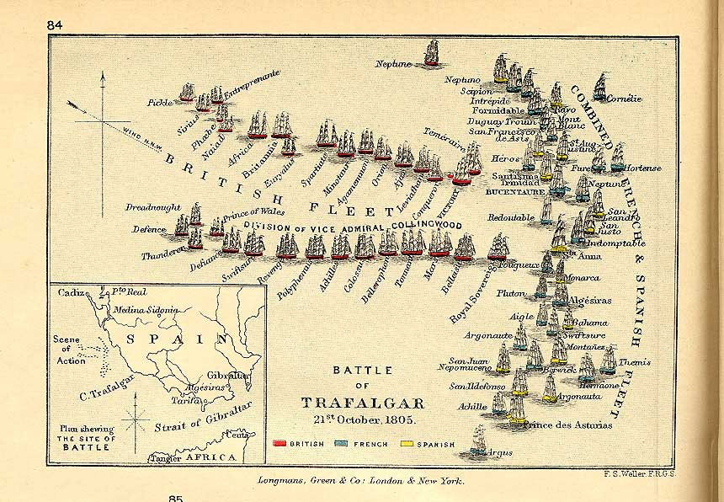



Admiral Nelson’s tactics
Traditional Broadside Tactics
Nelson’s Raking Tactics
THE BATTLE OF TRAFALGAR
The Battle of Trafalgar was Nelson’s most famous victory. Before the battle started, Nelson sent a famous signal to the other ships. He said, “England expects that every man shall do his duty”. England won the battle, but Admiral Nelson was killed. He was shot by a Spanish sniper.
THE DEATH OF NELSON
As he was dying, he said, “Not overboard, Captain Hardy”. This meant he did not want his body to be thrown into the sea, which is what usually happened. His body was taken back to England where he was buried with full naval honours. The nation was sad that they had lost such a great leader.
Normally in a naval battle, the two fleets would sail into battle in two parallel lines. Each ship would take on one of the opposing ships. Broadsides would be fired. The side that won sunk the most ships.
Nelson broke from tradition. He divided his fleet into three groups. Each group attacked sections of the enemy fleet at right angles. They could then break through the enemy lines and cut off a retreat route.
Key Stage 3 History The French Revolution
42

