Slide 1
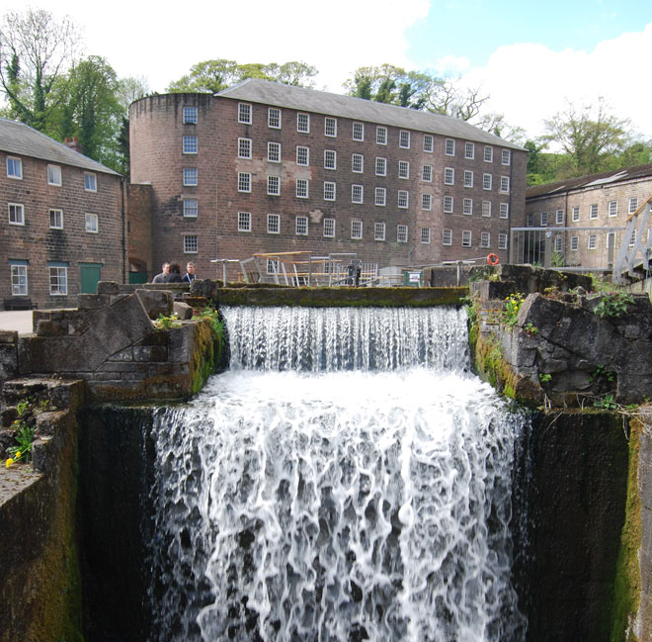

KEY STAGE 3 National Curriculum History
BRITAIN
1750-1900
INTERACTIVE
How and why did Britain change between 1750 and 1900?

Slide 2
History Interactive
Teaching and Learning Resources
These are sample slides.
There are no audio, document links or internet links in this sample.
See all of our resources at
www.historyinteractive.co.uk
History Interactive Teaching and Learning © 2013

Slide 3
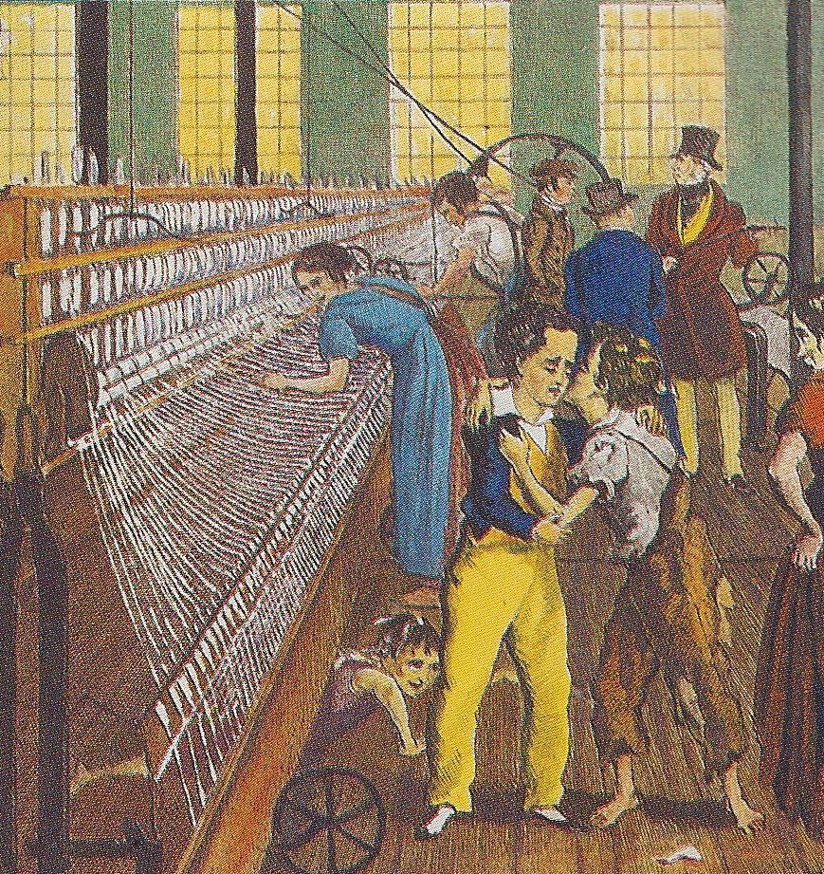
Factory Conditions
Child Labour
Factory Conditions
Many of the early textile factories employed large numbers of children. This was not surprising as children had always worked in the Domestic System. Some of the factory children were apprentices. These children were often orphans, who were sent to the factories from the large towns. Factory owners built houses for them near the factory. Other children came form the local area.
Windows were small so there was little ventilation. Factories were very hot in the Summer.
Children were sometimes hit with a strap to make them work faster.
Scavengers had to pick up the loose cotton from under the machinery. This was extremely dangerous as the children were expected to carry out the task while the machine was still working.
The overseer’s job was to make sure workers worked at full pace all the time.
The constant noise from the machines damaged hearing.
Machinery was not always fenced off and workers would be exposed to the moving parts while they worked.
Two tired children. They worked very long hours.
Key Stage 3 History Britain 1750-1900 Interactive
13

Slide 4
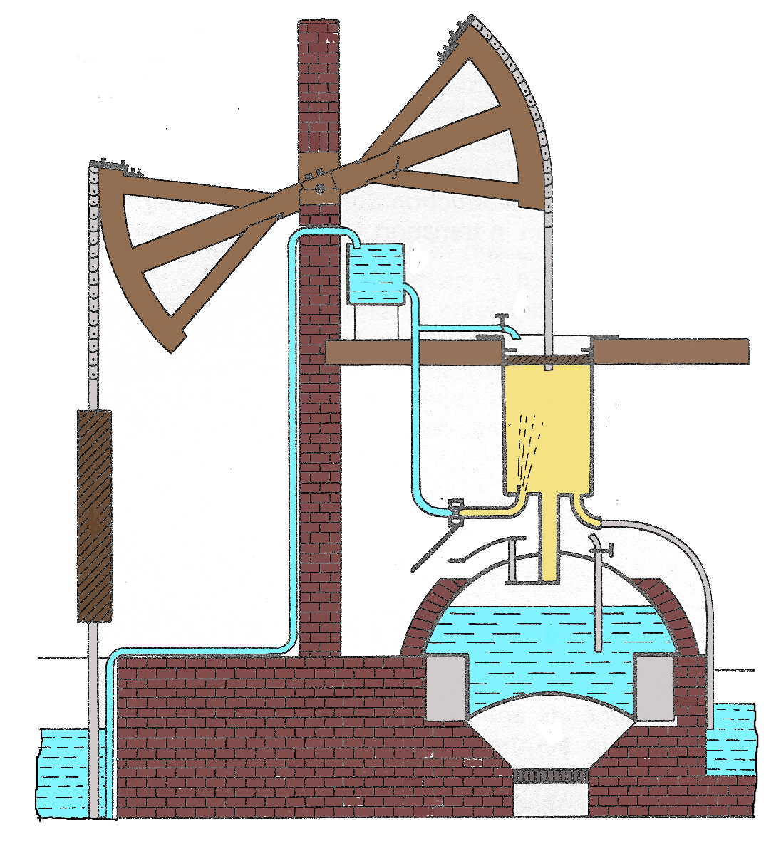
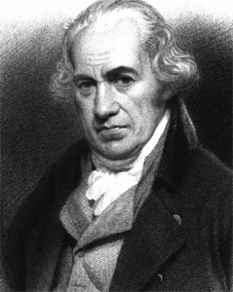

Newcomen’s Steam Pump
Balance Beam
⬥ Tap B is opened to allow cold water from the tank to condense the steam.
Cold Water Tank to condense the steam
 The vacuum created forces the pistol downwards.
JAMES WATT
The Rotary Steam Engine
James Watt did not invent the steam engine, but he made several important innovations that improved the efficiency of engines and made them useful in a wide range of industries.
He also designed a system of gears for effecting the up-and-down motion of the steam-driven piston into rotary motion. He produced a steam pressure gauge to record pressure in a cylinder and a rotary engine which could drive various forms of machinery.
STEAM POWER
Steam power was one of the most important developments of the Industrial Revolution. The first steam pumps were used to pump water out of mines.
B
Piston
Pump to fill water tank
◆ Tap A is opened to allow steam from the boiler into the cylinder.
❖ The steam forces the piston upwards.
Cylinder
Mine Pump
A
Boiler
Furness
Key Stage 3 History Britain 1750-1900 Interactive
24

Slide 5
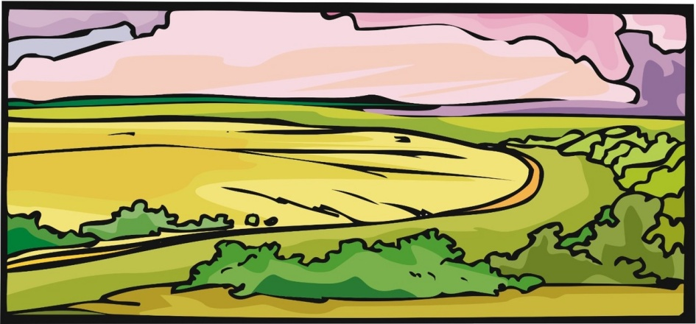
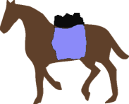





A Bell Pit Mine
A Bell Pit was where a shallow shaft was sunk and then dug around until it resembled a bell in shape.
An Adit Mine
Coal Mining
There had been coalmines in Britain since Roman times but production was small and mainly for domestic use. Miners used two main methods of mining the coal: Bell Pits and Adit Mines. By 1800, the demand for coal increased. Mine owners had to find better ways of extracting more coal.
Packhorses to carry coal away
The Adit Mine was used where the coal seam was near the surface of the ground.
Coal seam
Coal seam
Key Stage 3 History Britain 1750-1900 Interactive
26

Slide 6
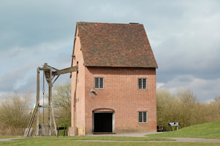
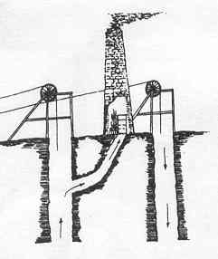
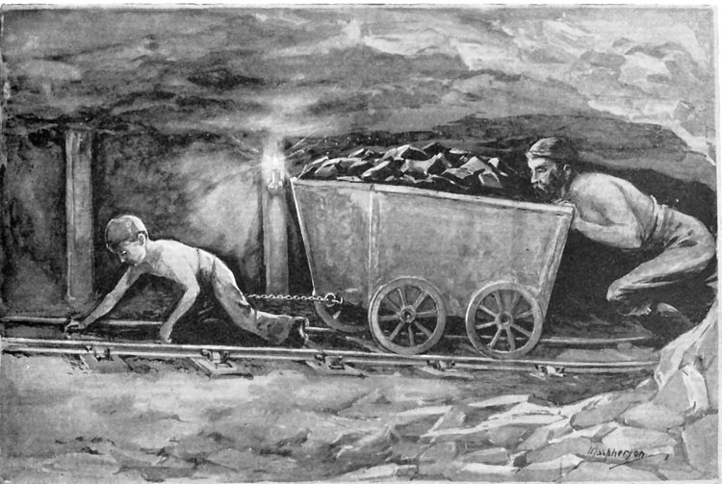
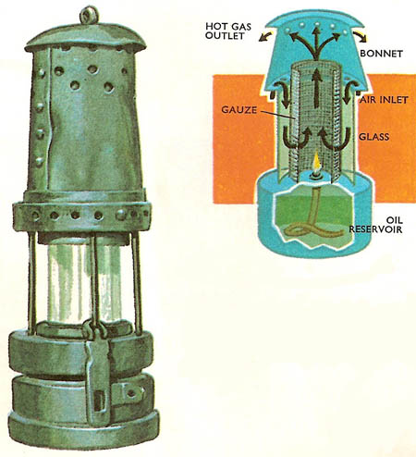
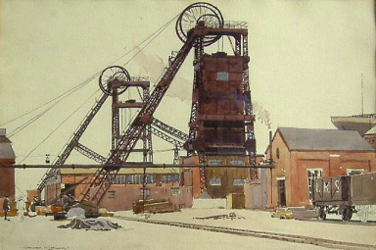
Flooding
When digging a pit water soon collects. This can be very dangerous. If a pit floods the miners face drowning.
Ventilation
Without a good supply of fresh air miners could not work properly and poisonous and explosive gases built up.
Solution
This problem of ventilation was improved by the use of a two-shaft system. This meant that fresh air could be sucked in down one shaft and the bad air expelled out the other.
Solution
The problem of flooding was solved by the use of the Newcomen and Watt steam pumps.
Coal Mining
Problems and Solutions
How working in mines improved
Explosive Gases
Methane gases was one of the greatest dangers. It is lighter than air and hard to detect. Miners often used candles and this led to explosions.
Difficulty of Transport
Coal is heavy and bulky. Hauling coal to the surface and moving it from place to place was difficult especially as mines were dug deeper.
Solution
This danger was reduced by Sir Humphrey Davy’s invention of the safety lamp in 1815. The flame was protected by wire gauze and prevented it from exploding the gases outside.
Solution
This was improved by the invention of the wire rope and the use of steam power to raise the coal. Transporting coal was solved by building canals and then railways.
15
Key Stage 3 History Britain 1750-1900 Interactive
27

Slide 7
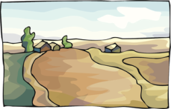
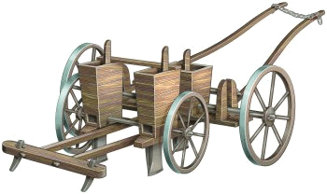
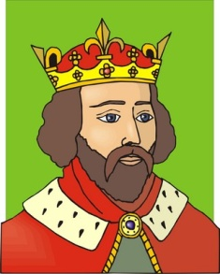
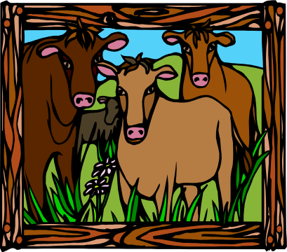
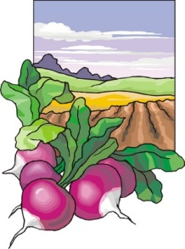



Explain how ideas about farming changed in the 18th century?
KEY SKILLS 2
Essay Writing
Explain how ideas about farming changed in the 18th century?
There were some very important changes in agriculture that helped to revolutionise farming and the countryside. Study the animation. Use the essay plan and mark scheme to help you answer the question.
Enclosure
Got rid of strip farming which was replaced by medium sized farms.
The Seed Drill
Invented by Jethro Tull. Seeds not wasted and planted in straight lines.
‘Farmer George’
King George III encouraged the new farming ideas. He had his own ‘model’ farm.
Selective Breeding
Robert Bakewell only bred the best cattle which were now bigger and better.
Viscount Townsend
Developed the 4 Course Rotation. He grew turnips which provided winter feed.
Improving the soil
Robert Colling, a Durham farmer used marl in sandy soil to grow more crops.
Key Stage 3 History Britain 1750-1900 Interactive
38

Slide 8

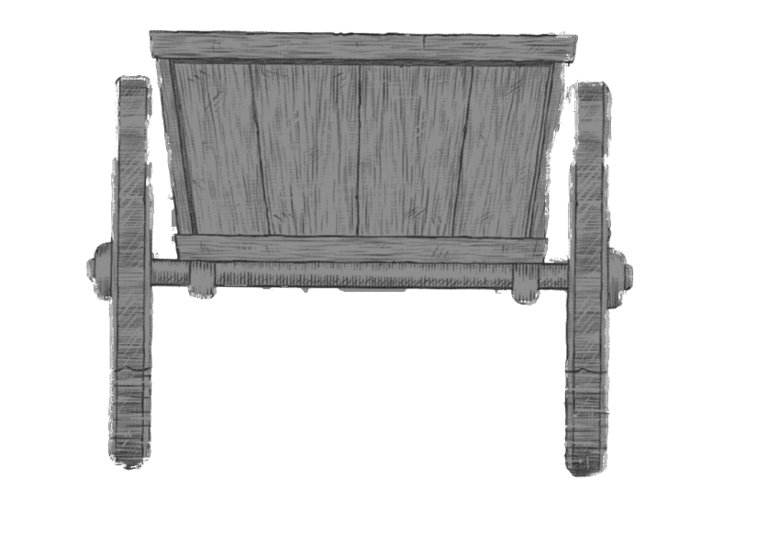

ROAD TRANSPORT IN 1750
No proper road surface or drainage.
How did roads improve?
A group of rich businessmen received permission from parliament to build or repair stretches of roads along which they would be allowed to charge a toll or fee for using the road. These Turnpike Trusts as they were called employed skilled engineers to build and plan better roads.
Nobody looked after or repaired the roads.
Roads were narrow, winding with sharp bends.
Heavy wagons would leave roads rutted or get stuck.
Many roads were unsuitable for wheeled traffic.
Famous Road Builders Two of the most famous road builders were Thomas Telford and John Macadam. These engineers built roads that had easy gradients, drainage and solid foundations.
Rough, rutted and bumpy road surface.
Key Stage 3 History Britain 1750-1900 Interactive
41

Slide 9
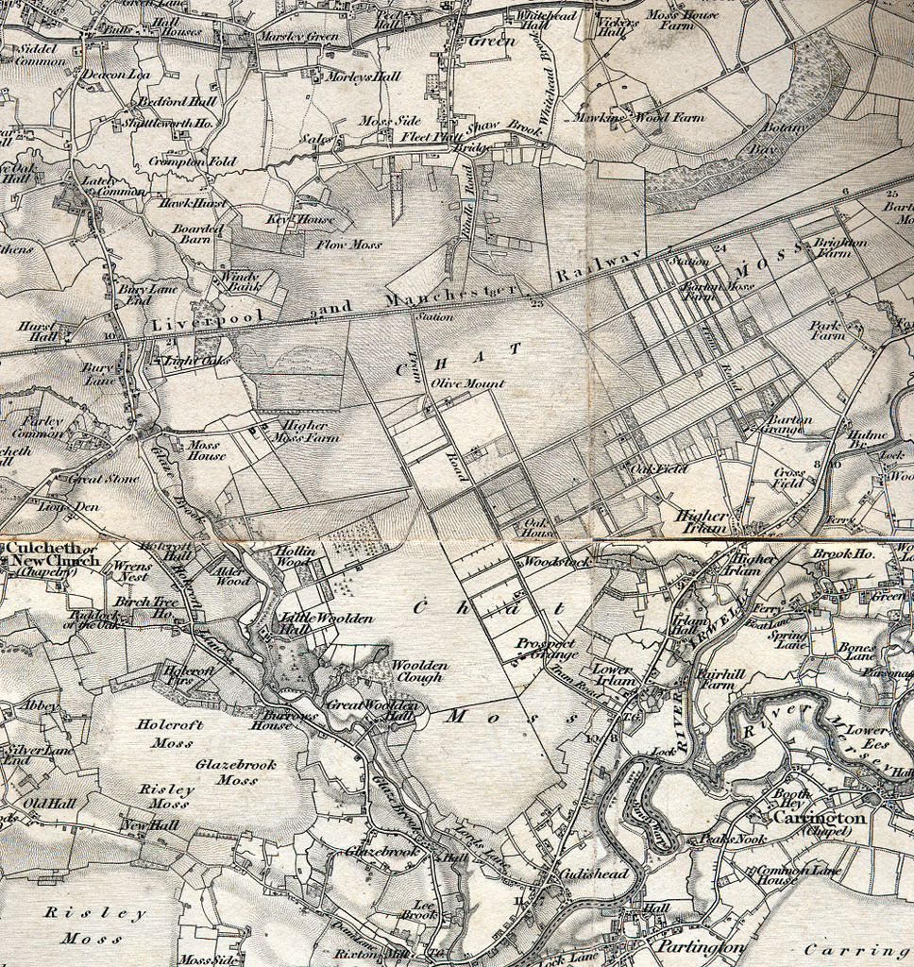
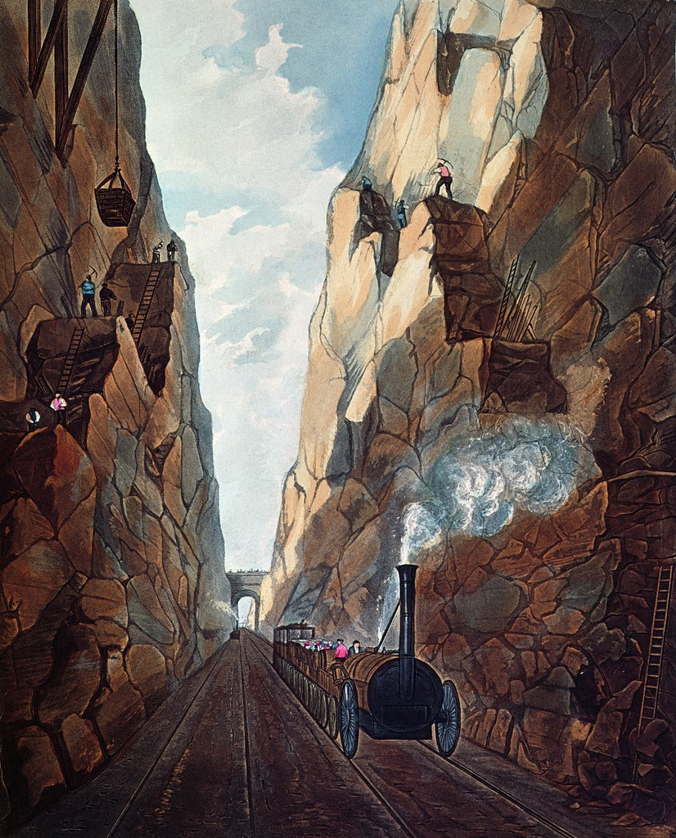
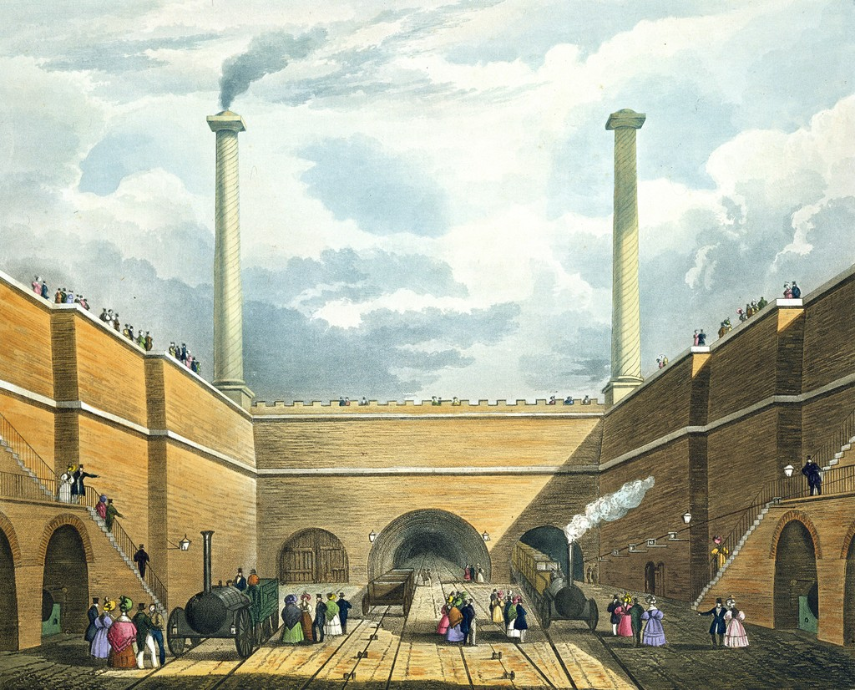
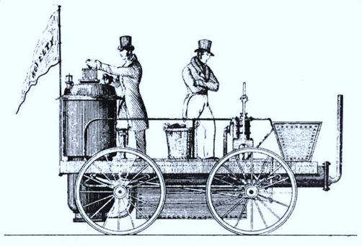
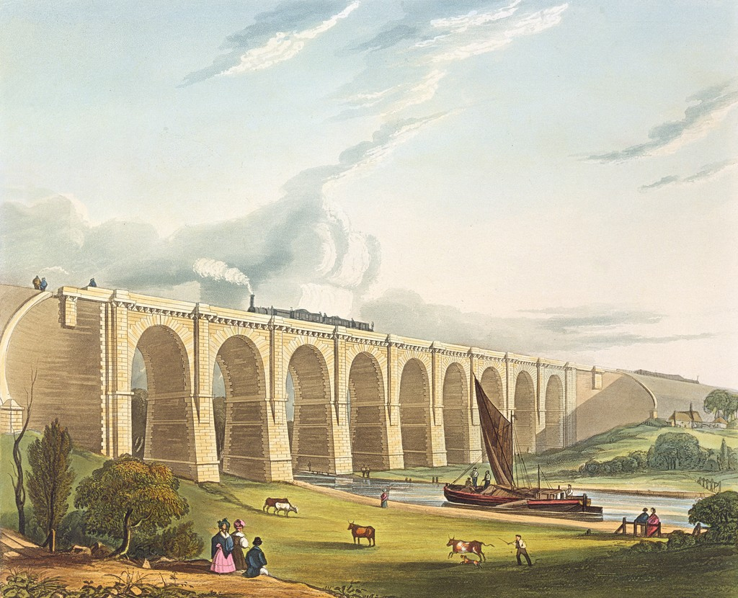

LIVERPOOL TO MANCHESTER RAILWAY
Excavation of Olive Mount, 4 Miles from Liverpool. The cutting was 20 ft (6.1 m) wide and 70 ft (21.3 m) deep.
PROBLEM 2 The Sankey Viaduct was built to carry the railway over the Sankey Brook.
The original Edge Hill station in Liverpool opened in 1830 by the Liverpool and Manchester Railway.
PROBLEM 4 Edgehill Navvies had to bore through 2 kilometres of solid rock.
Rainhill Trails 1829 to decide which locomotive to use.
St. Helens
Chat Moss
Bridgewater Canal
The Liverpool to Manchester Railway
How was it built?
In the 1820s, Liverpool and Manchester were two of the most important cities in England. Travel between the two was expensive and slow. In 1826, George Stephenson was invited to become the engineer to build a railway. This was a major undertaking. 40 miles separated the two cities and there were some major engineering problems to overcome.
The viaduct across the Sankey Valley. It was 70 ft (21.3 m) high, allowing sailing crafts to pass underneath.
Was the railway a success?
The Liverpool to Manchester line was opened in 1831 and carried 445,000 passengers in 1831. It led to a furious boom period in railway building ‘Railway Mania’. By 1872, Britain had 25,000 km of track, which was carrying 423 million passengers a year.
LIVERPOOL
Edgehill
Sankey Brook
Rainhill
MANCHESTER
Olive Mount
PROBLEM 1 Chat Moss was a boggy moorland. Stephenson had to float the track on a raft of brushwood, sand and gravel. Cuttings were made to drain the water away.
Bridgewater Canal
The Mersey
PROBLEM 3 Olive Mount Navvies had to dig a wide and deep cutting.
River Weaver
Braithwaite & Ericsson's locomotive Novelty, built for the Rainhill Trials of 1829.
A map showing the route of the Liverpool to Manchester Railway 1830
Chat Moss, 1843. Ordnance Survey one inch to one mile map.
Key Stage 3 History Britain 1750-1900 Interactive
47

Slide 10
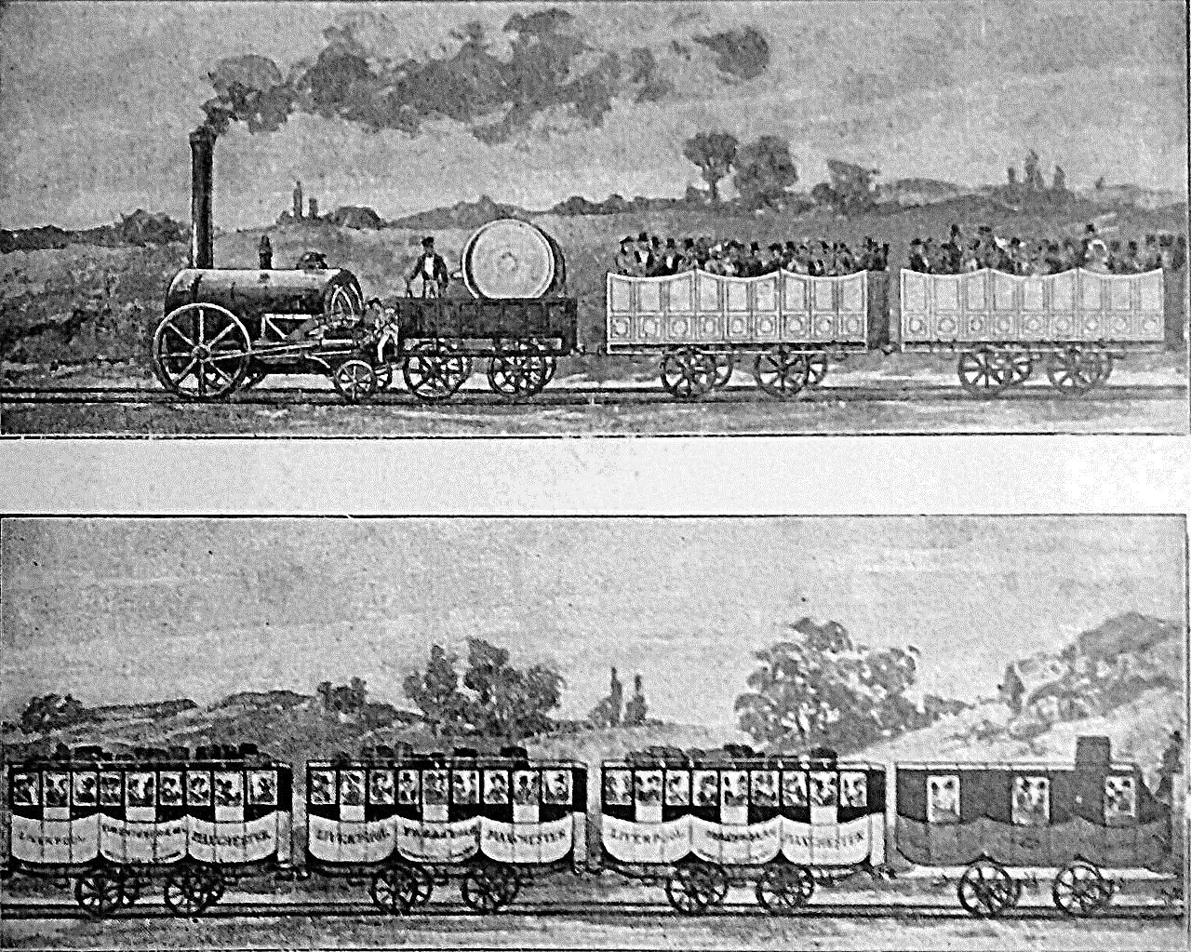

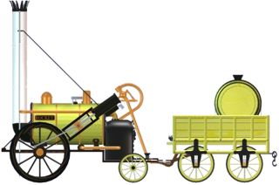
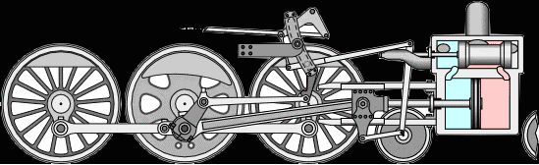


How steam locomotives worked
How did the railways change society?
Canals and stagecoaches lost much of their traffic to the railways which were faster.
Railways meant work for thousands of navvies. The work was done by hand with pick and shovel.
Mail was speeded up and national newspapers could be read on the same day in different parts of Britain.
Britain developed a new export trade in supplying rails, and locomotives to the rest of the world.
By 1900 there were over 20,000 miles of train track carrying millions of passengers every year.
Robert Stevenson’s Rocket
The Rocket was the first ever powered, passenger service and was produced at a time when many felt that such a performance could not be achieved. Maximum speeds were increased from around 10 to 37 miles per hour and journeys of 70 miles were completed in a mater of hours. This represented a revolution in travel and was reported on the front page of newspapers around the world.
4. The engine moves the pushrod left and right to move 5 up and down.
1. is the cylinder and valve block. The pink colour is steam from the boiler.
4
5
1
The first passenger carriage in Europe, 1830. George Stephenson´s steam locomotive, Liverpool and Manchester Railway.
3. is the crank provides the main force to move the valve.
2. is the crosshead, the sliding piece that guides the piston rod.
Steam is going into the right side of the cylinder pushing the piston to the left.
3
2
Key Stage 3 History Britain 1750-1900 Interactive
48

