Slide 1
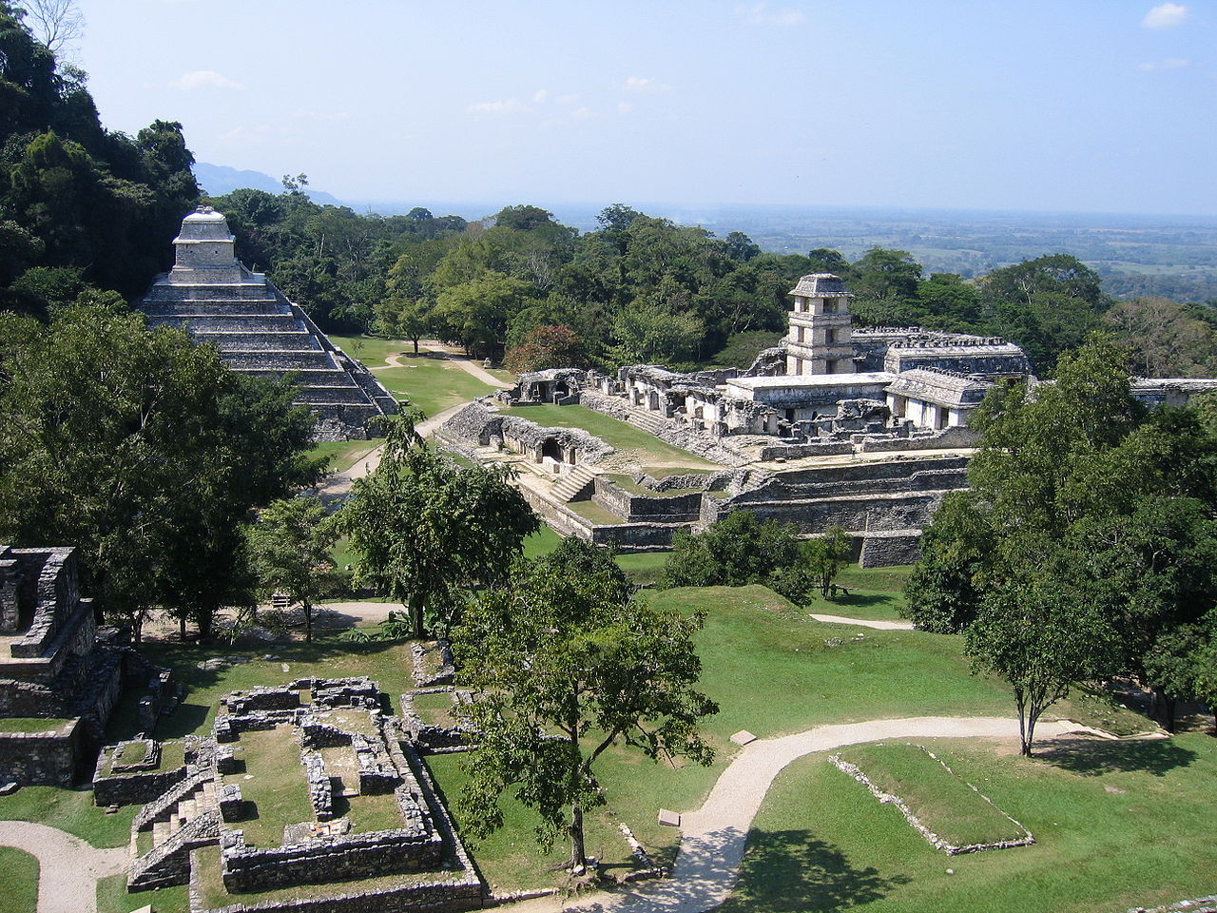

Key Stage 2 History
The Maya Civilisation
The Mysterious Maya

Slide 2
History Interactive
Teaching and Learning Resources
These are sample slides.
There are no audio, document links or internet links in this sample.
See all of our resources at
www.historyinteractive.co.uk
History Interactive Teaching and Learning © 2013

Slide 3
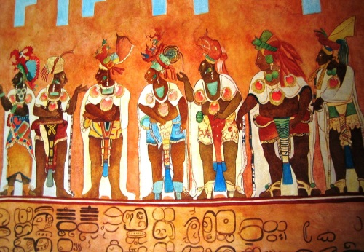
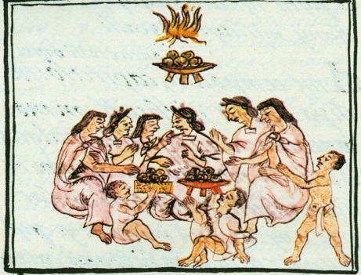
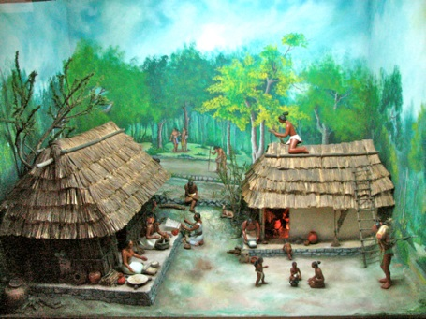
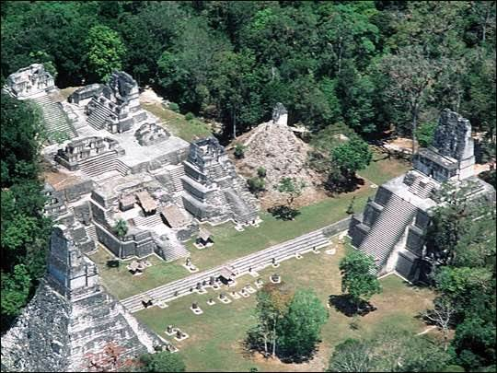
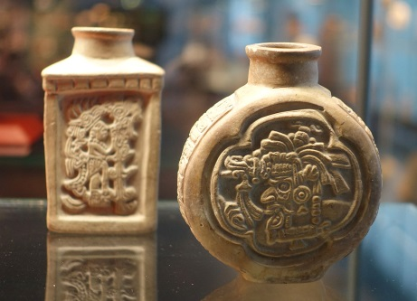
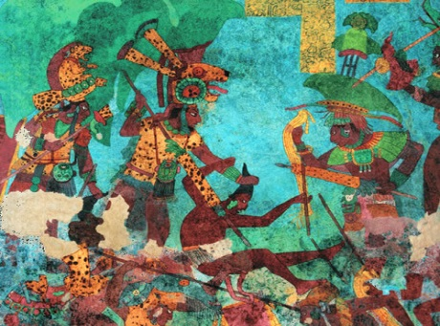



The Maya Civilisation
2
Where is Central America?
Maya farming and food
Maya life and society
Content Slides
Maya Art, Science and Maths
What happened to the Maya civilisation?
Maya cities
Print Activity Booklet
Watch Video
Do the end of topic test

Slide 4



3
Where is Central
America and when
did the Maya
civilisation begin?
Section 1
Where is Central America and when did the Maya civilisation begin?
In this section you will find out where in the world Central America is and the countries where the Maya people lived. When did the Maya civilisation begin?
What do you already
know about the
Maya civilisation?
Maya Civilisation History Interactive©

Slide 5
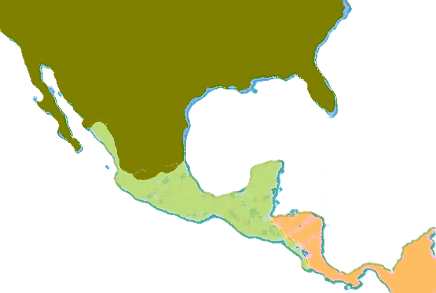
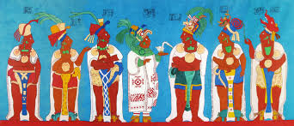
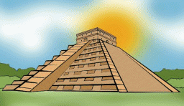
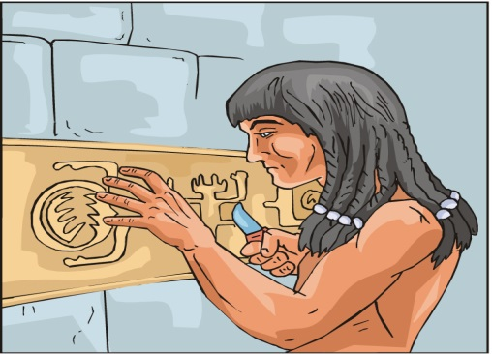
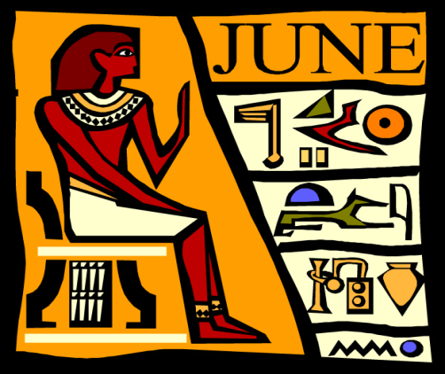
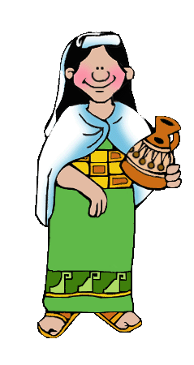
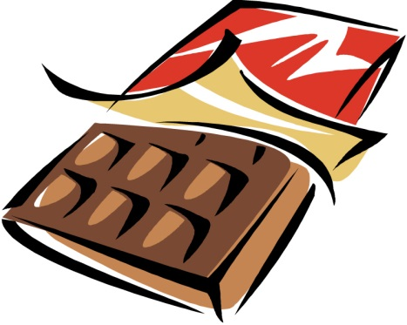
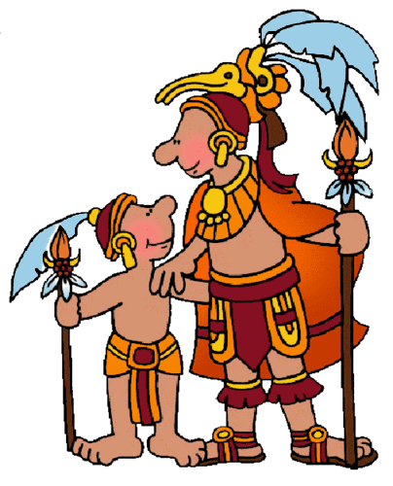
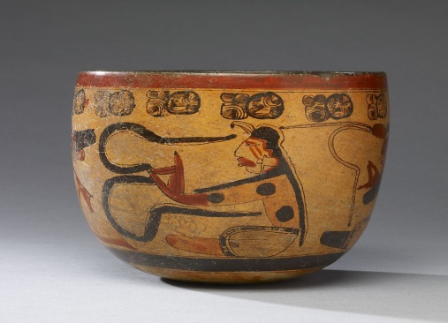
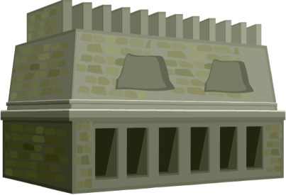
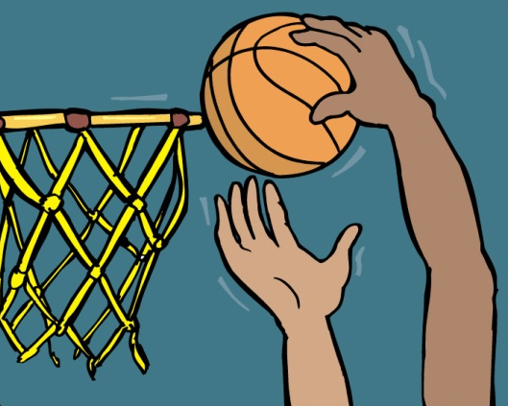

The Maya…
The Maya also…
6
North
America
Made a Calendar
Who were the Maya?
More than 2,300 years ago, the ancient Maya people lived in Central America. The ancient Maya built one of the most brilliant and advanced civilisations the world had ever known. They built hundreds of cities, temples, pyramids and palaces. They were famous for their writing and art.
Built pyramids
Could read and write
Invented
chocolate
The
Maya
Central America
Made beautiful art
Built
temples
Invented basketball
South
America
Who were the Maya?

Slide 6
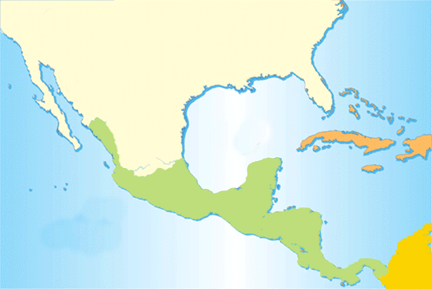
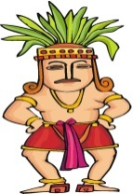
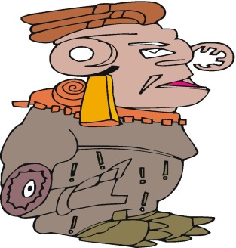
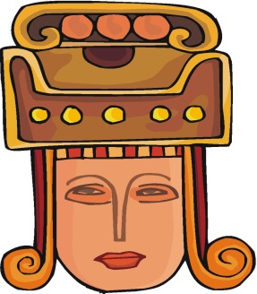
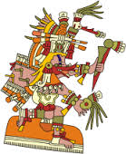
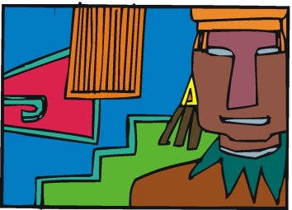

Where is Central America?
The Ancient Maya
7
The ancient Maya civilisation were a group of people who worked together to build a society.
Central America is the area where North and South America meet. ‘Central’ means middle, so Central America is in the middle, between North and South America. Central America includes the countries of Mexico, Guatemala, Honduras, El Salvador and Belize. 3000 years ago, many great civilisations began and settled in Central America. The Aztecs and the Olmec people built their civilisations in Central America. You are going to find out about the Maya civilisation. The Maya people were very advanced for their time.
North
America
Atlantic Ocean
The Olmec Civilisation
We call the Maya an ancient civilisation because they lived a long time ago, way back in history.
The Maya Civilisation
The Aztec
Civilisation
The Maya civilisation became very strong and took control of a large area of Central America.
Central America
They used what was around them to make life as good as possible for all members of the civilisation.
Pacific Ocean
South
America
Central America
Maya Civilisation History Interactive©

Slide 7
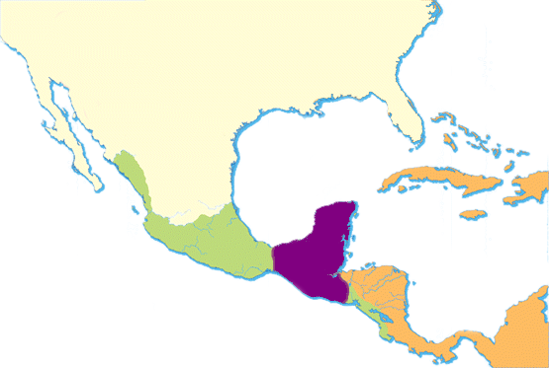

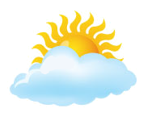
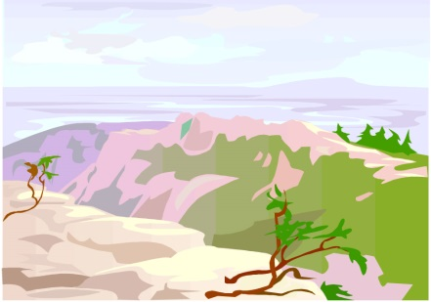
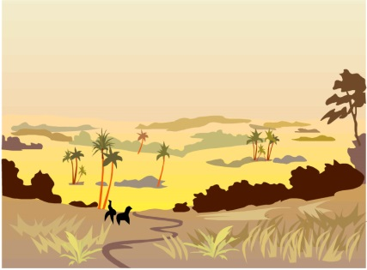
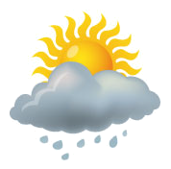
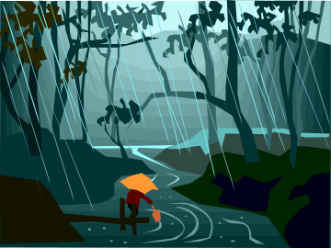
Central American Weather
10
Central America
What is the weather like?
The Maya lived in a part of the world where the weather is hot and there is also a lot of rain. In the hot season, the temperature can be as high as 40°C. On the hottest days in the summer in England, it is normally about 25°C. There is a wet season in Central America which can last for five months. It starts in May and ends in September. The Maya had to plan what they did around the weather.
Hot and cloudy
Hot and dry
Mountains
Grasslands
Maya
Mountains
Grasslands
Rainforest
Central America
Hot and rainy
Hottest temperature
40ºC
Rainforest
Jungle

Slide 8
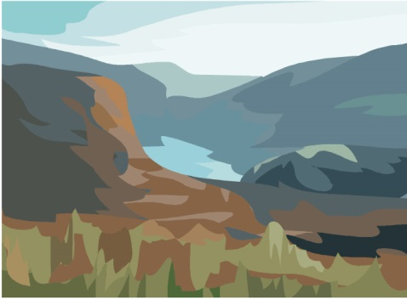
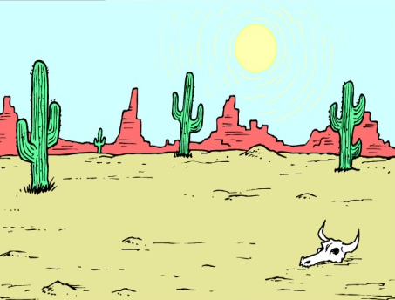
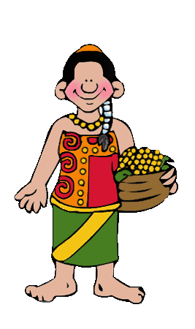
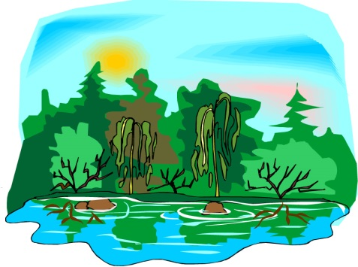
Maya Farming
16
What do you need for farming?
Problem 1
Mountains
Here, the land was hilly and it was difficult to farm on high ground.
Grasslands
Here, the land is very dry and sometimes there is no water or river nearby.
Problem 2
Flat land, light and sun.
Good soil for growing.
Plenty of water nearby.
Maya Farming Problems
The Maya civilisation was spread out over large areas of Mexico, Guatemala and Honduras. The land and weather was very different. Farming would have been difficult. The land could be hilly, dry or wet. The Maya did not have the modern farming tools that we use today. But the Maya were clever enough to work out the best ways to farm on the land.
Problem 3
Can you think of ways the Maya solved some of their farming problems?
The
Maya
Rainforest
Here, there are a lot of trees and the land can be a swamp because of all the rain.

Slide 9
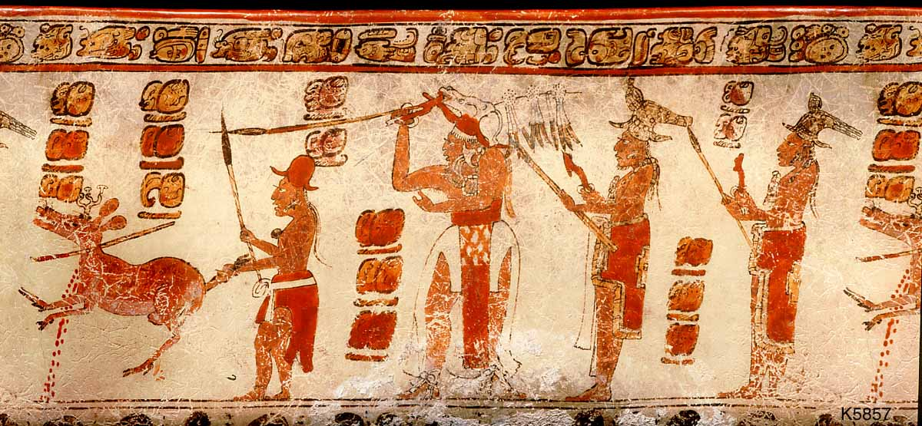
Hunting and Gathering
What can you see when you really look?
25
4
The Maya did not keep animals like cows, sheep or pigs for food, so they had to hunt and fish for meat to add to their fruit and vegetable diet. Hunters caught small animals like rabbits and foxes in nets. With bow and arrows they shot ducks, pigeons and other birds for their feathers. They hunted for bigger animals like deer, wild boar, pumas and jaguars for their meat and beautiful firs. The Maya gathered many plants and insects. Seeds, leaves and flowers were used in medicines and to make paper and baskets.
3
1
1
2
Maya Civilisation History Interactive©

Slide 10
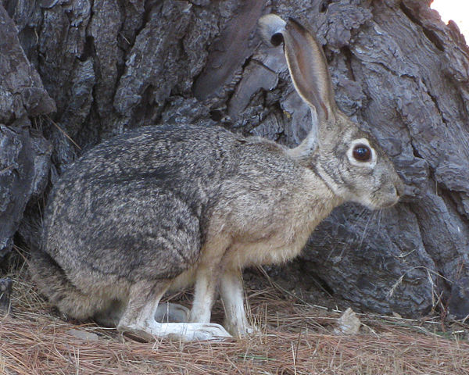
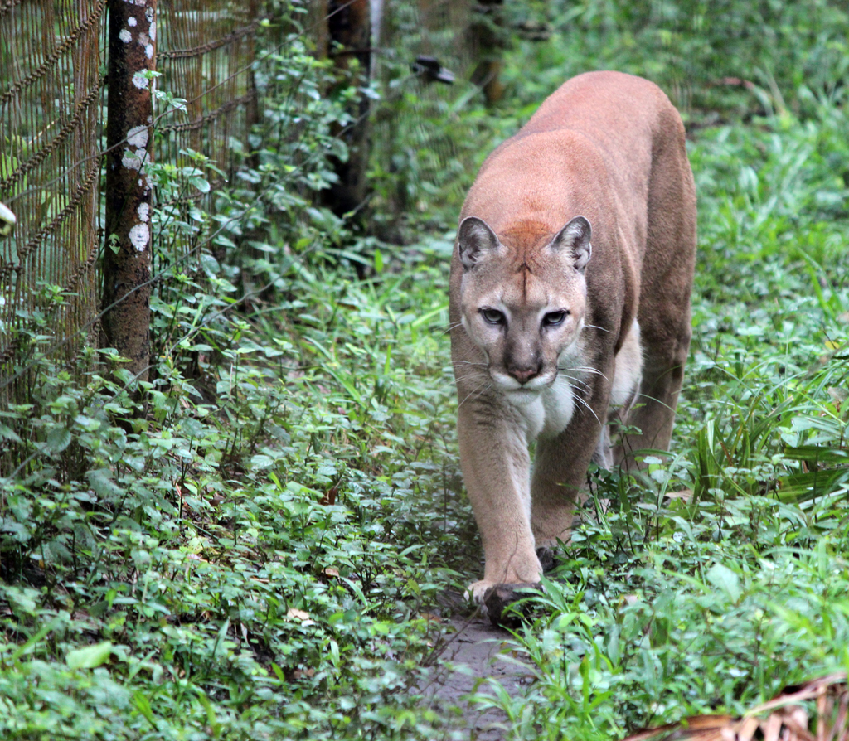
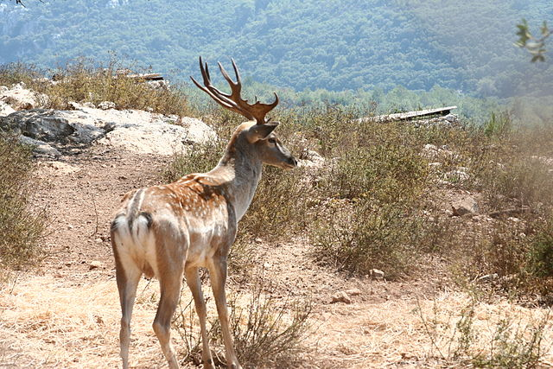
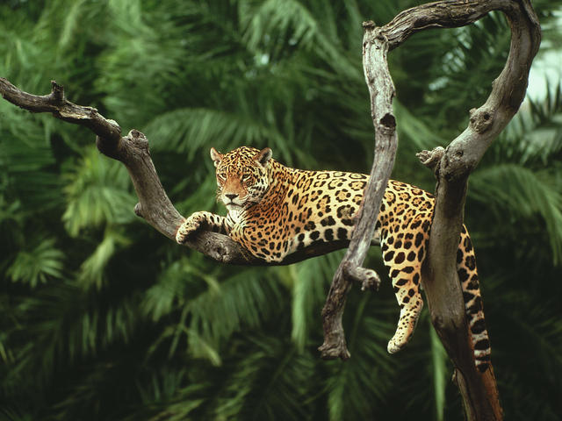
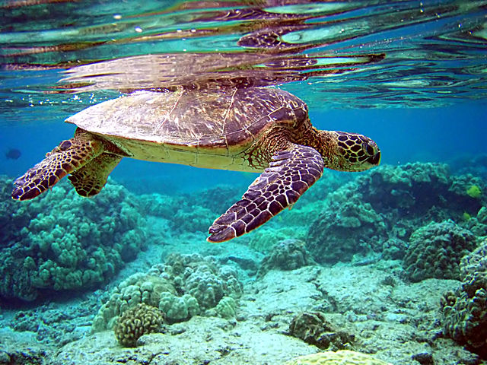
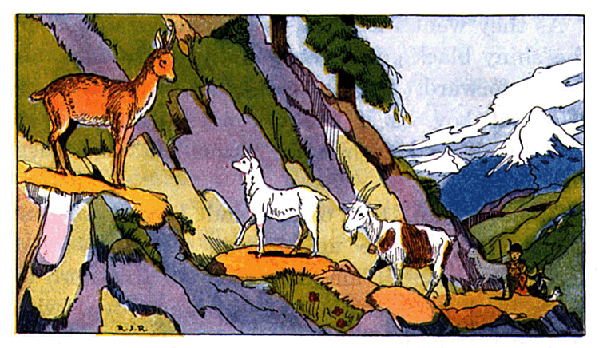
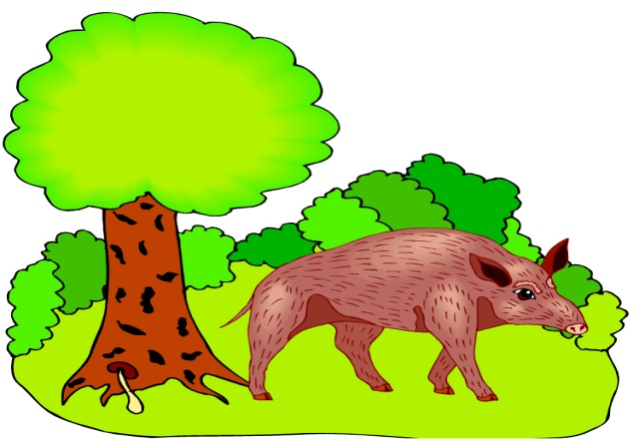
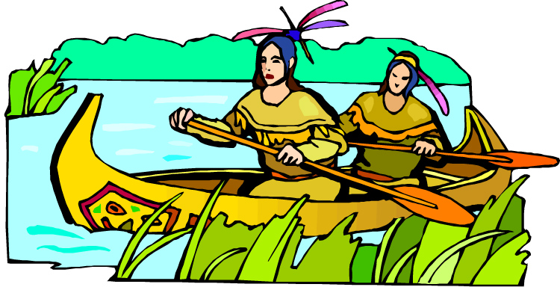
What animals did the Maya hunt?
26
Animals in the mountains
Deer
Rabbits
Animals in the rivers
Turtles
Fish
Animals in the rainforest
Foxes
Dolphins
Puma
Jaguar
Wild boar
Deer lived on the dry mountain slopes.
This is a Jaguar. The Maya liked its beautiful fir.
The Puma is like a big cat and lived in the rainforest.
The Maya hunted the black tailed Jackal Rabbit.
This is a turtle. Turtle shells were used in Maya crafts.
Maya Civilisation History Interactive©

Slide 11
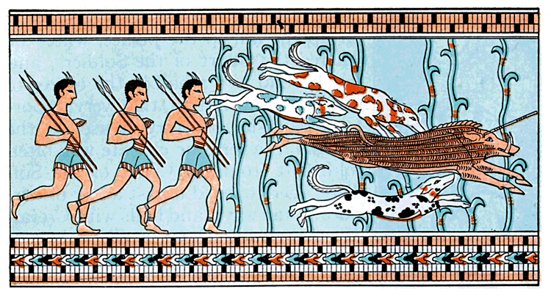
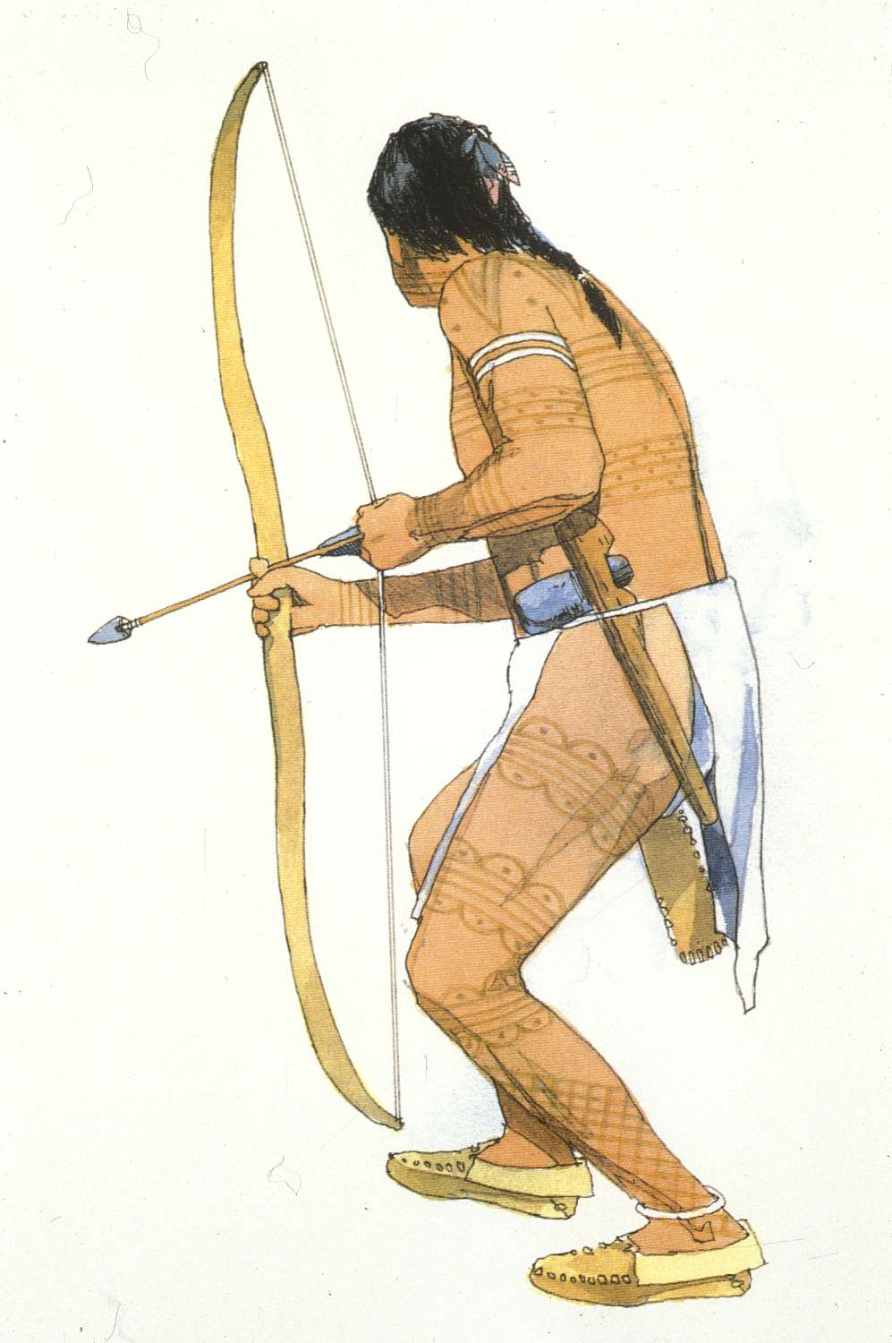
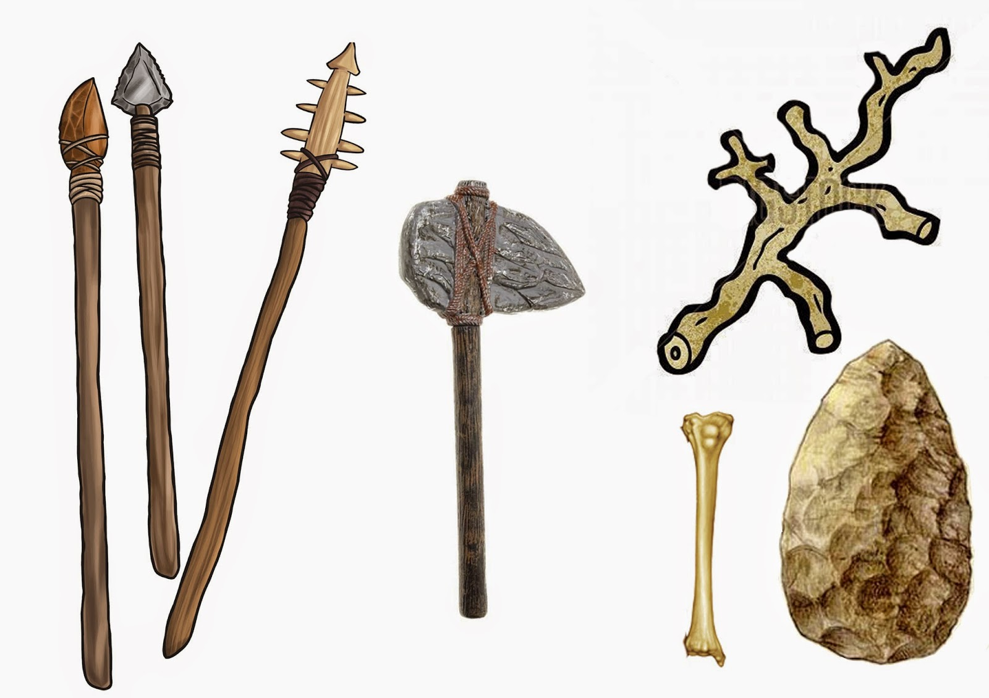
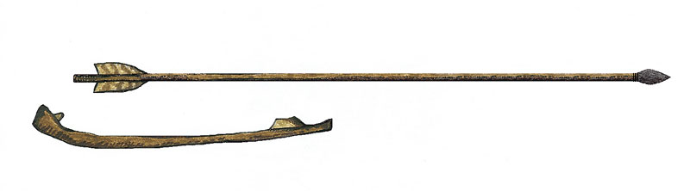
The Bow and Arrow
The Maya used a bow and arrow for hunting.
The bows were 2 metres long and the arrows were pointed with flint, bone or glass from a volcano. The arrows were kept in a pouch called a quiver. The Maya were very skilled in using the bow and arrow. It is believed that the arrows could fly 120 metres or more.
2
27
3
❶ Spears were thrown with a grooved piece of wood called an atlatl.
Hunting for wild animals
Maya men went hunting with bows and arrows, slings, clubs and spears. Dogs were used for hunting. The skill of hunting was passed down from father to son. Boys were taught how to hunt at an early age. At the age of 14, boys were ready to join the hunt with the men.
❷ Hunters’ bows were made of wood and their arrows were tipped with a sharp volcanic glass.
1
4
❹ Their clubs were made of lumps of rock tied together with rope or leather.
❸ The Maya made small boats or canoes and caught fish with nets, hooks and harpoons.

Slide 12
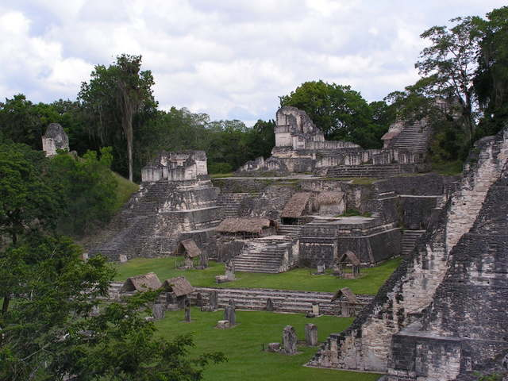
43
How did the Maya
build their cities and
what was famous
about them?
Section 4
How did the Maya build their cities and what was famous about them?
In this section you will learn about some of the Maya cities and kings. You will find out how these cities were built and what famous buildings you can see.
Maya Civilisation History Interactive©

Slide 13
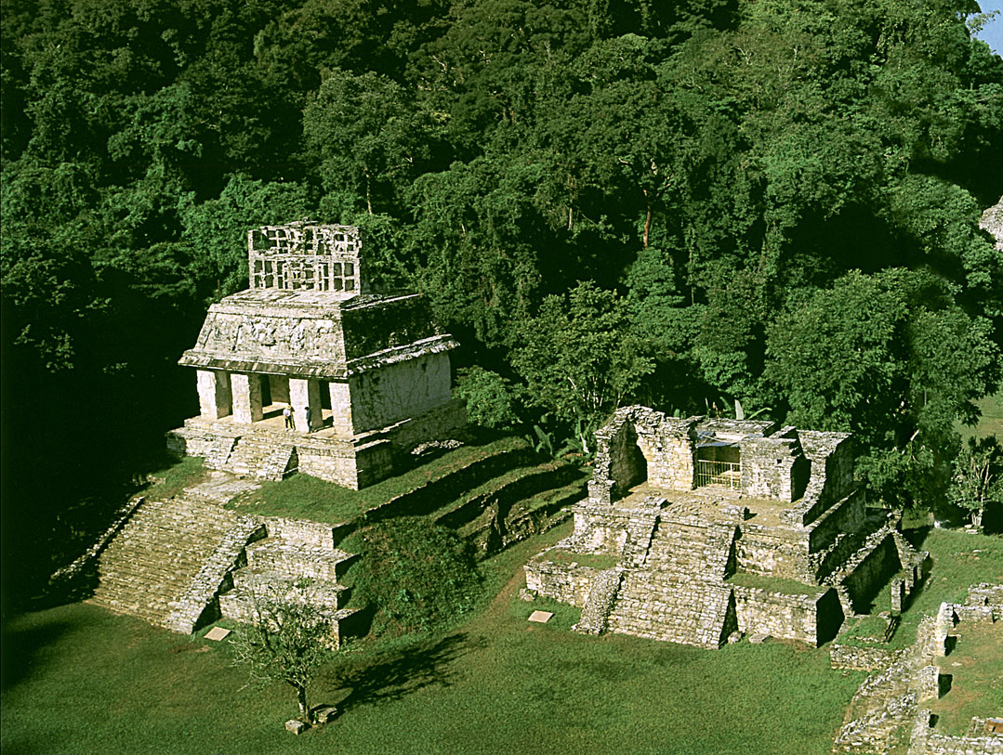

Maya Cities
This is part of the Maya city of Palenque.
44
The Maya were famous for building magnificent cities. The King, nobles and priests lived in the cities. Although the Maya built their cities hundreds of years ago, they were such great builders that ruins of their cities remain today in Central America. The problem was finding them.
The Maya built their cities deep in the jungles. You cannot look for these ruins by air, because the thick jungle hides everything. The jungle is a dangerous place but people were so curious about the mysterious Maya that they were willing to search the jungles.
They came across unfriendly natives, poisonous snakes, wild animals, spiders, quicksand pits and all kinds of nasty things.
Finding the lost Maya cities was not easy. Archaeologists had to travel through the jungle on foot cutting their way through the forest.
Maya Civilisation History Interactive©

Slide 14
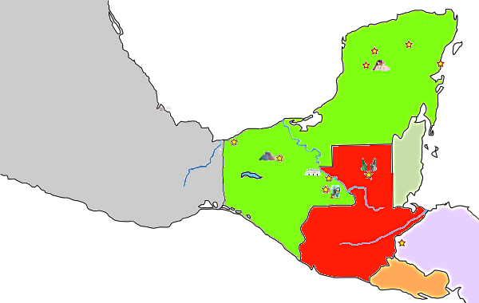



Maya Cities
45
Chichen Itza
Chichen Itza
Mayapan
Gulf of Mexico
Uxmal
Tullum
Chichen Itza
Find out more
Mexico
Mexico
La Venta
Palenque
Palenque
Belize
Yaxchilan
Tikal
Tikal
Palenque
Find out more
Bonampak
Guatemala
Copan
Pacific Ocean
Honduras
El Salvador
Tikal
Find out more

Slide 15


Part of Copan City
46
The Ball Court
They used, stone tools (drills, axes, chisels) and rope.
They used mainly limestone which had to be cut and shaped.
Some of their temples were 200 metres high.
They did not have the use of the wheel or animals for transport.
Pyramid Temple 1
How did the Maya build their cities?
Maya Cities
The Maya built many cities. Each city was built in the same way. Each city had a huge central plaza. The plaza was surrounded with temples, pyramids, a ball court and a palace for the city ruler. The plaza would have been used as a marketplace and well as a meeting place for ceremonies and festivals.
Central Plaza
Temple
2
The palace is not shown on this drawing.
The Maya also built roads which were made with large stones and small stones. The surface had a smooth layer of white cement. The longest Maya road was more than 90 kilometres in length.

