Slide 1
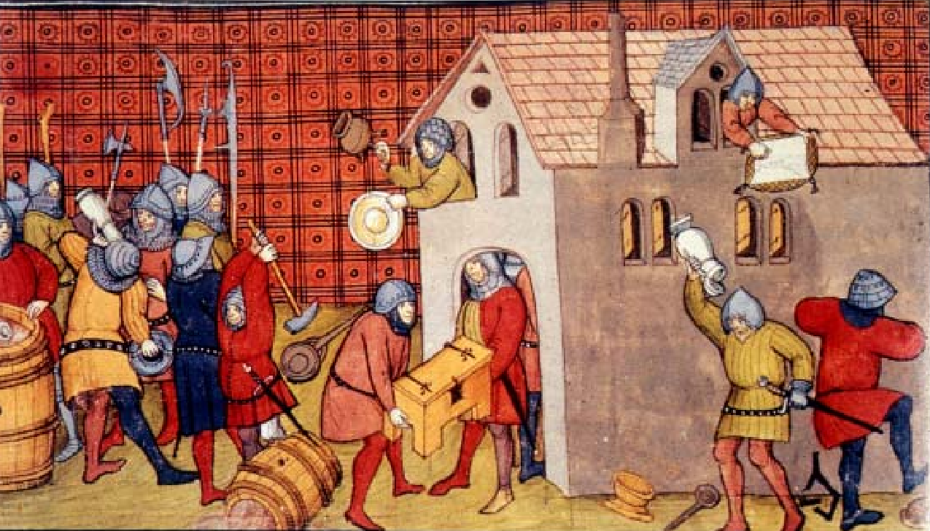

NATIONAL CURRICULUM HISTORY
THE MIDDLE AGES
BRITAIN 1300-1453
INTERACTIVE
How were peoples’ lives affected by disease, rebellion and war?

Slide 2
History Interactive
Teaching and Learning Resources
These are sample slides.
There are no audio, document links or internet links in this sample.
See all of our resources at
www.historyinteractive.co.uk
History Interactive Teaching and Learning © 2013

Slide 3
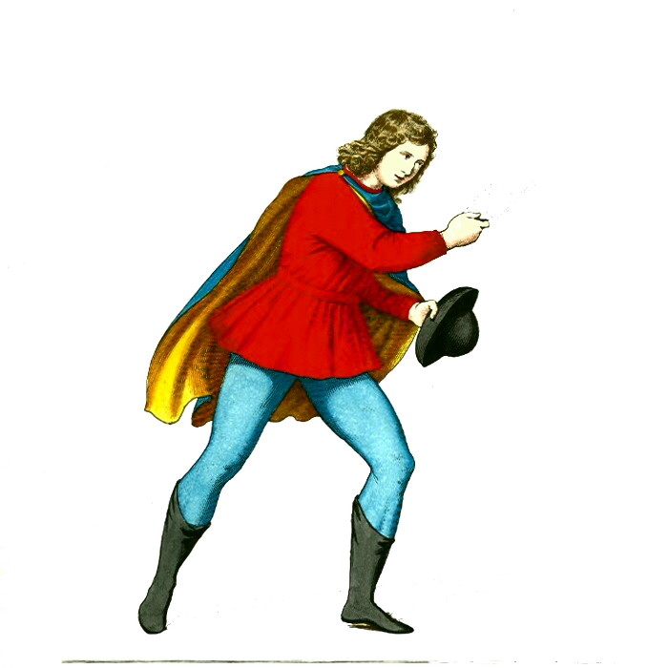
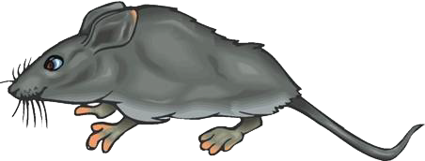
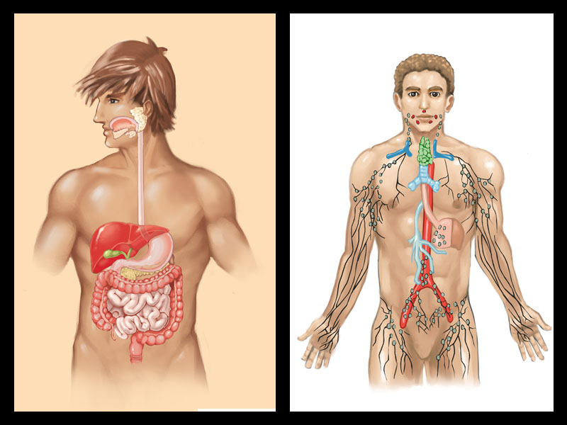

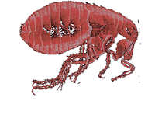

What were the symptoms of the Black Death?
What caused the Black Death?
Pneumonic plague
Bubonic plague
❹ When the rat died, the fleas jumped on to humans and passed on the deadly disease.
There were two types of plague:
Fever and headache
Bubonic plague was the more common and was carried in the bloodstream of rats. The fleas would bite people and passed on the disease. Victims would get a fever and buboes [swellings] in the groin and armpits. It took 4-7 days to die.
❶ The disease was started by the black rat which carried the germ that caused the plague.
Lymph node swellings
Coughing and sneezing
Infected lungs
Pneumonic plague was less common, but more deadly. It was caught by breathing in the germs released when an infected person coughed or sneezed. It destroyed the breathing system.
❷ The plague was spread by a tiny insect called a flea. They lived in the fur of black rats.
Sickness
❸ The flea sucked the rat’s blood which contained the plague germs.
Aches in all bones & joints
Bleeding from buboes
The Middle Ages 1300-1453 Disease, Rebellion and War
12

Slide 4
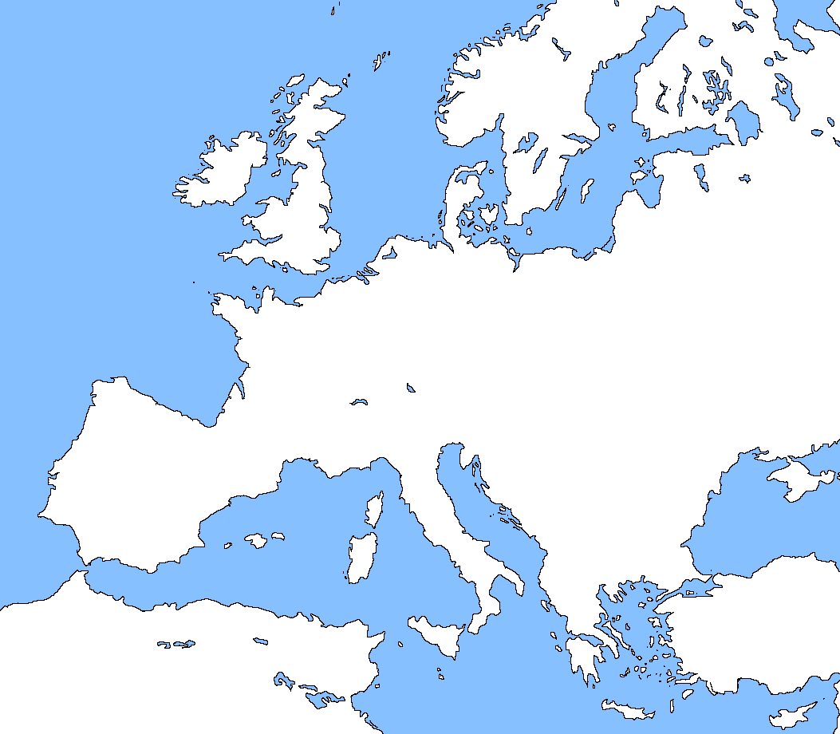








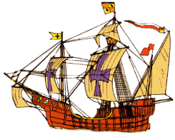
The route of the Black Death
Why did the Black Death spread?
Cause 1: Trade
The Black Death Arrives
In the summer of 1348, a French ship docked in the small port of Melcombe in Dorset. The sailors unloaded boxes from the ship. The sailors then went off into the town but one of them was very ill. He already had the plague. The sailor died but he had already passed the disease onto other sailors. The illness soon spread very fast to the rest of Melcombe.
Some areas like northern Germany and Poland escaped the worst of the plague because they were isolated and away from major trade routes.
1349
Where did the plague come from?
The Black Death travelled along trading routes. European merchants traded with merchants in China and Asia. Some historians believe that the rats got on boats in China and India, where it is thought the disease began. Italian traders carried infected rats and fleas and the disease on their ships back to Europe.
1350
London
Areas not affected by the plague.
Paris
Early- 1349
Mid- 1348
Genoa
Pyrenees and Alps were mountainous so few people travelled through them.
Early-1348
Constantinople
1347
The Middle Ages 1300-1453 Disease, Plague and War
14

Slide 5
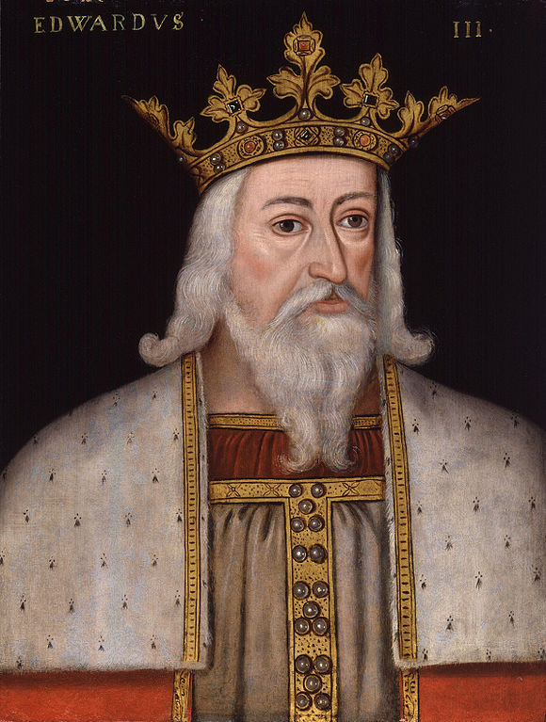


Changes after the Black Death
Why did life for peasants improve after the Black Death?
Good times for the peasants did not last for long.
Parliament was not happy about the changes that gave the peasants some power. In 1351, King Edward III passed a law called the Statute of Labourers. The law said that wages must be kept at the same level as they were before the Black Death.
Because so many people died, the Black Death brought about other changes in English society. The biggest changes were on the farms and in the countryside.
Source 1
Source 2
“As soon as masters accuse their workers of bad work … they leave quickly and find jobs in new places at higher wages. Masters dare not upset their workers…” from Introduction to a Law.
At Woodeaton there were only two farmers left and they would have gone away if the abbot had not made a new agreement with them to reduce their work service…” from the records of Eynsham Abbey.
For peasants who survived, the future looked good. Because there were fewer workers, they could demand higher wages.
Some now had the chance to break free from their lord of the manor or decide to work for someone else who paid more money.
Peasants stopped doing work for their lord. The lords did not complain because they wanted to keep their peasants.
King Edward III
The Middle Ages 1300-1453 Disease, Rebellion and War
24

Slide 6
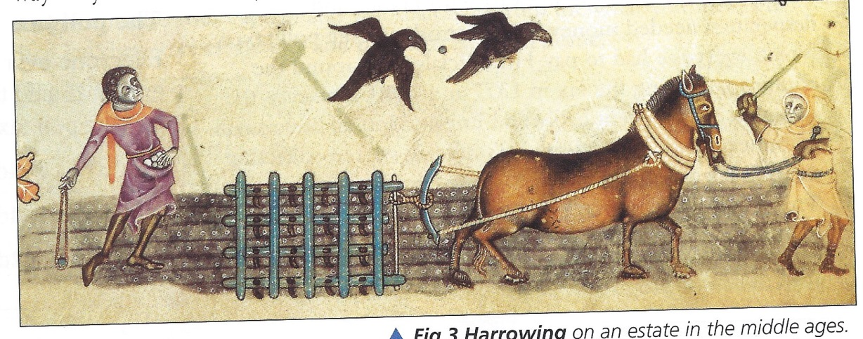
Why were the peasants not happy with their lives?
Why did the peasants revolt?
Cause 1: Lack of rights
The Magna Carta of 1215 had not improved their lives.
They wanted to end the old feudal system.
They had to do work for their lord and pay fines.
The Statue of Labourers of 1351 had lowered their wages.
Peasants wanted all men to be free and equal and less harsh laws.
Historians try to work out the causes, or reasons why things happened. Sometimes the causes of important events are long-term causes – problems that had been around for years. Other causes are short-term causes and these are things that happened immediately beforehand.
So what made the peasants revolt in 1381?
Anger
Frustration
The villeins [peasants] had to work on the lord of the manor’s land for three days a week for no pay. They wanted to be free labourers.
The Middle Ages 1300-1453 Disease, Rebellion and War
27

Slide 7
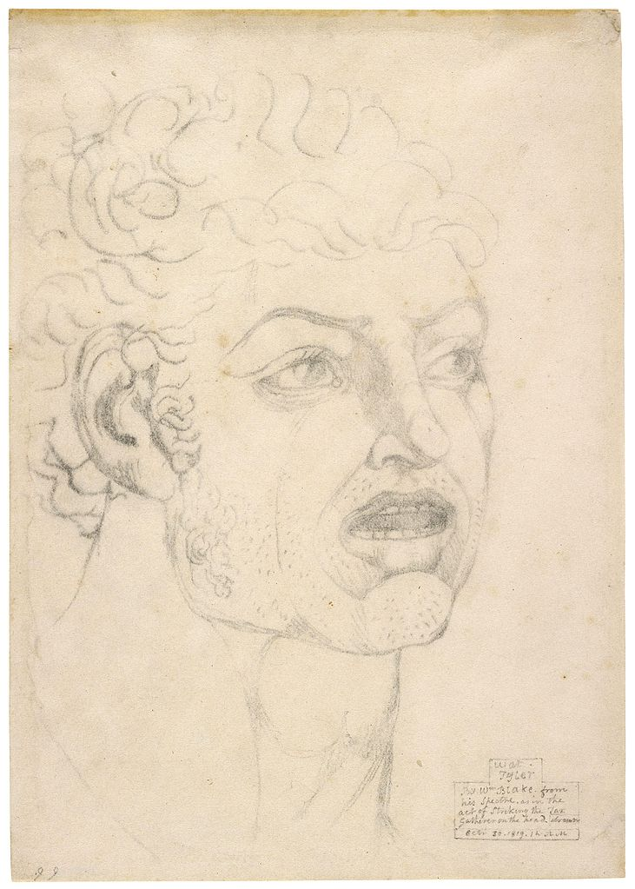
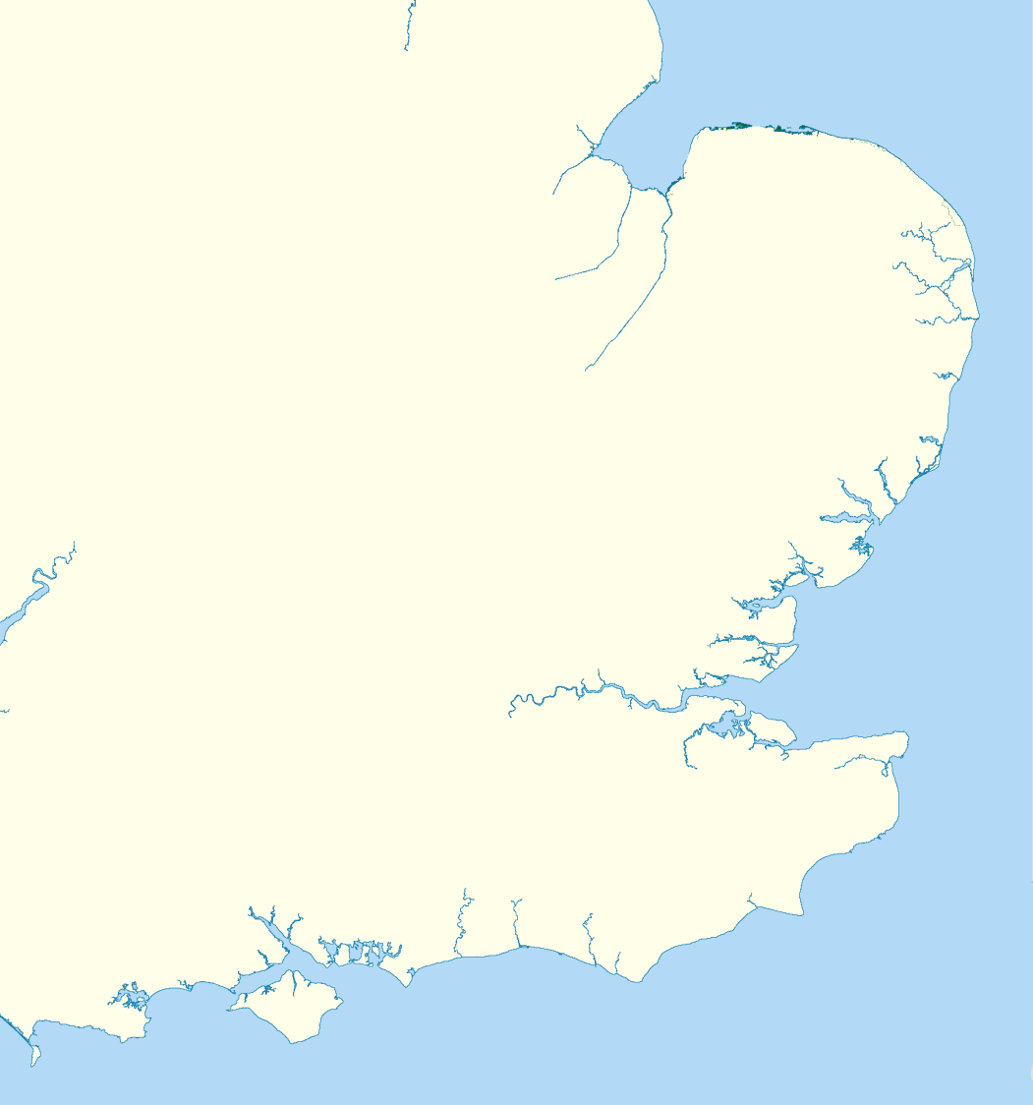
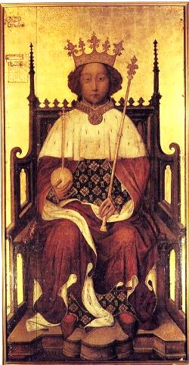
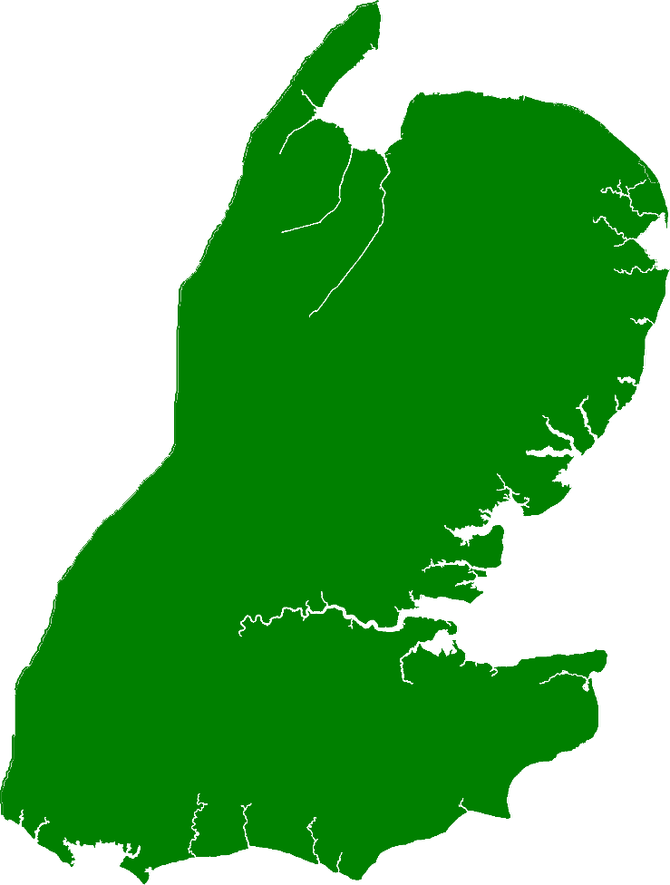

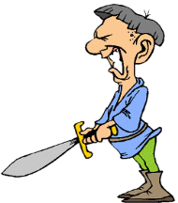
The Peasants’ Revolt
Norfolk
Limit of the Peasants’ Revolt
March of the rebels to London
Some peasant disturbances here.
Suffolk
Essex
The rebels were mainly from Essex and Kent.
Mile
End
London
Blackheath
The rebels set up camp at Blackheath and Mile End.
Maidstone
Kent
Watt Tyler, leader of the Peasants’ Revolt from a sketch by William Blake in 1820.
King Richard II was only 14 years old at the time and had only been king for 4 years.
The Middle Ages 1300-1453 Disease, Plague and War
31

Slide 8
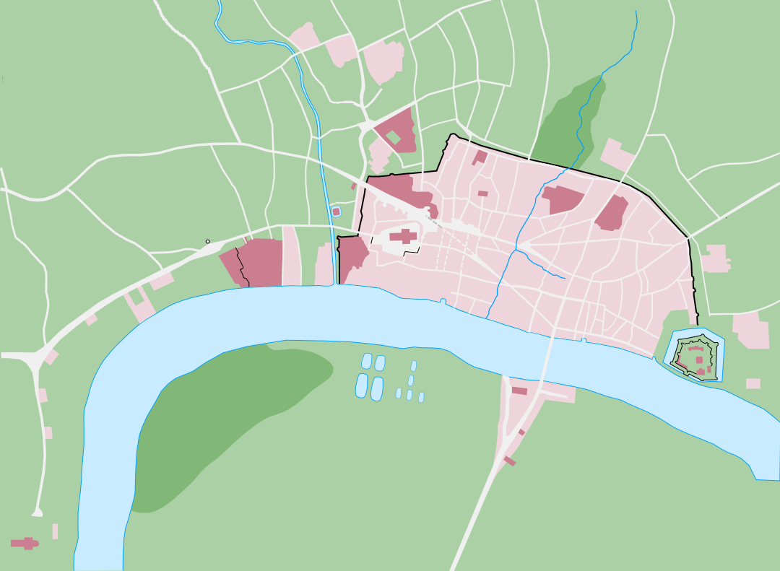
What happened next?
The peasants forced their way through the city gates of London.
They went on the rampage burning and looting houses of the rich.
More peasants arrive in London, probably about 100,000 of them.
The king watches this from the safety of the Tower of London.
The king meets the peasants at Mile End.
The king agreed to many of the peasants’ demands.
Archbishop of Canterbury and the King’s treasurer killed.
The king agrees to meets the peasants at Smithfield.
Essex rebels
The Peasants’ Revolt 1381
London in 1381
Mile End
Smithfield
St Paul’s Cathedral
Savoy Palace
River Thames
London Bridge
Tower of London
Blackheath 3km
Kent rebels
Westminster Abbey
The Middle Ages 1300-1453 Disease, Rebellion and War
32

Slide 9
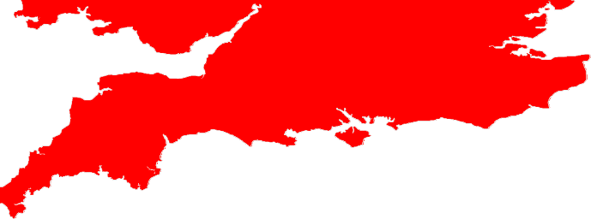
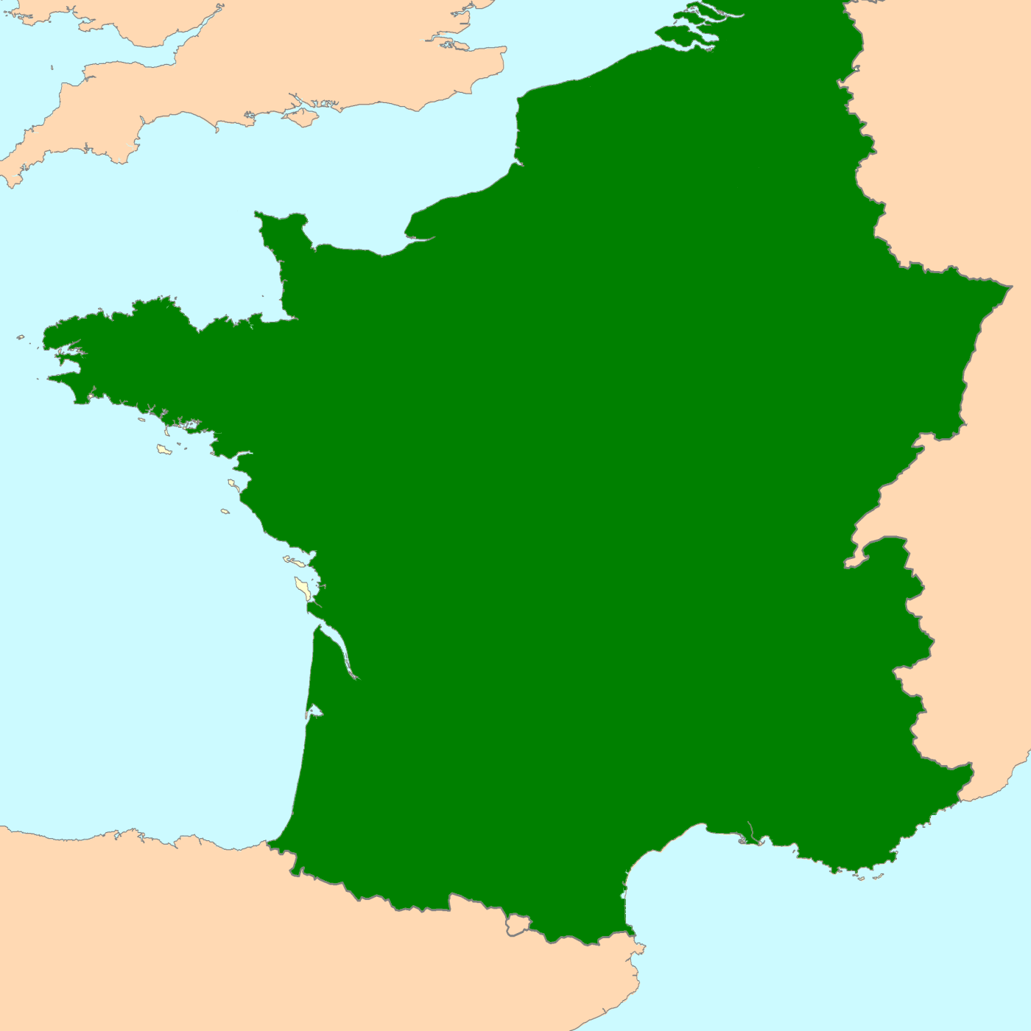
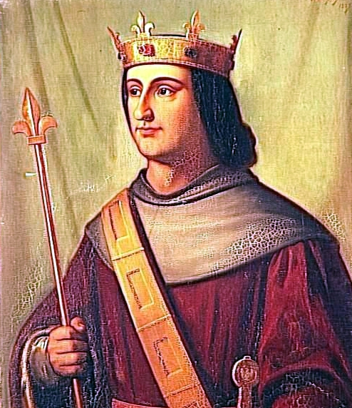

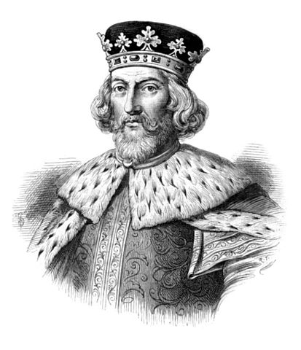
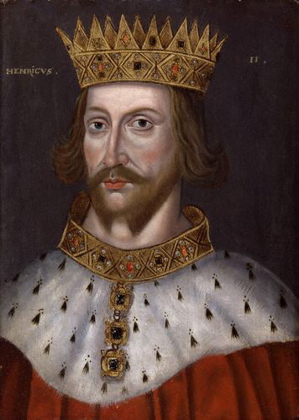
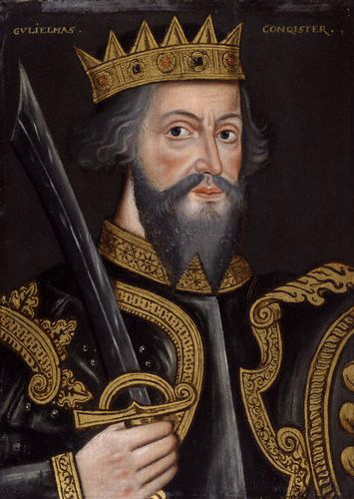
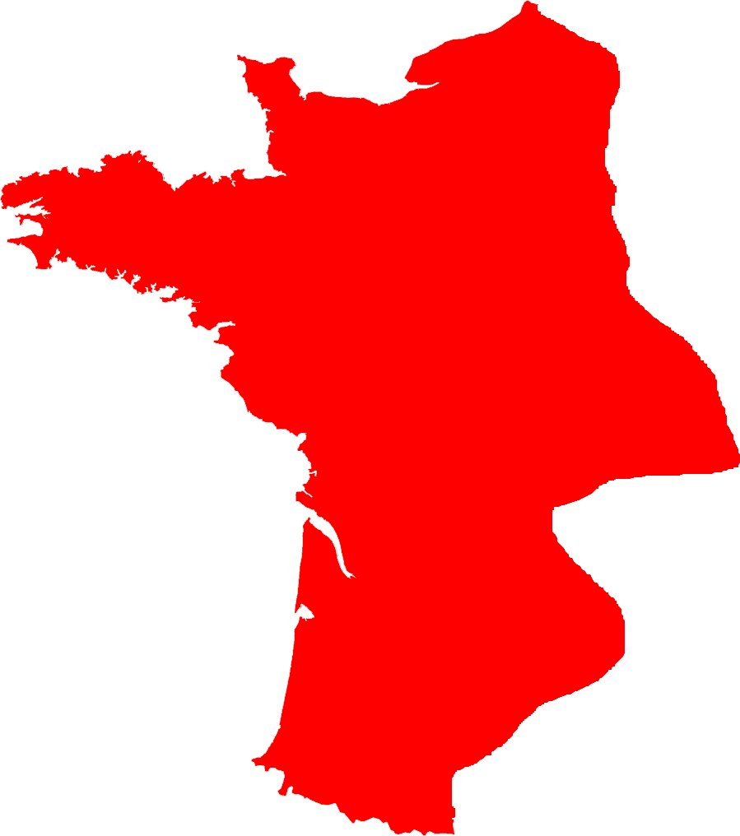
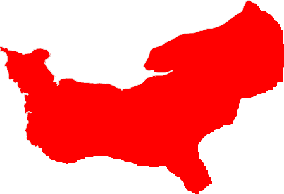

England
English lands in France
Calais
English Channel
Who should be the next king of France?
In 1328, King of France Charles IV died without heirs. Edward III of England had a claim to the throne of France, through his mother and said he should be the next king of France but the French chose Philip VI. Edward declared war on France. This was the start of the Hundred Years' War.
English lands in France
Conflict between England and France over land dated back to 1066 when William, Duke of Normandy, conquered England. His descendants in England gained further lands in France by the reign of Henry II. The English and French royal families had also married into each other for centuries leading up the Hundred Years’ War.
Normandy
France
Brittany
Anjou
Kings who followed Henry II found the land they owned in France too large and difficult to control. King John lost Normandy, Brittany and Anjou to France in 1204.
At the start of Edward III’s reign, the land England controlled in France included Aquitaine and Calais. While England was at war with Scotland, the French seized Aquitaine.
Henry II became king of England in 1154. He was already Duke of Anjou and his marriage to Eleanor of Aquitaine brought more French lands.
William the Conqueror was already Duke of Normandy when he became king of England in 1066. He ruled over England and Normandy.
Aquitaine
Land controlled by England
Edward III of England
Philip VI of France
38

Slide 10
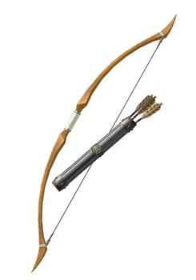
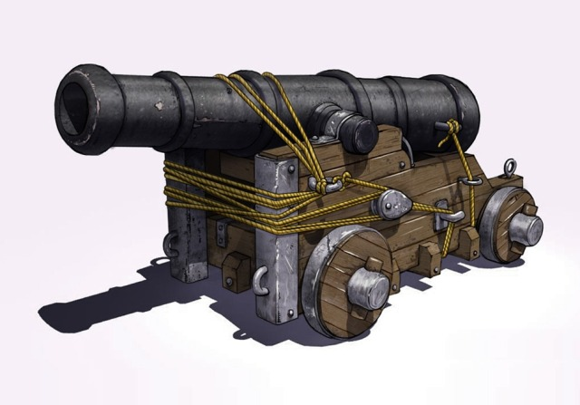
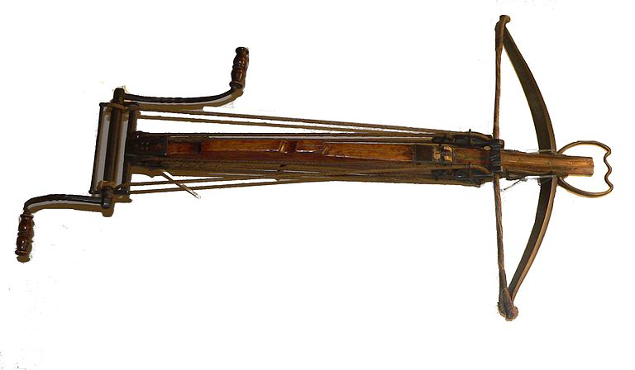
Weapons of the Hundred Years' War
Crossbow
Mainly used by the French because it took little training or skill to operate and it had a tremendous firing power.
Longbow
An English weapon. It was difficult to use and required a lot of training. It also required tremendous strength.
Cannon
Gunpowder was invented during the Hundred Years' War. Early cannons often exploded and killed the soldiers who fired them.
French strengths
The French had a population of about 16,000,000.
France was far richer than England.
English strengths
English tactics were to engage in quick, profitable raids.
The longbow was a better weapon than the crossbow.
At one point, the French fielded an army of over 50,000.
England was supported by soldiers from the Flemish army.
When the Hundred Years' War began, King Edward III had to raise an army. There were men who looked forward to fighting abroad in an army as it gave them the opportunity to plunder treasure and bring things back to England which could make them rich. However, many men were not keen on fighting as they were usually more concerned about farming. New weapons and tactics replaced the older system of feudal armies.
Cannon
Used for the first time at the Battle of Crécy. Cannon allowed the French to capture most of the English strongholds.
The French Crossbow
However, it was slow to reload, heavy and easily damaged by rain. It was also not as accurate as the longbow.
The English Longbow
Could fire 3 arrows in the time a French crossbow man could fire one arrow. It could also pierce medieval armour.
42

