Slide 1
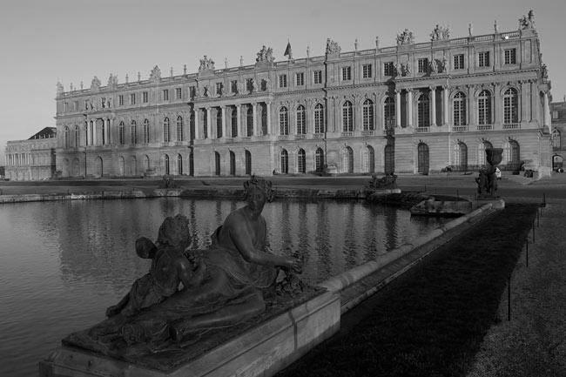

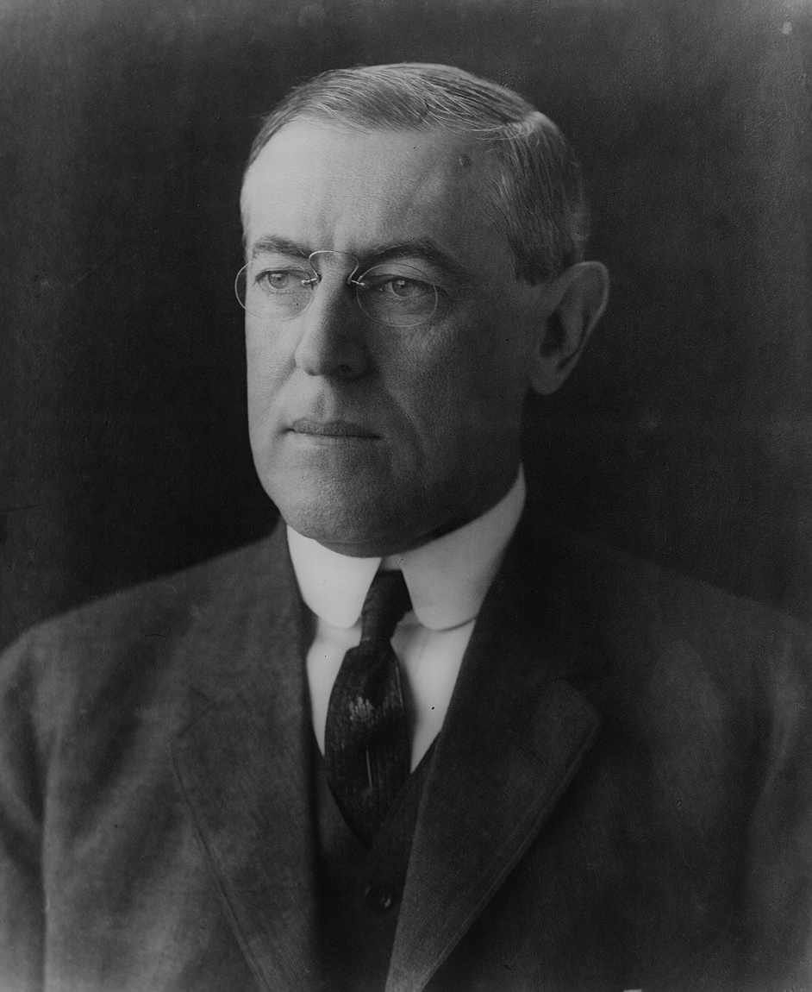
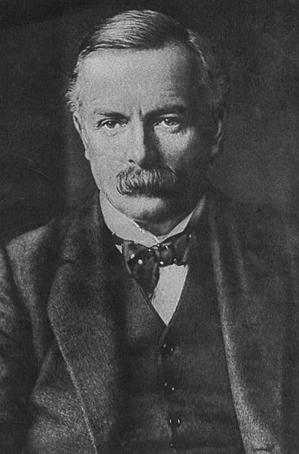
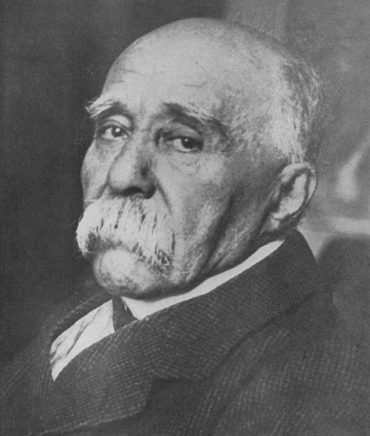
GCSE MODERN WORLD HISTORY
INTERNATIONAL RELATIONS 1918-1945
THE PARIS PEACE CONFERENCE 1919-1920
INTERACTIVE
How successful were the peace treaties?

Slide 2
History Interactive
Teaching and Learning Resources
These are sample slides.
There is no audio, document links or internet links in this sample.
See all of our resources at
www.historyinteractive.co.uk
History Interactive Teaching and Learning © 2013

Slide 3


SECTION 2
THE PEACE CONFERENCE
12
Learning Outcomes
By the end of this section you will learn what the Paris Peace Conference was, who attended and what they wanted for their country. You will consider why the leaders had different aims and why they could not get what they wanted.
Learning outcomes are what you will know and be able to do after the learning activities in this next section.
GCSE Modern World History The Paris Peace Conference 1919-1920

Slide 4
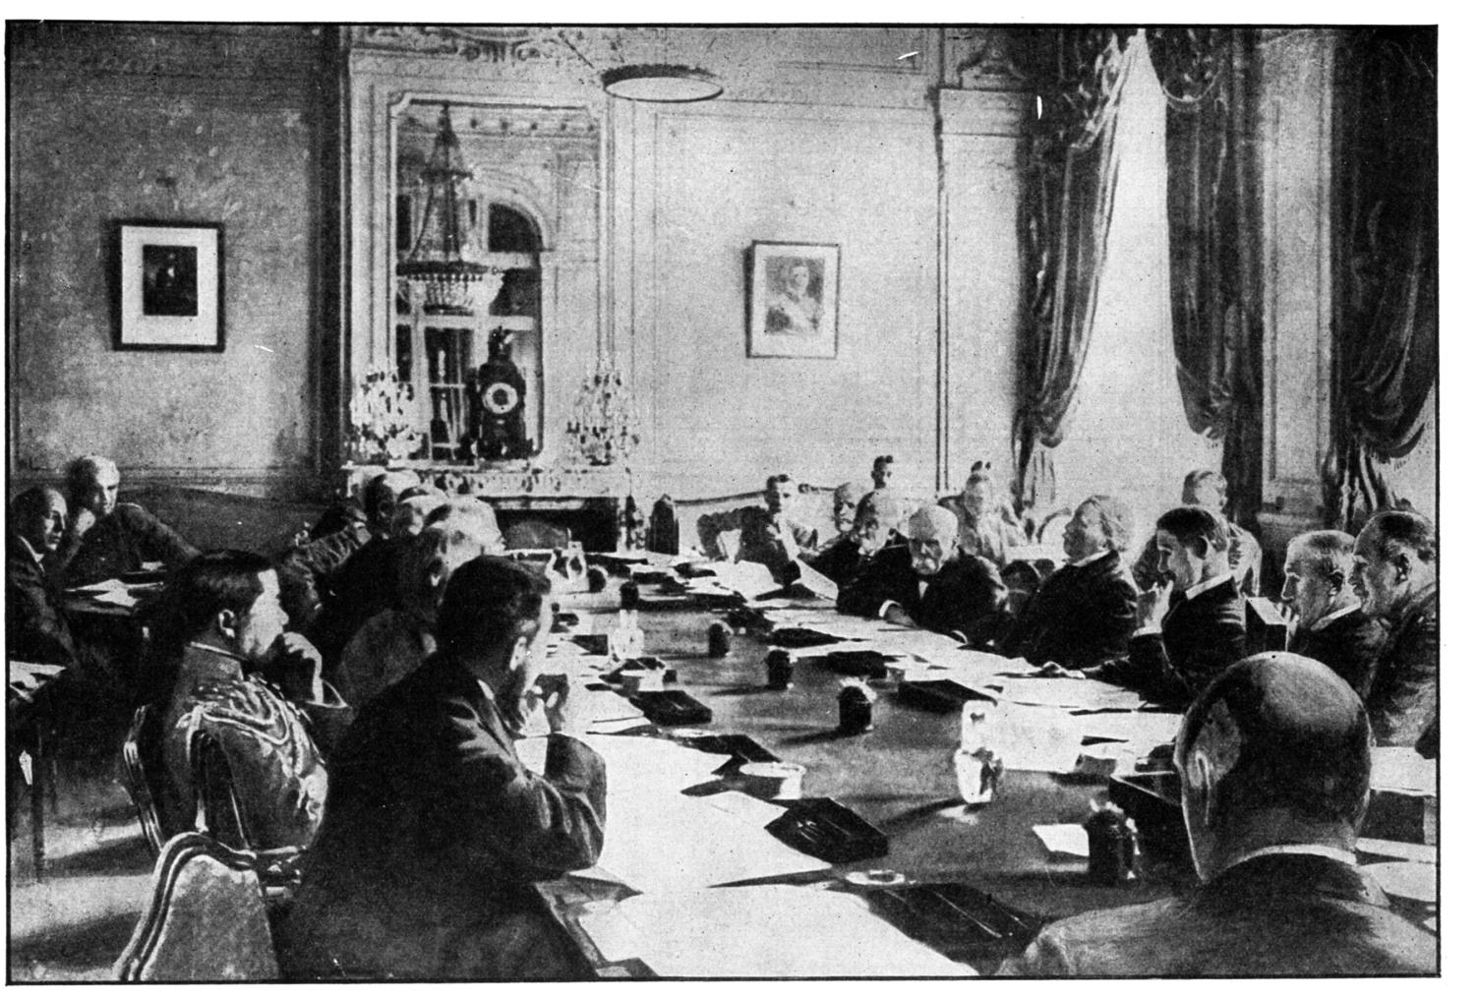



The Paris Peace Conference
13
The main leaders at the Paris Peace Conference
From left to right:-
Clemenceau, Lloyd George, Orlando [The Italian Prime Minister] and Wilson.
In January 1919 leaders of the Allied countries met in Paris to decide on the peace terms they would offer the Central Powers. This was known as the Peace Conference. They met at the Palace of Versailles just outside Paris. The defeated countries were not invited to the conference or consulted about the peace terms. 32 countries were present but all the major decisions were made by the ‘Big Three’: Clemenceau, Lloyd George and Wilson. The ‘Big Three’ got on badly from the start and relations between them got worse throughout the conference, especially the relationship between Clemenceau and Wilson. There were 5 peace treaties drawn up at the conference. The main one was the Treaty of Versailles which dealt with Germany. Russia was not invited because she fell out with the Allies, could not be trusted and had become a Communist country. Besides, Russia had already made peace with Germany.
The winners had different views about peace.
Who would pay for all the damage and destruction?
Why would making
peace be difficult?
Some countries wanted revenge.
The losers were not invited to the Peace Conference.
The Peace Conference was in Paris.
GCSE Modern World History The Paris Peace Conference 1919-1920

Slide 5
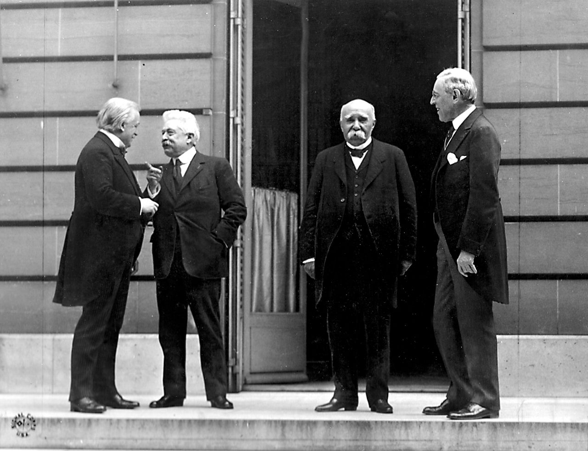

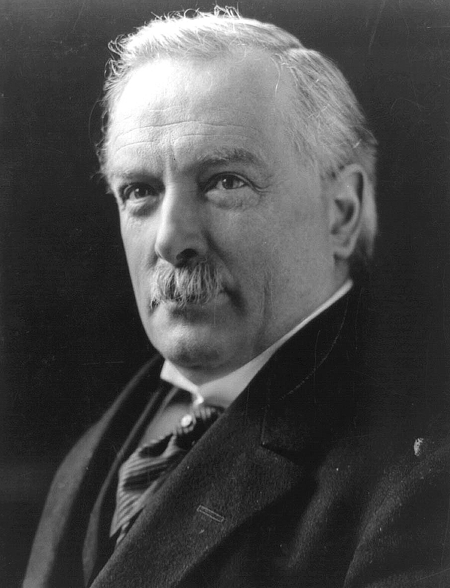
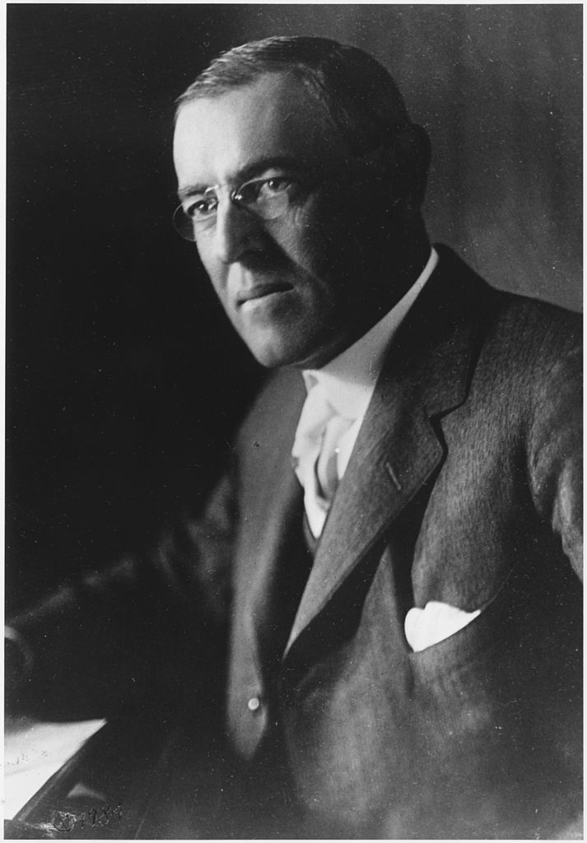

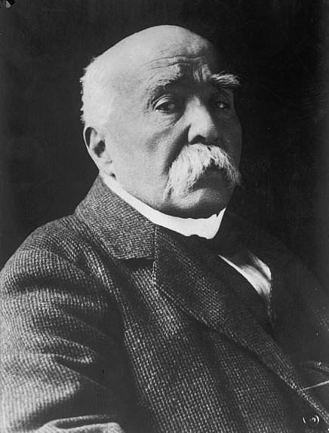





The Big Three
15
David Lloyd George
Britain
Georges Clemenceau
France
Wilson was an idealist who wanted to build a better and more peaceful world. He wanted to find perfect solutions to problems. In 1918 he put forward his Fourteen Points. He wanted to set up a League of Nations and give people of different nationalities the right to govern themselves. He called this self determination. Overall, he wanted ‘a fair, just and lasting peace.’
He had to be careful to reflect what British people wanted which was to ‘make Germany pay’ and ‘Squeeze them until the pips squeak’. However, Lloyd George wanted a peace in Europe that would last. He wanted Germany to lose her navy and colonies because they threatened the British Empire. Overall, he wanted ‘Germany punished but not too harshly.’
Clemenceau was nicknamed the ‘Tiger’ because he was determined that France should not lose the war. He wanted revenge on Germany.
He also wanted them to pay for French suffering and the damage. To weaken Germany he wanted their land and armed forces taken away.
Overall, he wanted ‘revenge, security and reparations’
MAKING PEACE 1919
Making an agreement was going to be very difficult, as each country had different aims and felt they knew best. For example: the USA did not want Italy getting their territory, France wanted to take the whole of the Rhineland, but Britain felt it should only be a demilitarized zone (an area where military equipment or soldiers are banned). Clemenceau did not support most of Wilson’s Fourteen Points.
Reasons for the American attitude?
Reasons for the French attitude?
Reasons for the British attitude?
The Paris Peace Conference
The Leaders of the Big 4 Nations
The leaders of Britain, France, Italy and the USA met in Paris to negotiate the peace treaties. They were the dominant diplomatic countries at the conference.
Orlando left the Peace Conference in disgust because he did not think that Italy was being treated fairly or had a big enough say in decisions made.
German soldiers deliberately destroyed French land.
Britain lost I million men and spent £8 billion.
He did not understand the hatred between Germany and France.
FRANCE
BRITAIN
People blamed Germany and wanted revenge.
America joined the war late. They only lost 116,000 men.
USA
Most of the fighting was in France.
He was keen to protect British trade with Germany.
France was invaded by Germany in 1870 and 1914.
He thought his 14 Points would solve most world problems.
What did each leader hope to achieve at the conference?
David Lloyd GEORGE
British PRIME MINISTER
Georges CLEMENCEAU
French PRIME MINISTER
Woodrow WILSON
American PRESIDENT
Vittorio Orlando
Italy
Woodrow Wilson
USA
GCSE Modern World History The Paris Peace Conference 1919-1920

