Slide 1
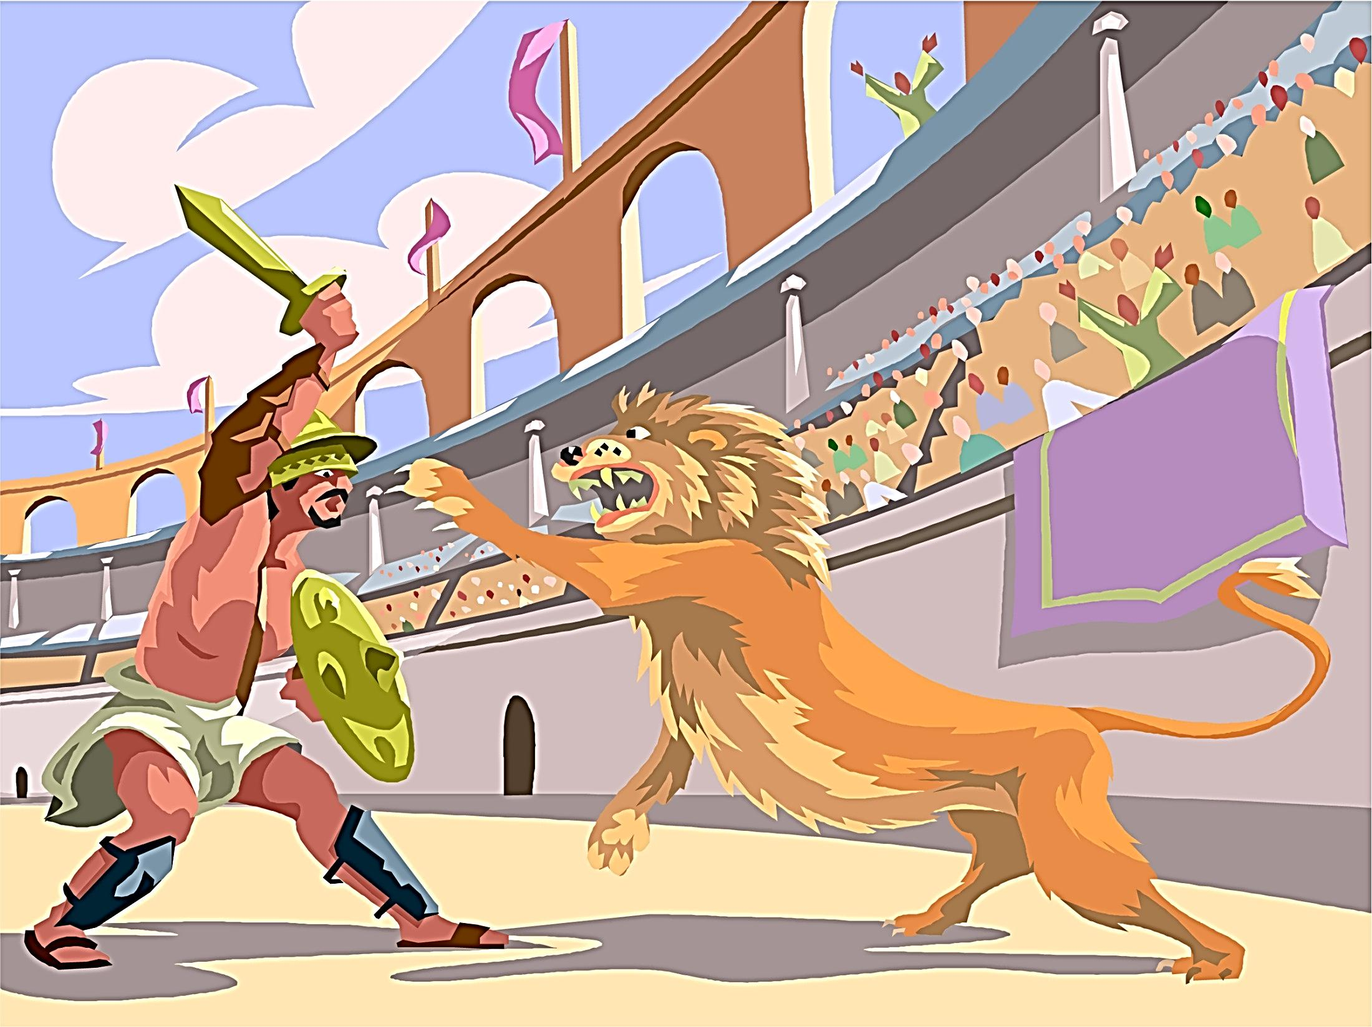

Key Stage 2 History
Roman Britain
Why have people invaded and settled in Britain in the past?

Slide 2
History Interactive
Teaching and Learning Resources
These are sample slides.
There are no audio, document links or internet links in this sample.
See all of our resources at
www.historyinteractive.co.uk
History Interactive Teaching and Learning © 2013

Slide 3
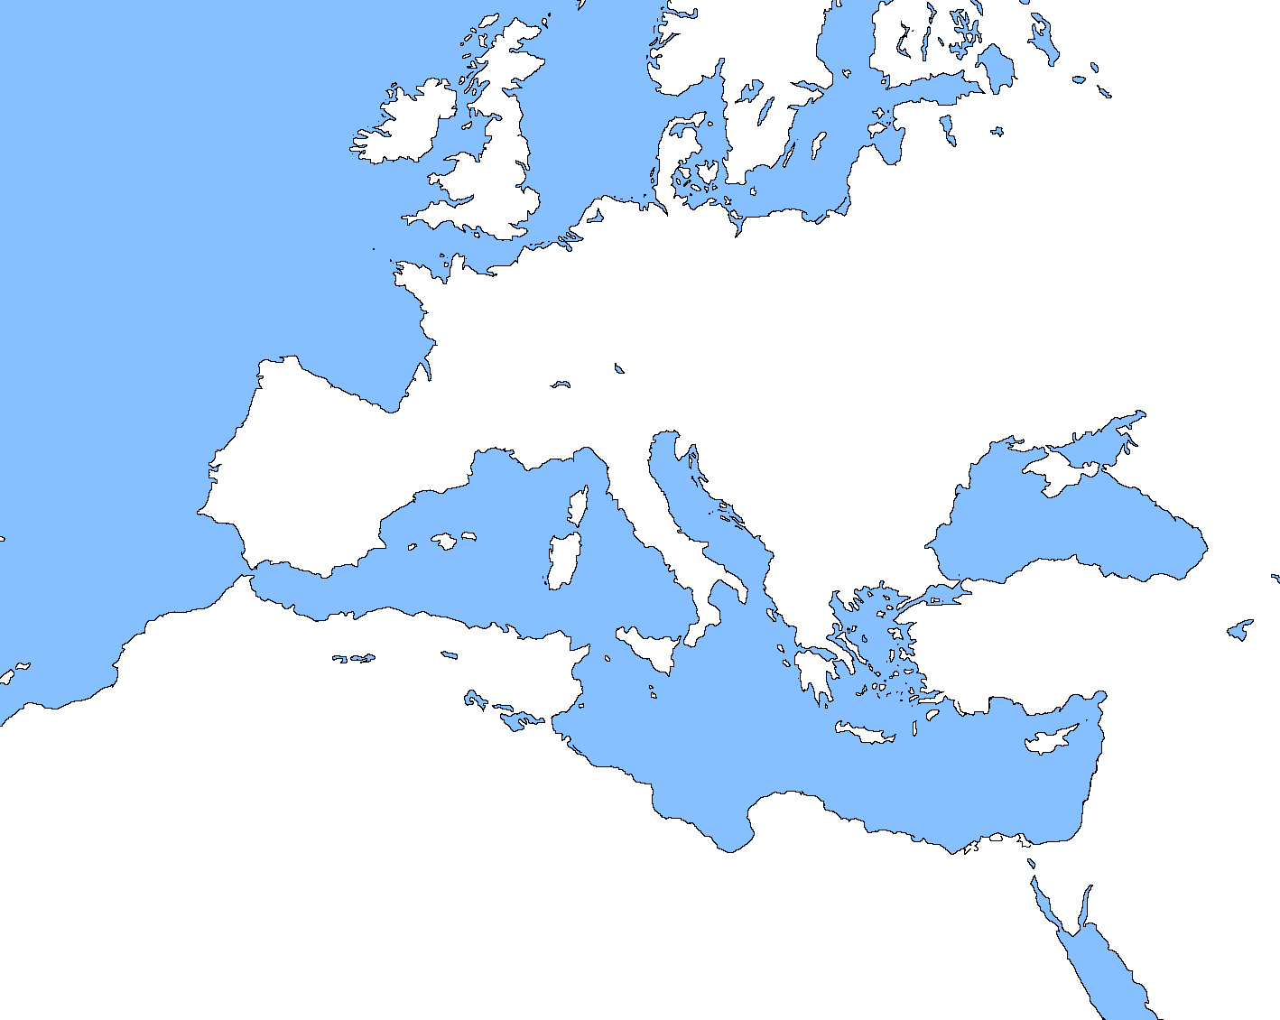
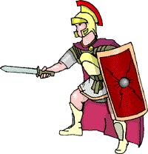


















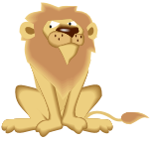





12
The Roman Empire
14 AD
The Roman Empire
121 BC
The Roman Empire
264 BC
The Roman Empire
201 BC
Britain
Germany
What was the Roman Empire?
The Romans became very successful in gaining more and more land. The Roman Empire was the land the Romans had conquered and controlled. The empire made the Romans the most powerful people in the world.
Gaul
Roman Trade
The Romans made a lot of money trading all over their empire. Having an empire meant money and power for the Romans.
Spain
Italy
Greece
Asia Minor
Sicily
North Africa
The Roman Empire and the trade they did.
This map shows how the Roman Empire grew.
Egypt
Roman Britain History Interactive ©

Slide 4
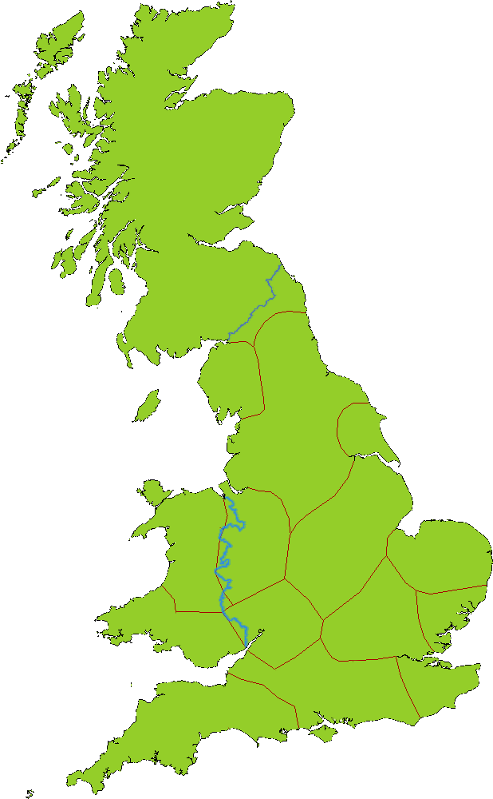
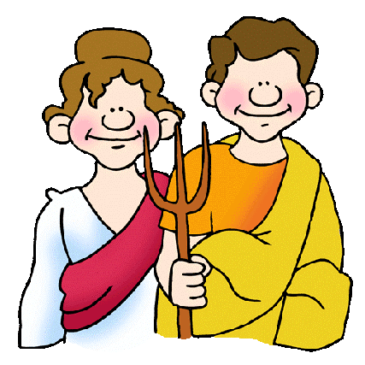
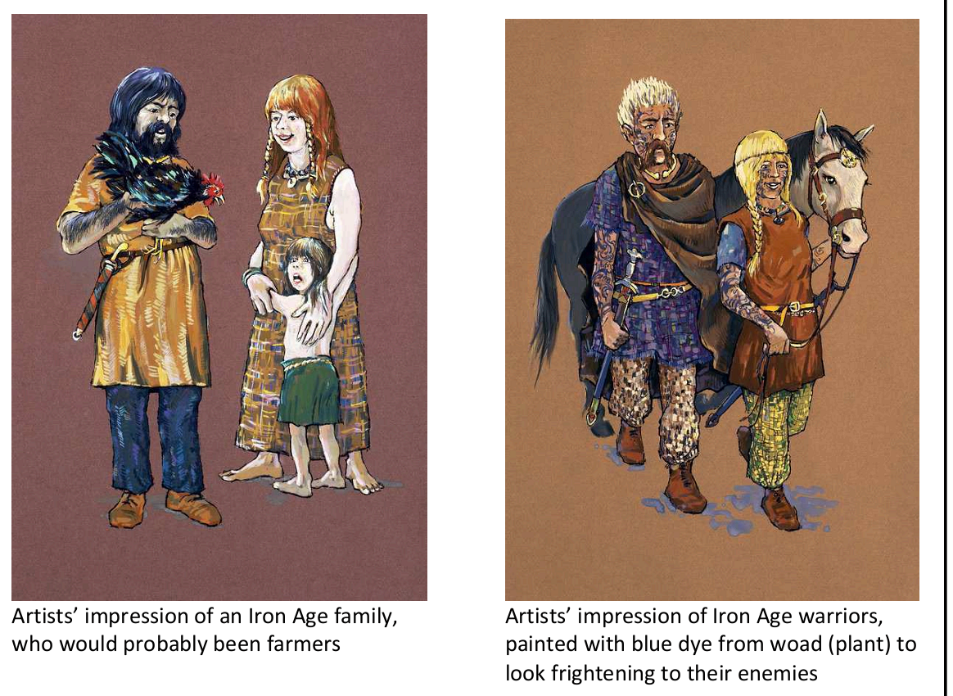
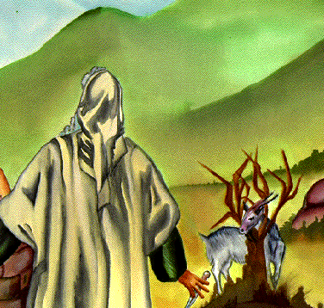
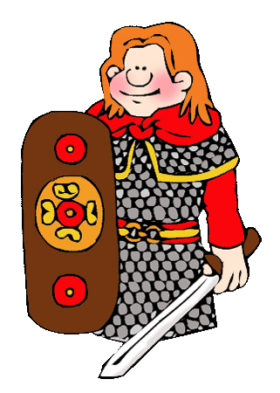
What did the Celts look like?
The Celts
15
Celts lived in farmhouses. They grew corn and kept sheep and cattle.
This map shows the different Celtic tribes before the Romans came to Britain.
The Celtic People
The Celts did not make up one country like Britain today. People belonged to different tribes. Each tribe had its own king or queen, whom people had to obey. Each leader had warriors to fight for them. The Celts were known as the Britons.
They worshipped different gods and goddesses. Druids [priests] made religious sacrifices.
Carvetii
Brigantes
Demetae
Coritani
Iceni
The Celts were fierce warriors and enjoyed sports and fighting.
Trinovantes
Silures
Dobunni
Catuvellauni
This is a picture of a Celtic family. The Celts were farmers.
This is a picture of Celtic warriors. The Celts were good fighters.
Regnenses
Cantiaci
Dumnonii
Roman Britain History Interactive ©

Slide 5
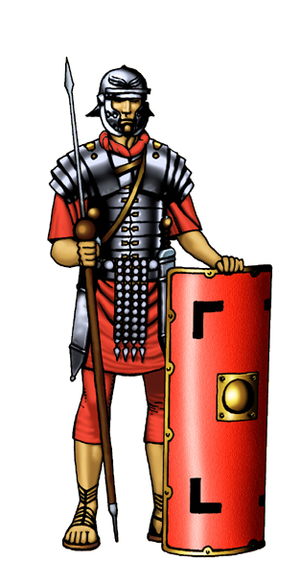
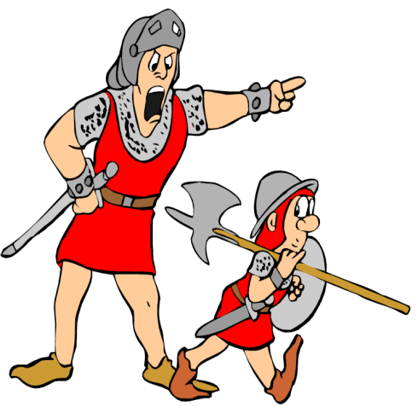
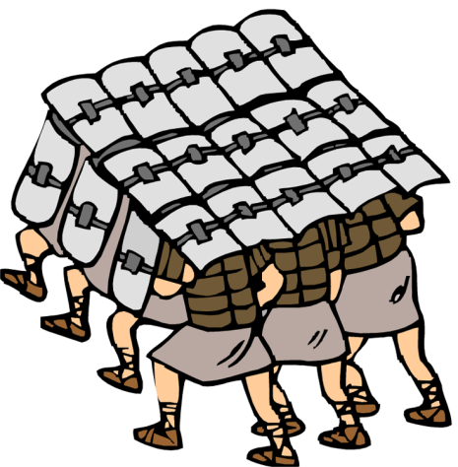
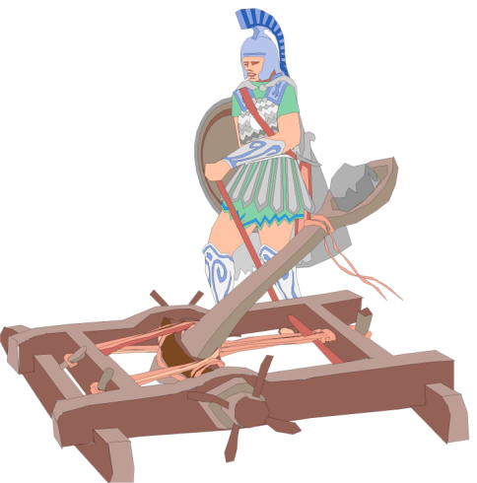
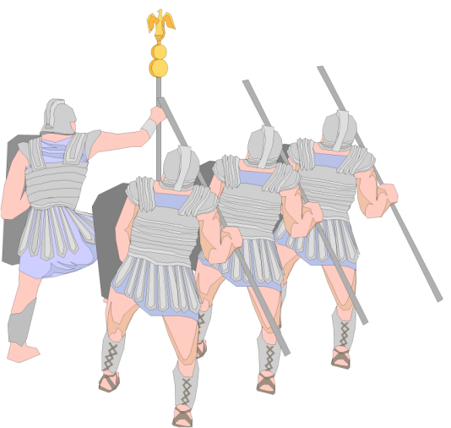


A Roman Legionary
Soldier
25
They never stopped training.
They were very organised.
They were well led.
They had better weapons.
They were very disciplined.
Helmet
Made of strips of metal. It was very heavy.
To become a legionary you had to be:-
A male
At least 1.75m tall
Fit and healthy with good eyesight
18-24 years old
Ready to serve for 25 years
Happy to be away from home for a long time
Javelin
About 2 metres long. Made of wood and iron.
Why was the Roman
army so successful?
Jacket
Made from iron plates held together by leather.
Sword
Made of iron with a wood or bone handle.
Dagger
This was attached to a belt with metal strips.
Tunic
Made of wool. Short trousers were also worn.
Shield
Made of wood strengthened with metal.
Sandals
Made of leather. Iron studs were on the sole.
Roman Britain History Interactive ©

Slide 6
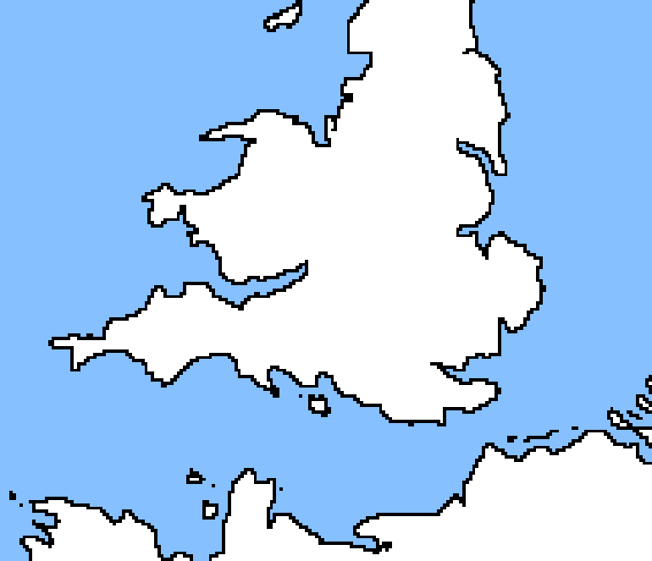

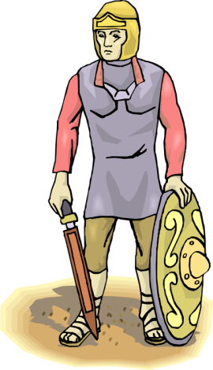

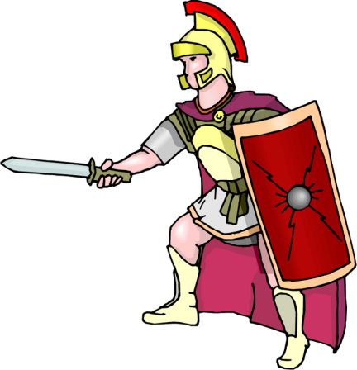


The Battle of 60 AD
❷ In 60 AD, Boudicca and her followers tried to force the Romans out of Britain.
31
❸ Boudicca attacked Colchester first.
❹ Her army then took control of St Albans and London.
The Romans killed 80,000 Britons. Only 400 Romans died.
Queen Boudicca had lost.
Boudicca led the biggest rebellion against the Romans in 60 AD. This animation tells the story of what happened to Boudicca and her army.
Britain
Wales
❺ The Romans had to call their army in Wales to help out.
Iceni
Colchester
St Albans
❻ Boudicca and her army was pushed north into open country and defeated.
London
Londinium
❶ The Romans invaded Britain in 43 AD. Their army travelled from Gaul.
Gaul
Roman Britain History Interactive ©

Slide 7
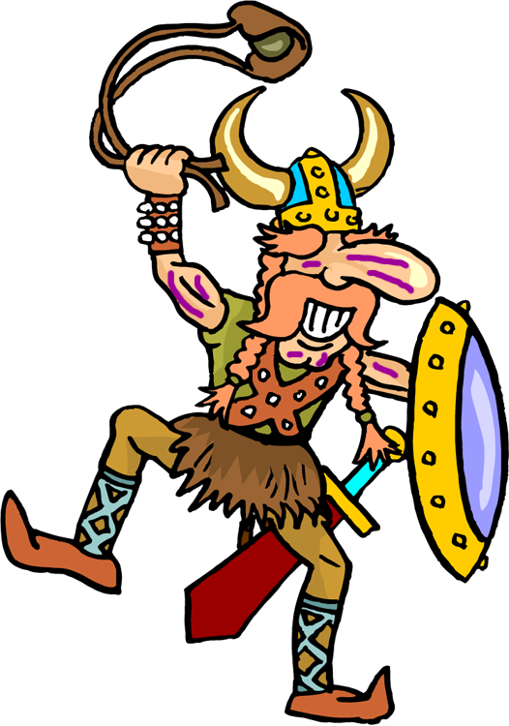

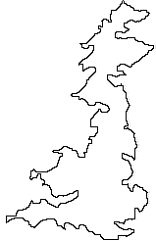
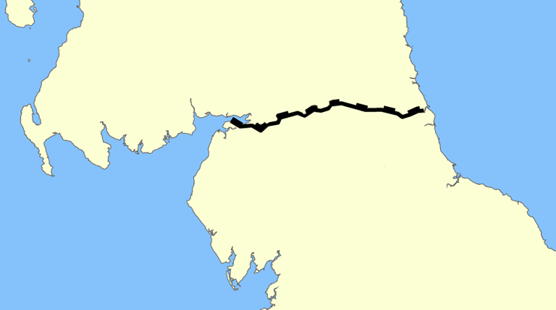
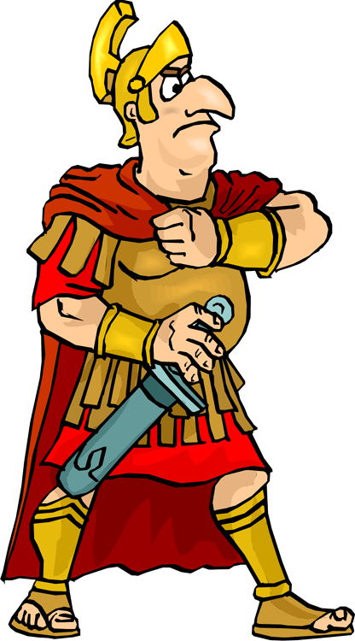
The Romans called the Scots picts because the Scots used to paint their face to make themselves look more frightening.
35
The wall was built across the narrowest part of Britain.
The wall was 117km long and 6.5m tall. It took 7 years to build.
Scotland
Caledonia
Hadrian’s Wall
The Roman Emperor at the time was
called Hadrian. He came to Britain to
see why his army was not winning the
war against the Scots. In 122 AD, Emperor Hadrian told his men to built a long wall from one side of Britain to the other. This wall would keep out the Scots.
Barrow on Solway
Wallsend
The North Sea
The Romans and Scotland
The Romans quickly beat the British
tribes. They then wanted to defeat the
Scots. A Roman army was sent to
Scotland. It won a lot of battles but could
not beat all of the Scottish tribes.
Hadrian’s Wall
Hadrian’s Wall
Solway Firth
Roman Britain in 117 AD
The Romans decided not to invade such a large country so, they built a wall to keep the Scots out.
The Romans began building the wall in 122 AD.
The Scots tried three times to destroy the wall but it was rebuilt.
The English
Channel
Roman Britain History Interactive ©

Slide 8
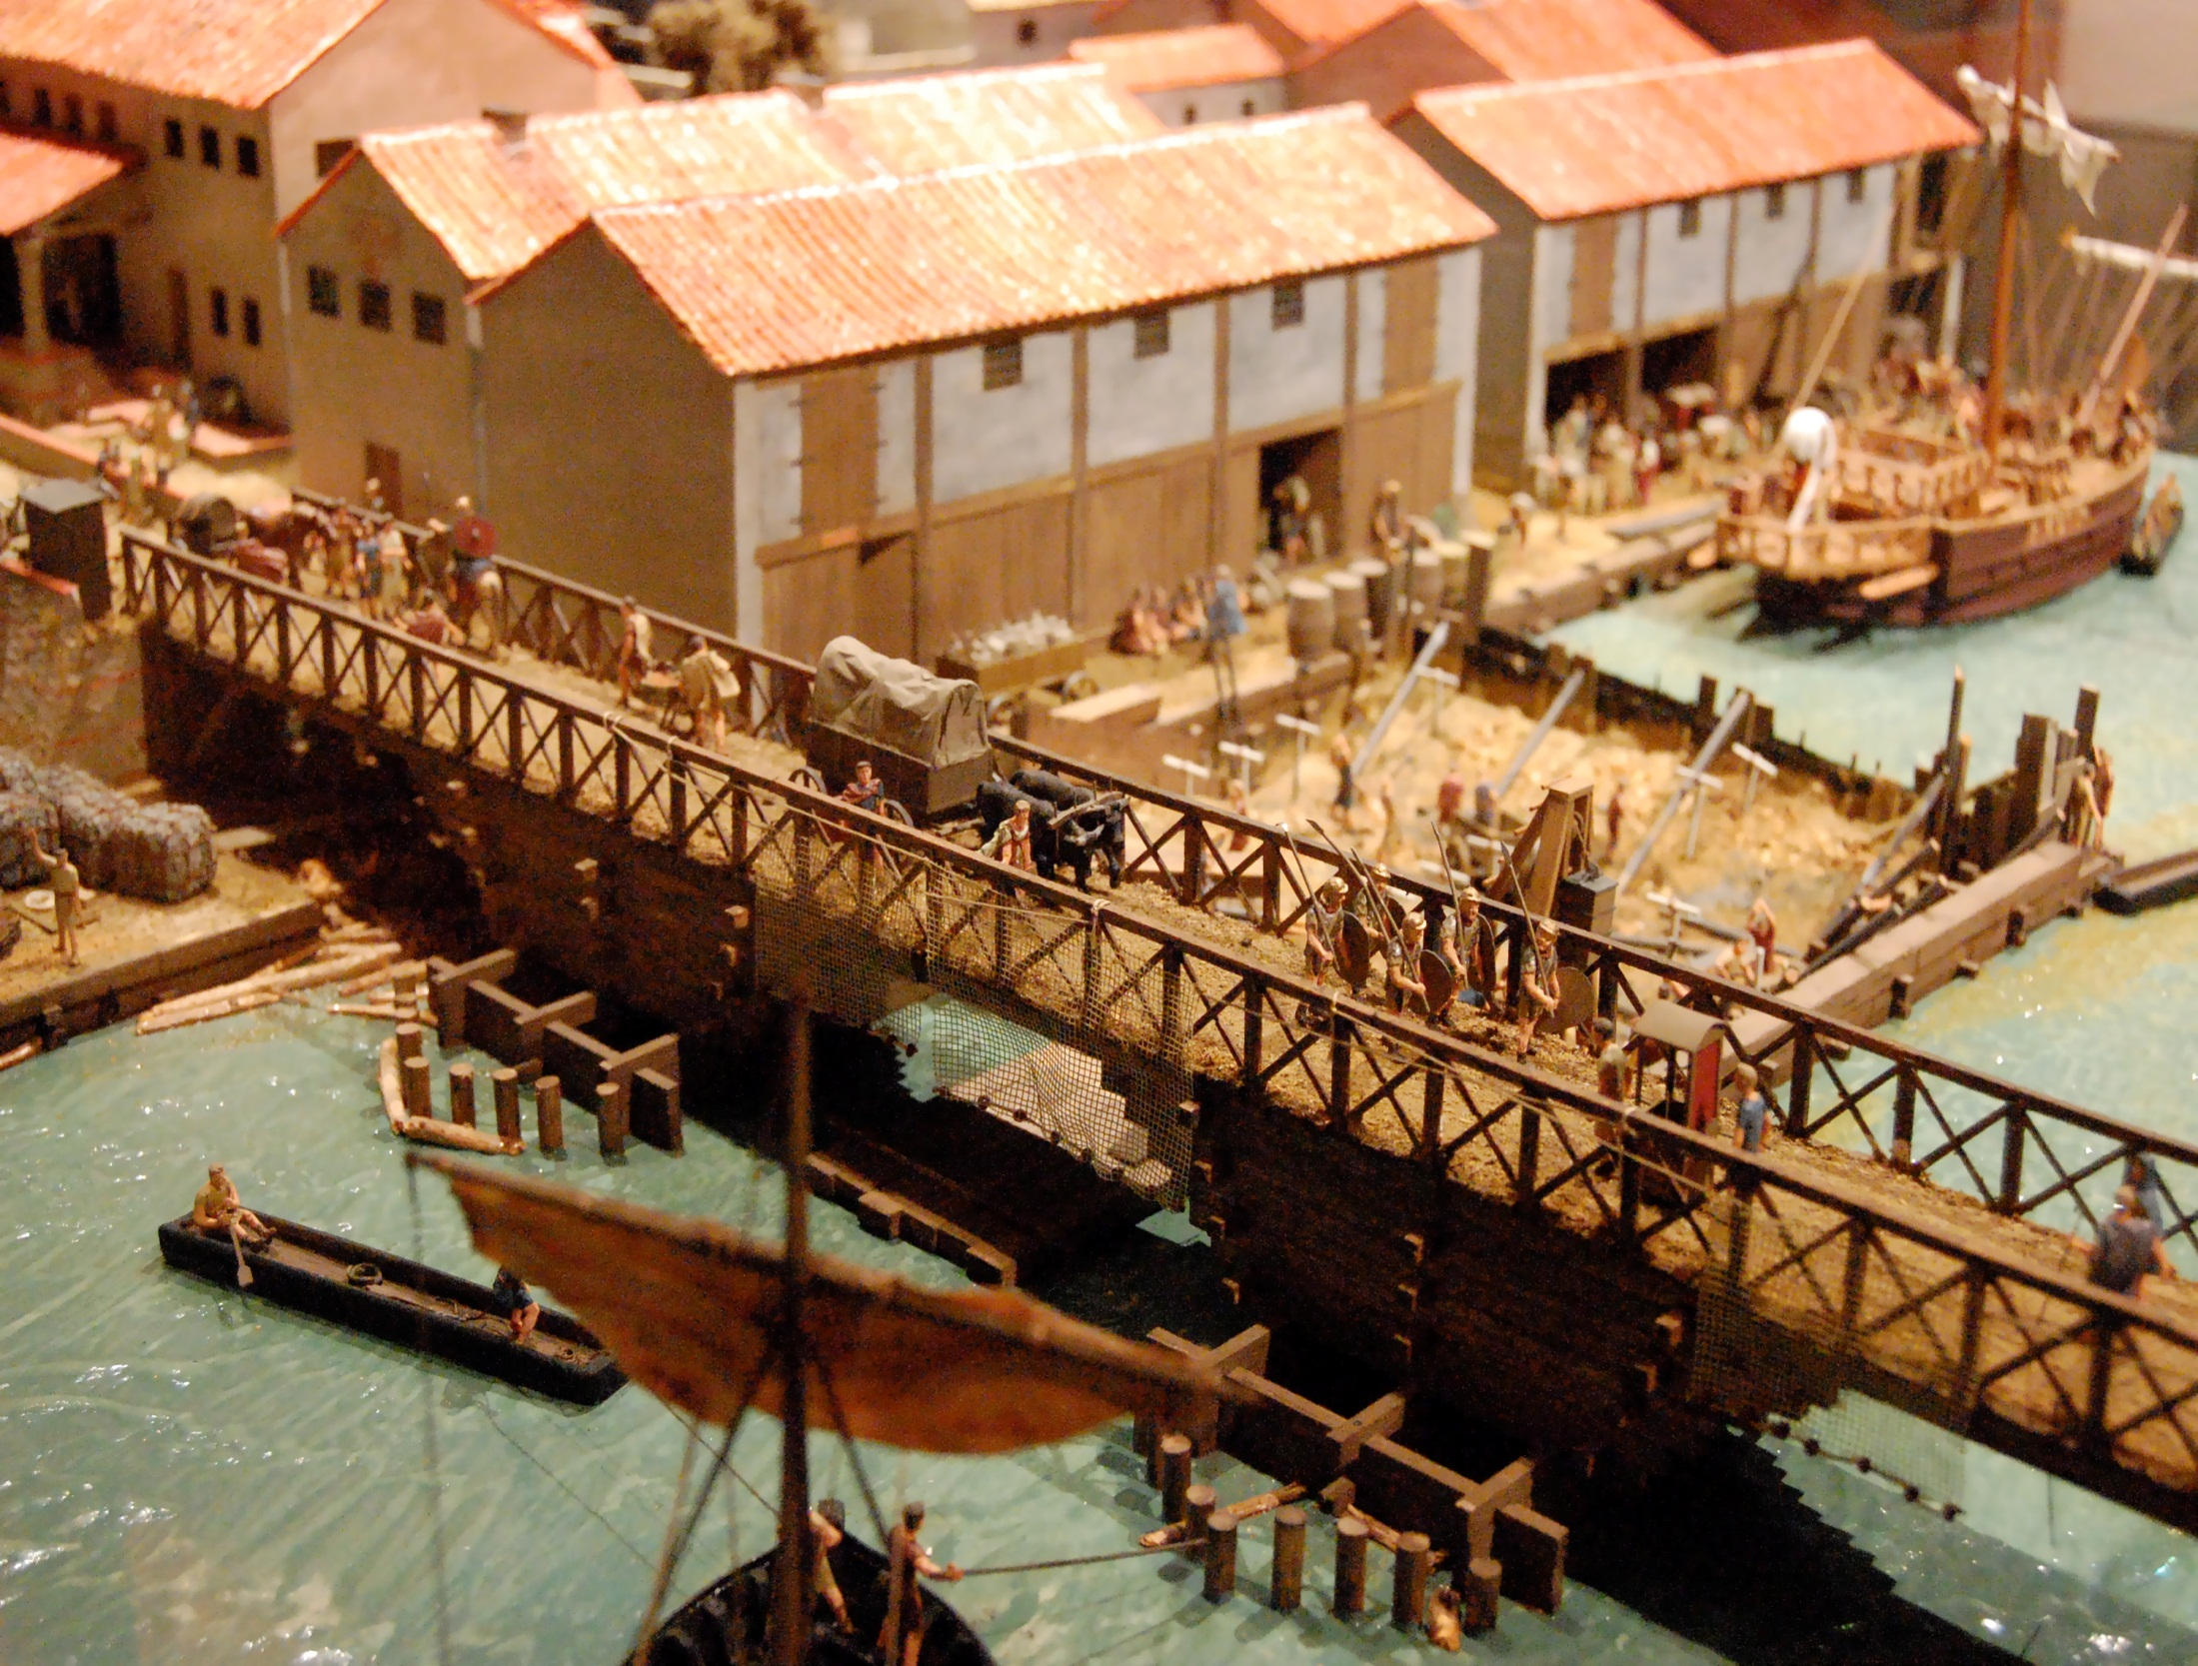
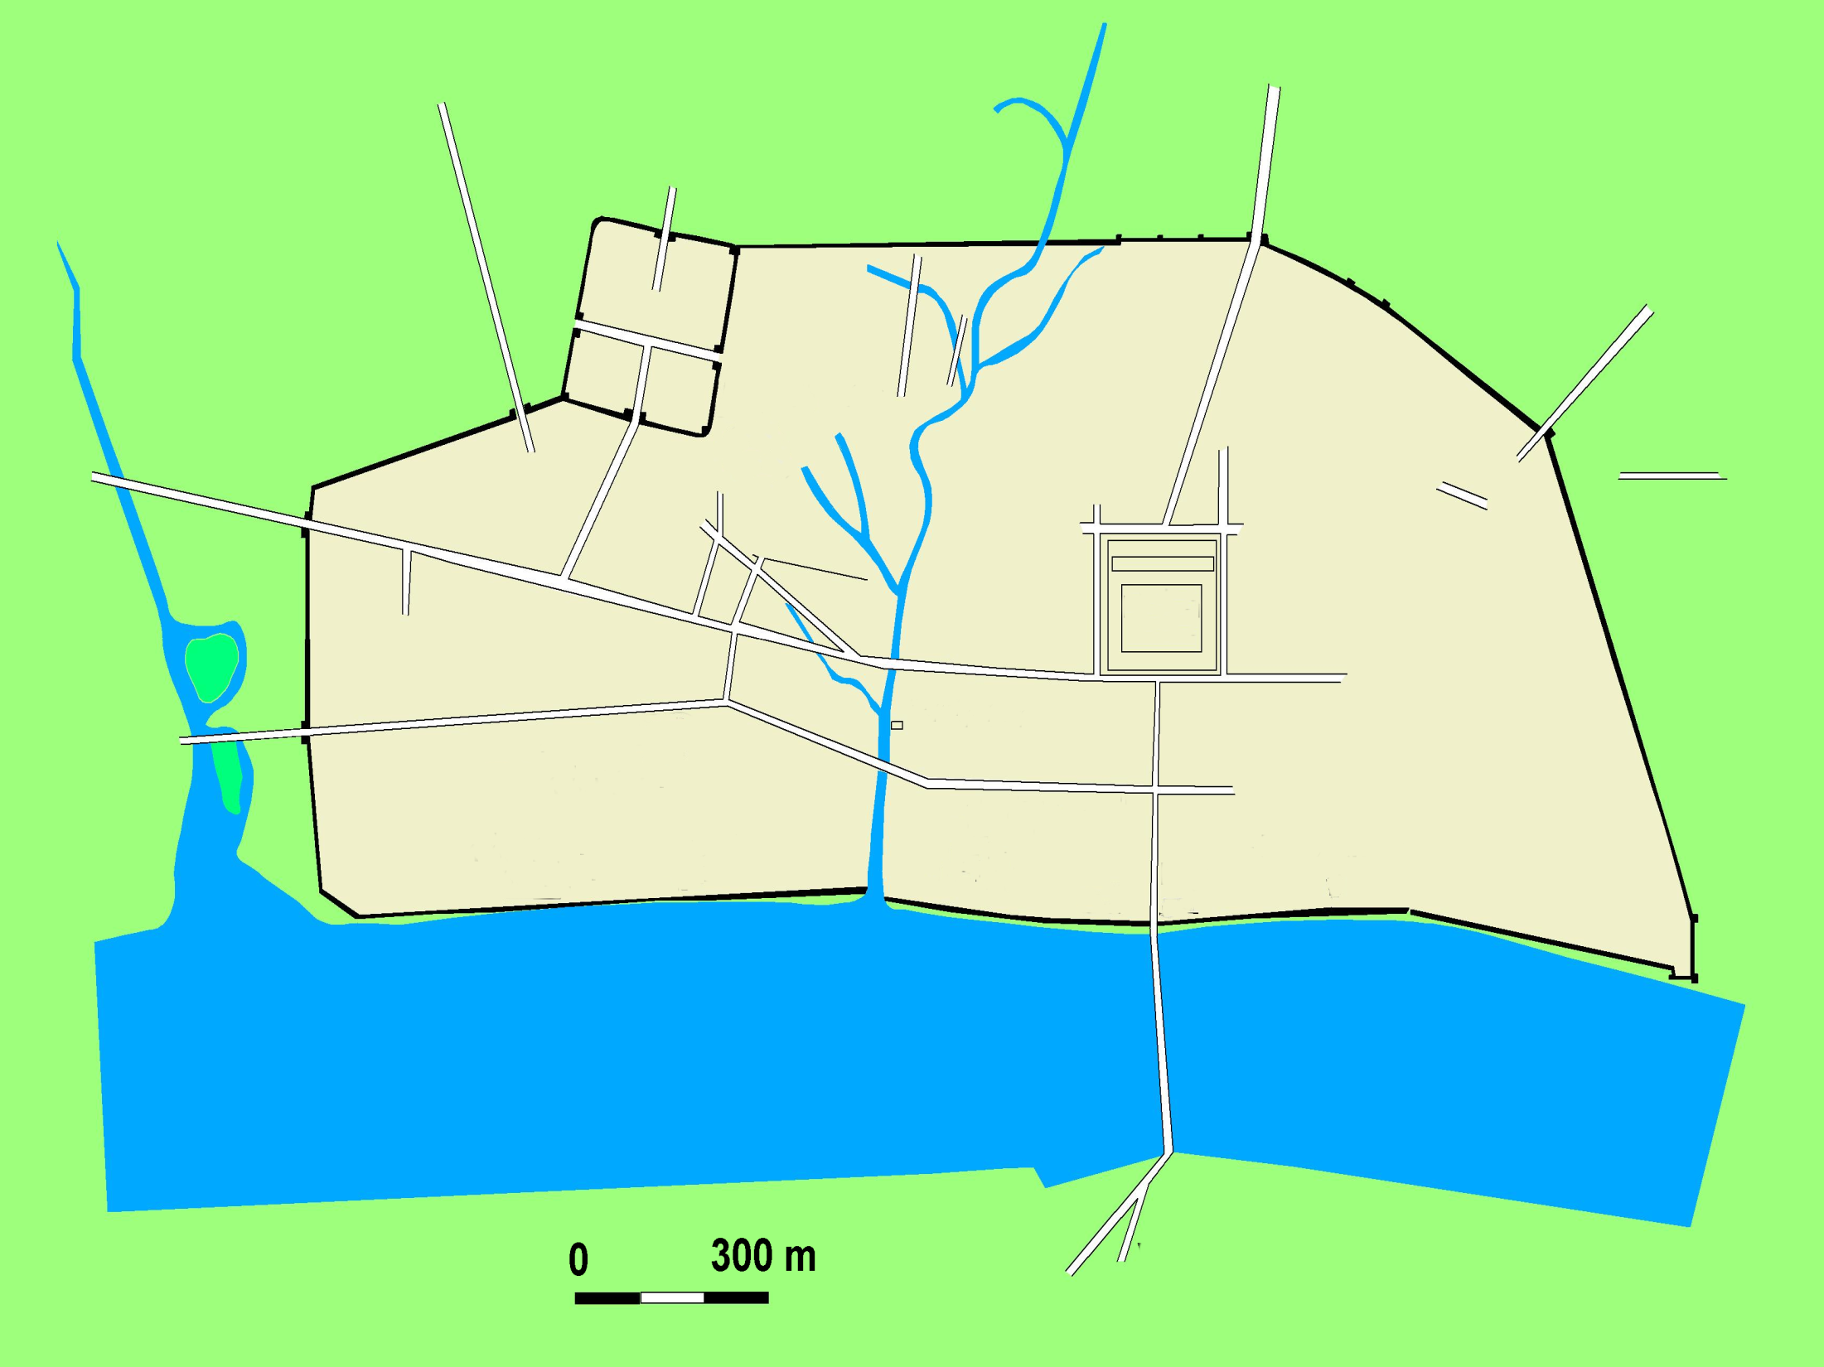
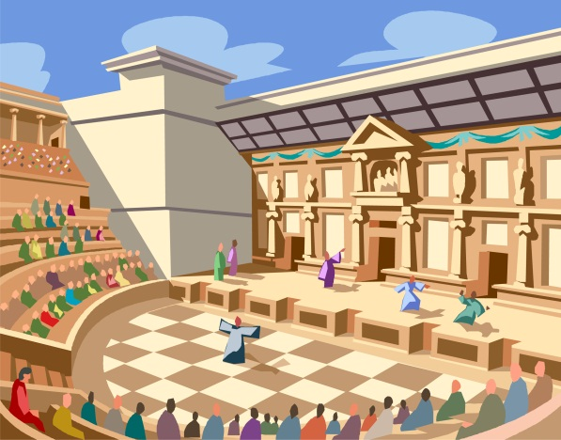
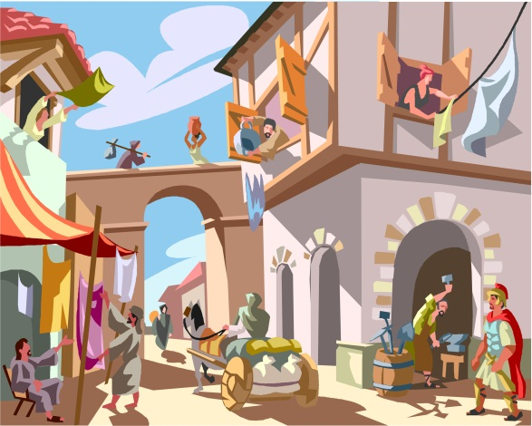
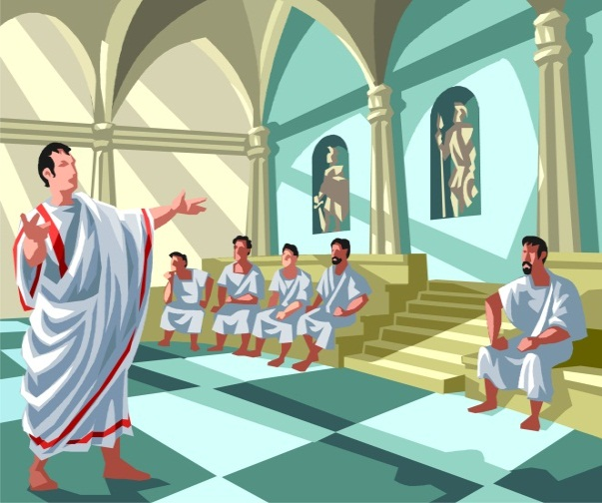
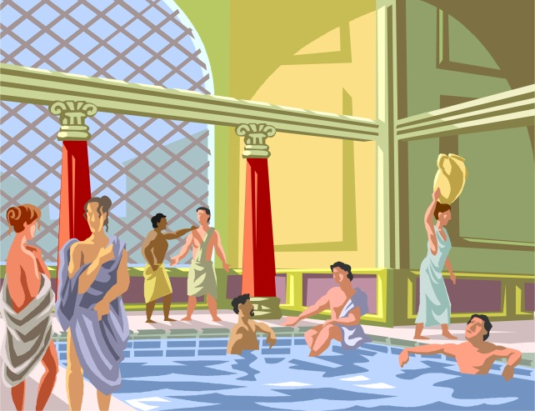
A model of London in Roman times
A town plan of Roman London
42
Amphitheatre
Forum
Fort
The Romans built towns
One change that the Celts would have noticed was that the Romans built towns all over Britain. London began as a fort called Londinium which was built on the north bank of the River Thames. Roman towns were very organised, with straight roads and neat rows of buildings.
This was used for entertainment and gladiator fights.
This was the market square with shops and meeting places.
Forum
Town Hall
Bath House
The River Thames
This is where people went to have a bath and do exercise.
This is where the important officials met to run the town.
Roman Britain History Interactive ©

Slide 9

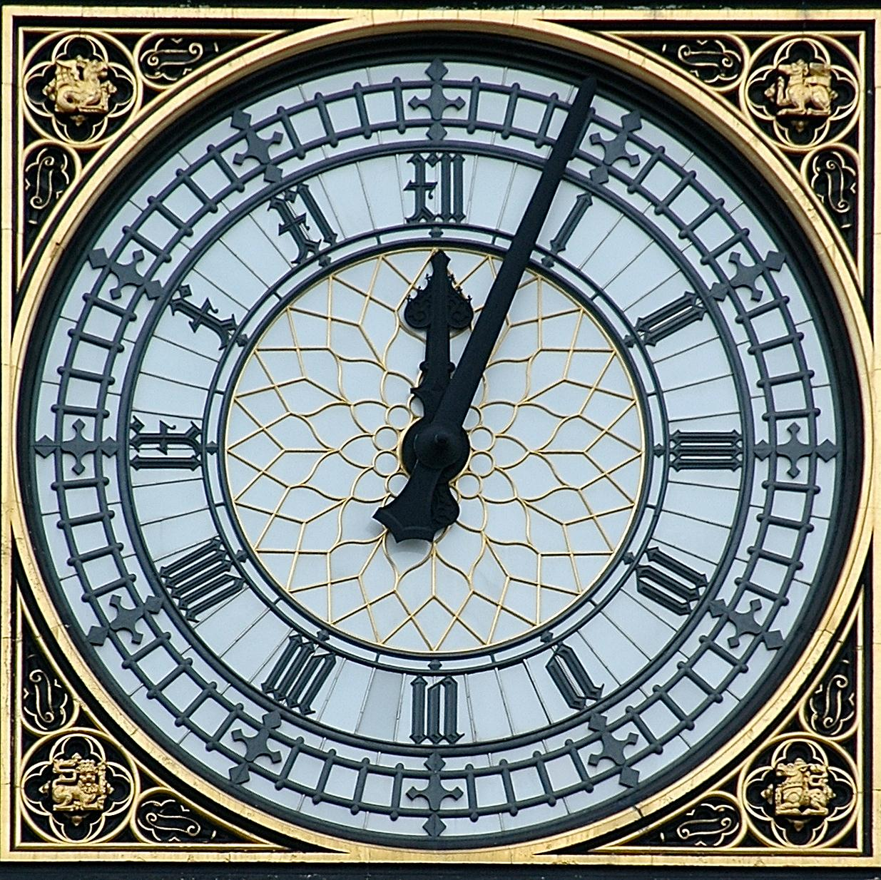







Roman Numerals
50
I | II | III | IV | V
1 | 2 | 3 | 4 | 5
VI | VII | VIII | IX | X
6 | 7 | 8 | 9 | 10
L | C | D | M
50 | 100 | 500 | 1000
Can you work out
what these Roman
numerals mean?
Roman Numerals
The Romans left behind their system of numbers which was made up of just seven letters.
We still use Roman numerals today. They are most often seen on clock or watch faces. The hours are marked as I to XII.
The clock face on ‘Big Ben’.
Roman Britain History Interactive ©

