Slide 1
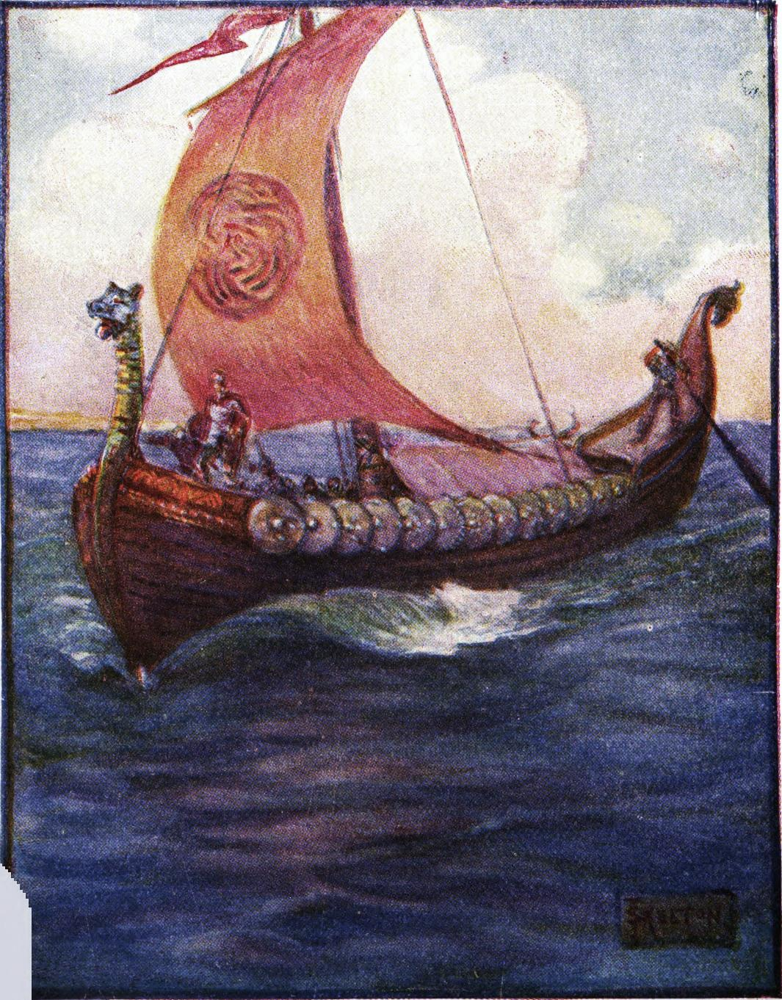

Key Stage 2 History
The Invaders
Anglo-Saxons and Vikings

Slide 2
History Interactive
Teaching and Learning Resources
These are sample slides.
There are no audio, document links or internet links in this sample.
See all of our resources at
www.historyinteractive.co.uk
History Interactive Teaching and Learning © 2013

Slide 3
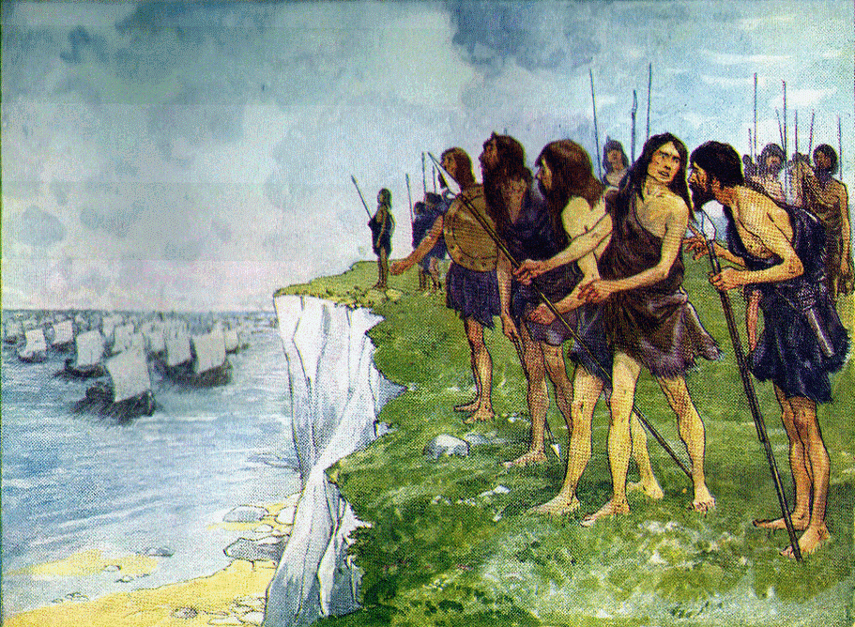
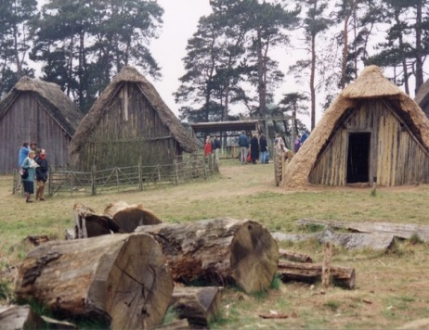
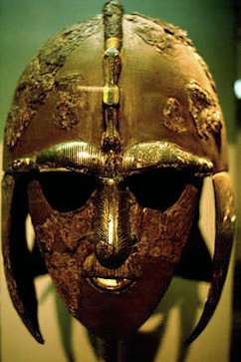
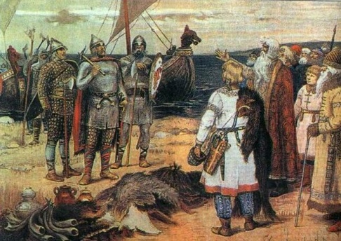
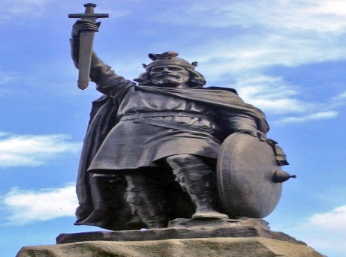
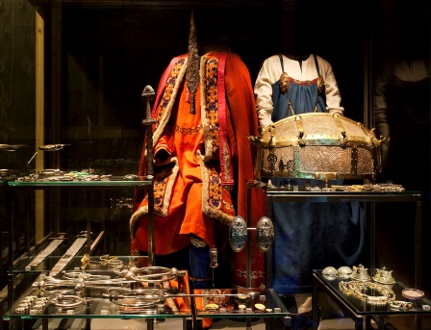



The Saxons and Vikings
2
The end of the
Romans in Britain
The Anglo-Saxons
Sutton Hoo
Content Slides
How do we know?
The Vikings
Alfred the Great
Print work booklet
Watch Video
Do the end of topic test

Slide 4
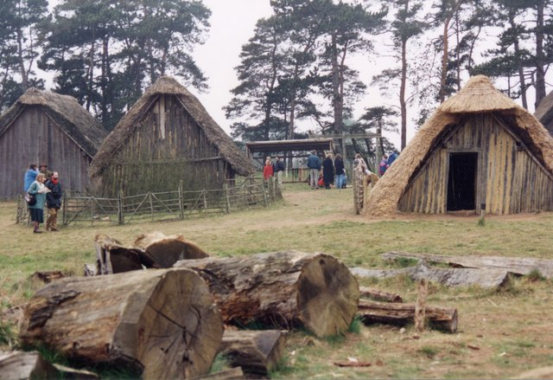

17
Section 2
What was life like in Anglo-Saxon England?
In this section you will find out how people lived in Anglo-Saxon England. Where did they live and build their homes, what did they make and what did they believe in?
What was life
like in Anglo-Saxon
England?
The Invaders History Interactive©

Slide 5
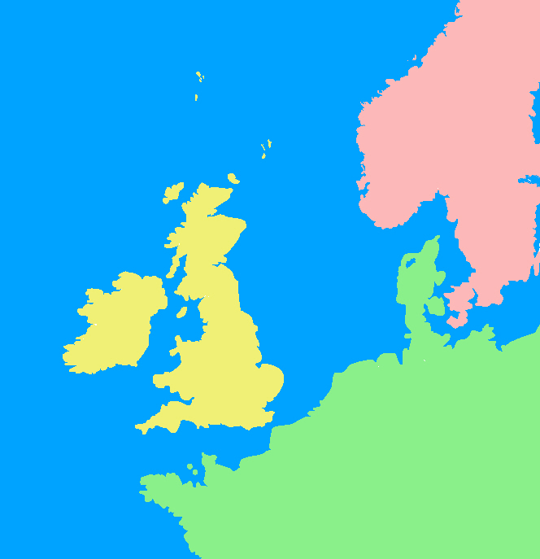
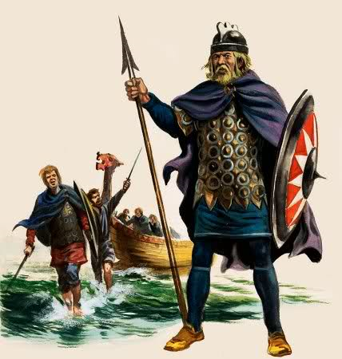
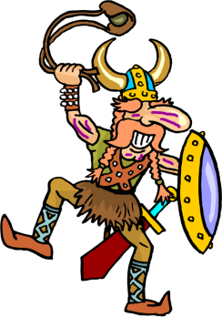

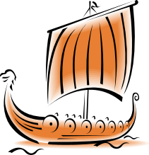
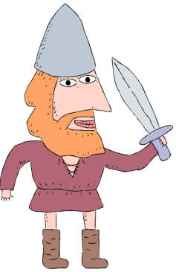
The Anglo-Saxons invade
13
❹ Other people came from Denmark and North Germany.
❺ They then defeated the Celts, took over and lived in England.
❸ At first, the Saxons came to England to help and trade with the Celts.
❷ The leader of the Celts asked the Saxons for help.
❶ The Picts and Scots invaded England after the Romans left.
Why did the Anglo-Saxons come to England?
They came to help the leader of the Celts.
The land in Germany and Denmark was not good for farming.
They spotted that Britain had good farming land.
The Romans had gone and Britain was not protected.
The Anglo-Saxons invade Britain.
Norway
Sweden
After the Romans left, Britain warriors called the Angles, the Saxons and Jutes came to England. We called them the Anglo-Saxons.
Picts
The
North Sea
Denmark
Jutes
Scots
Saxons
Celts
England
Angles
North
Germany
Scots and Picts
Saxons
Jutes
Angles

Slide 6
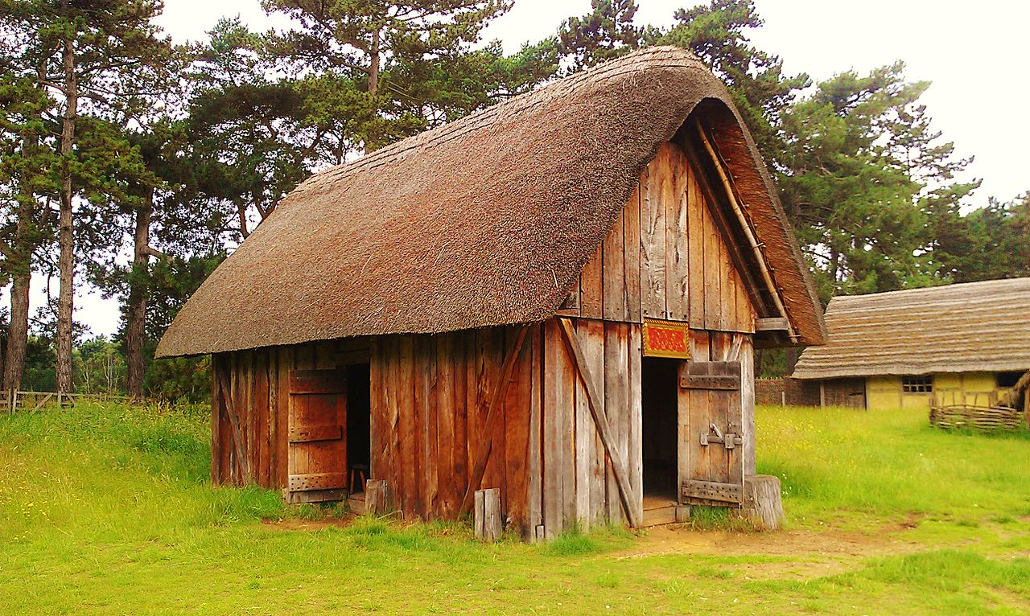
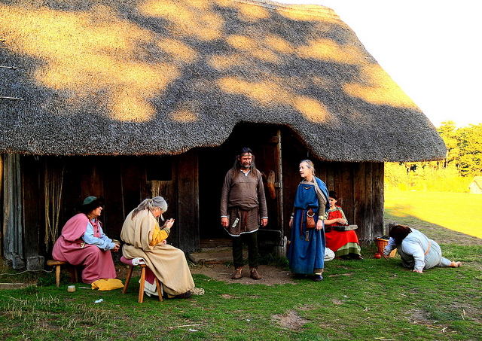
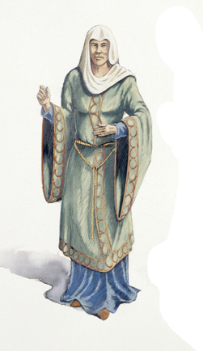
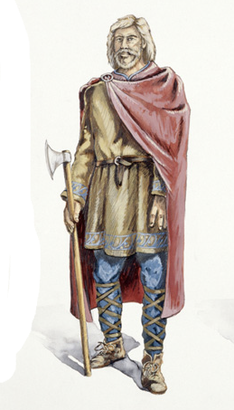



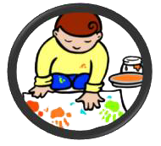
What did the Anglo-Saxons wear?
What happened in the Great Hall?
A reconstruction of the Great Hall at West Stow Anglo-Saxon Village.
29
Actors at West Stow dressed as Anglo-Saxons.
Cloaks which were fastened with brooches.
Feasting
The Great Hall would be used for feast nights and celebrations.
Everyone in the village would eat and drink all night.
Music
During feasting, a minstrel sang songs and people danced.
Instruments were the lyre, whistles and harp.
Stories
The Anglo-Saxons told stories about warriors and gods.
They also liked making up long poems.
Head covered with a scarf or hood called a wimple.
How do we know what Anglo-Saxons wore?
We cannot be sure exactly what the Anglo-Saxon would have worn, but we can make a guess from objects found in graves and from drawings in Anglo-Saxon books. Poor Anglo-Saxons would wear clothes made of woollen cloth. The rich could afford finer cloth made from linen.
An Anglo-Saxon Great Hall
One of the most important houses in an Anglo-Saxon village was the great hall. The hall was like a big barn. The villages would often eat their meals together in the hall. It was also used for feasts, celebrating victories in battle and listening to stories and music.
A belt around waist.
Ankle-length tunic.
Knee-length tunic.
Women wore a lot of jewellery on their hands and strings of beads around their waist
Trousers or leggings.
Leather garters.
Leather shoes.
A long plain dress.
The Invaders History Interactive©

Slide 7
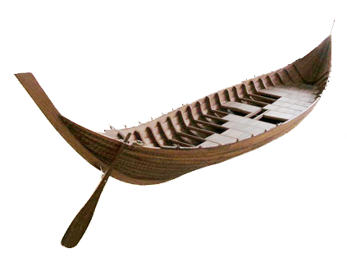
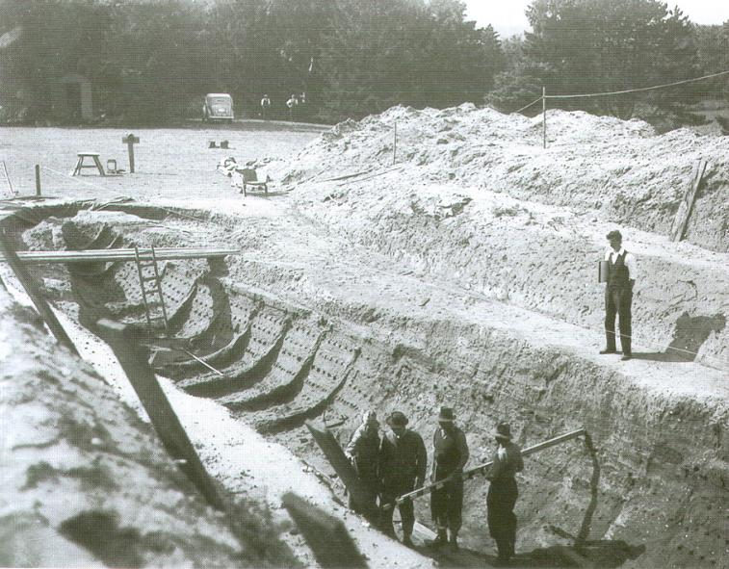
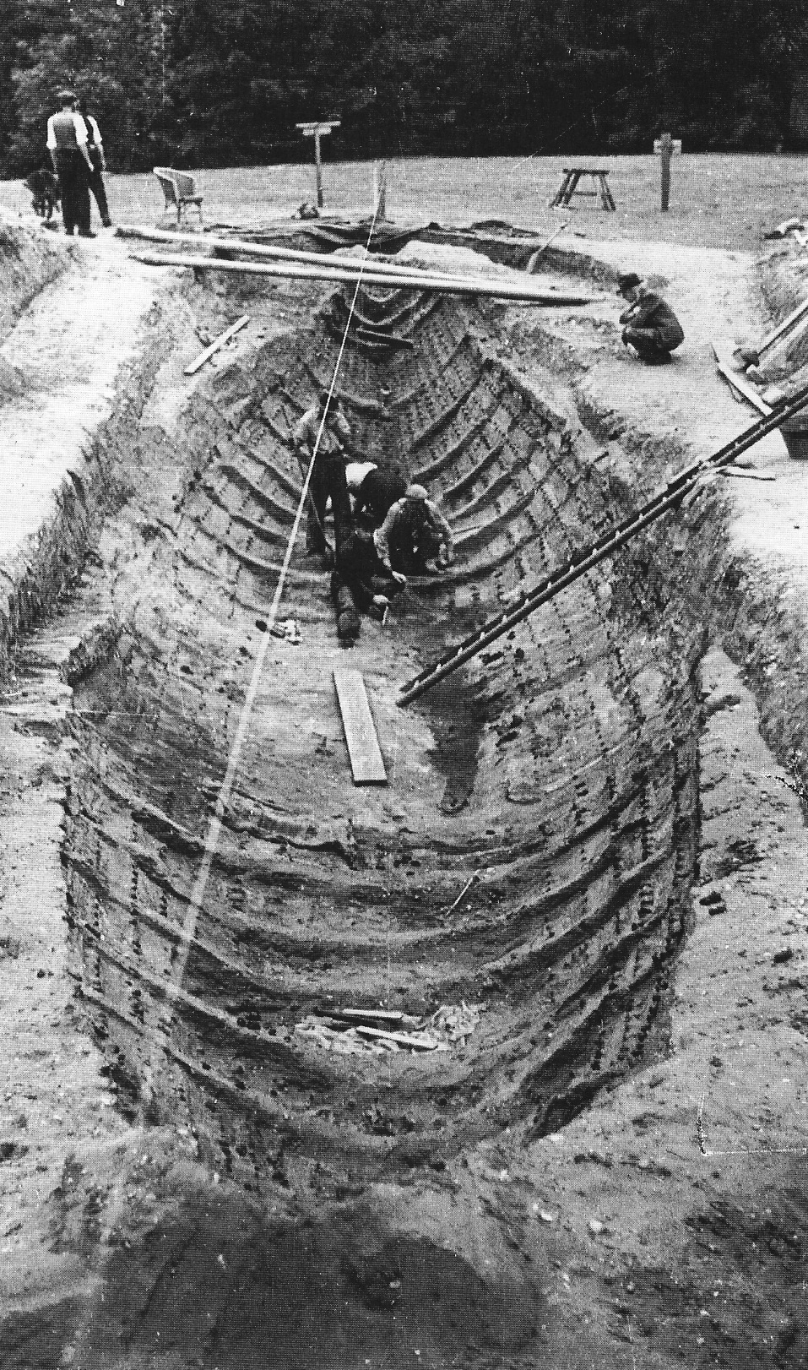
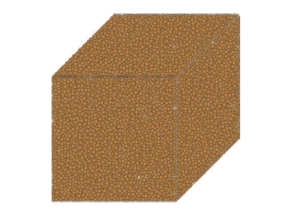
Archaeologists think the ship would have looked like this. In the middle of the ship there was a wooden chamber. Inside the chamber archaeologists found the richest collection of treasures ever found in Britain.
What did they find at Sutton Hoo?
36
The ship was 27.5 metres long and 4.5 metres wide. The ship had no sail or mast.
They discovered an outline of a very large ship.
There were a group of earth mounds at Sutton Hoo.
Archaeologists opened up the largest mound.
This is the burial chamber.
The wood had rotted away and turned the sandy soil a darker colour.
4.5 metres
All that was left of the ship were the rusty nails that held the ship together.
The ship was rowed along the River Deben and then dragged to the burial site.
They laid it in a large hole, filled in the soil and made a earth mound on top.
27.5 metres

Slide 8
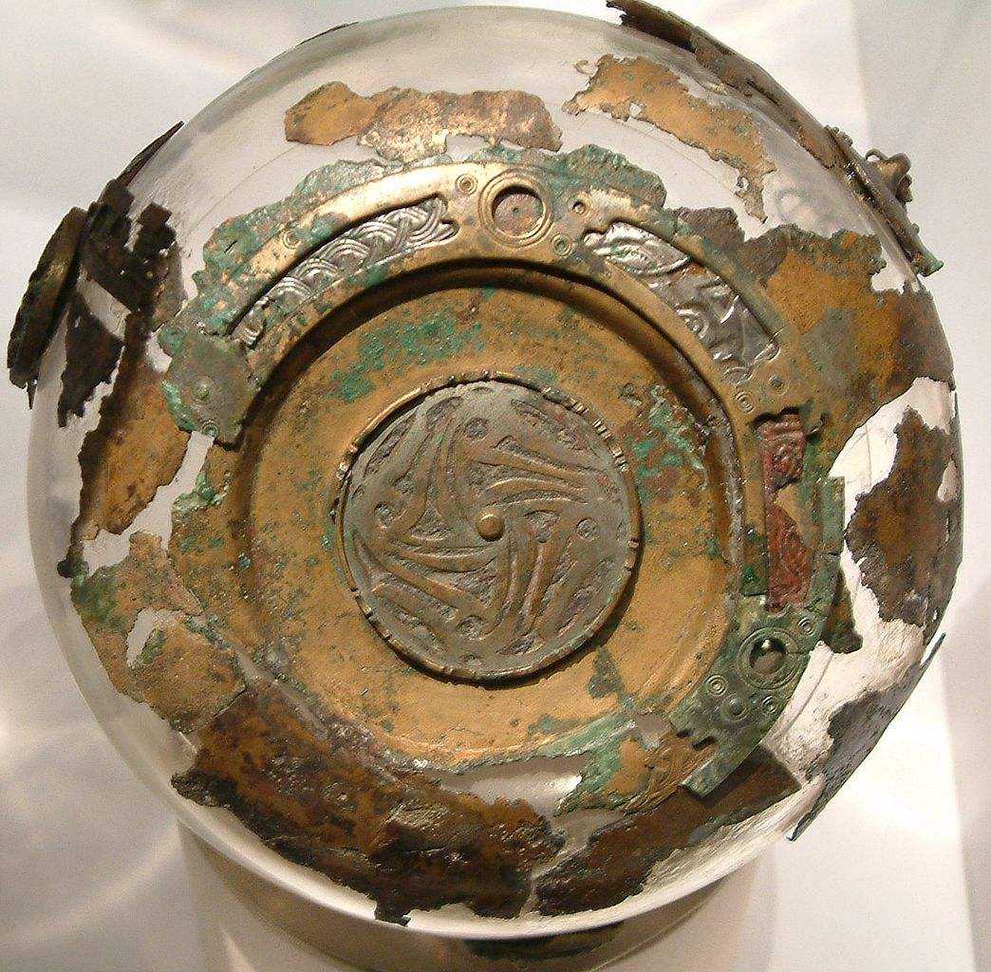
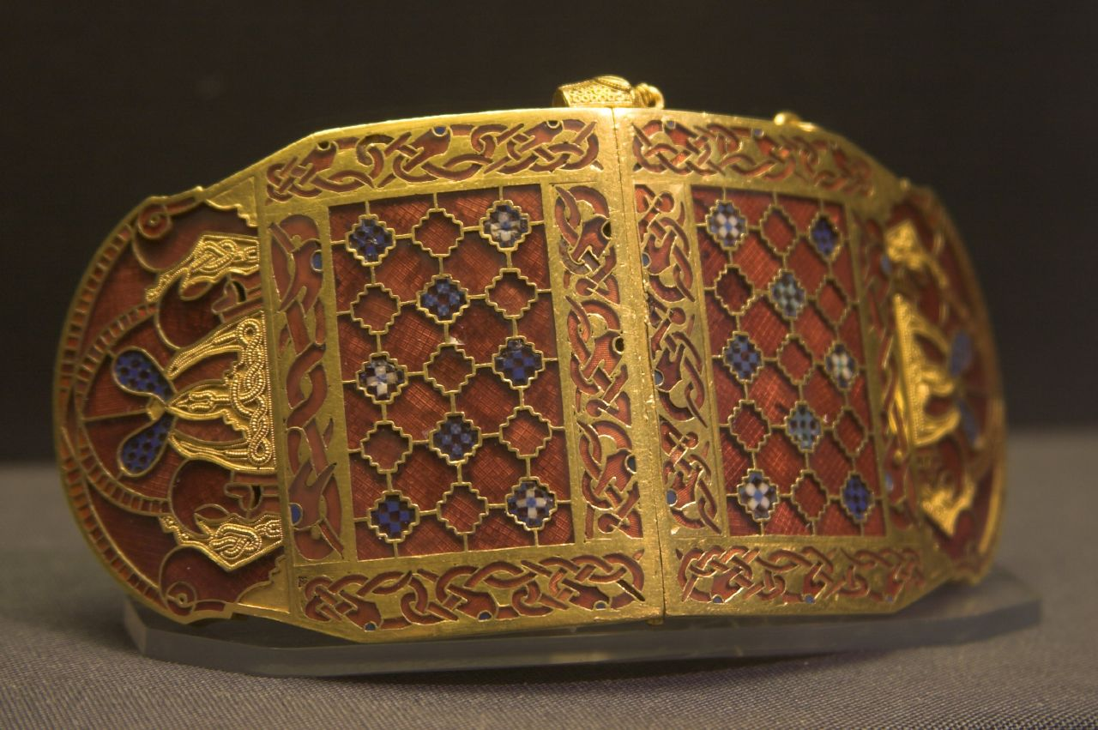
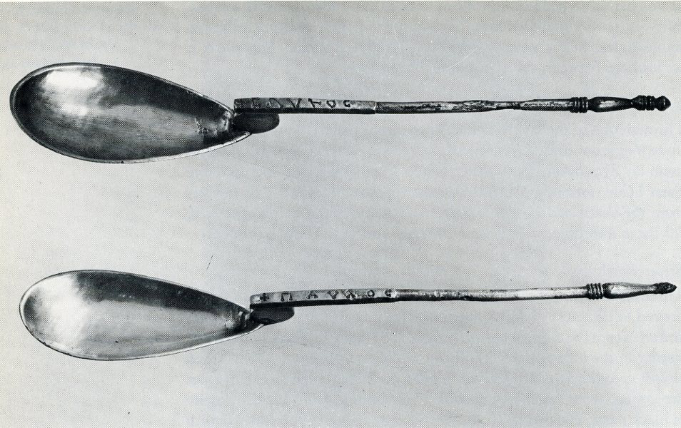
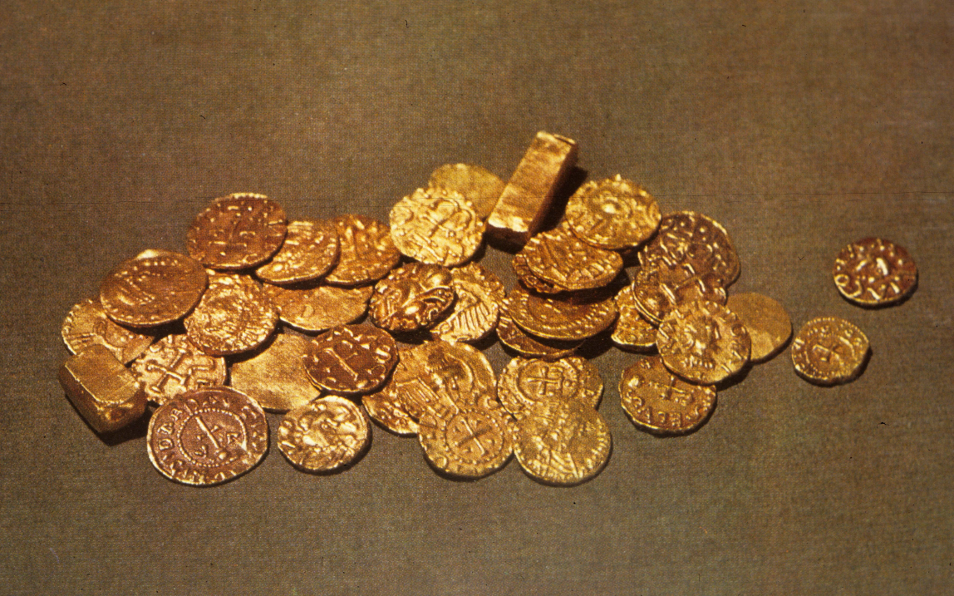
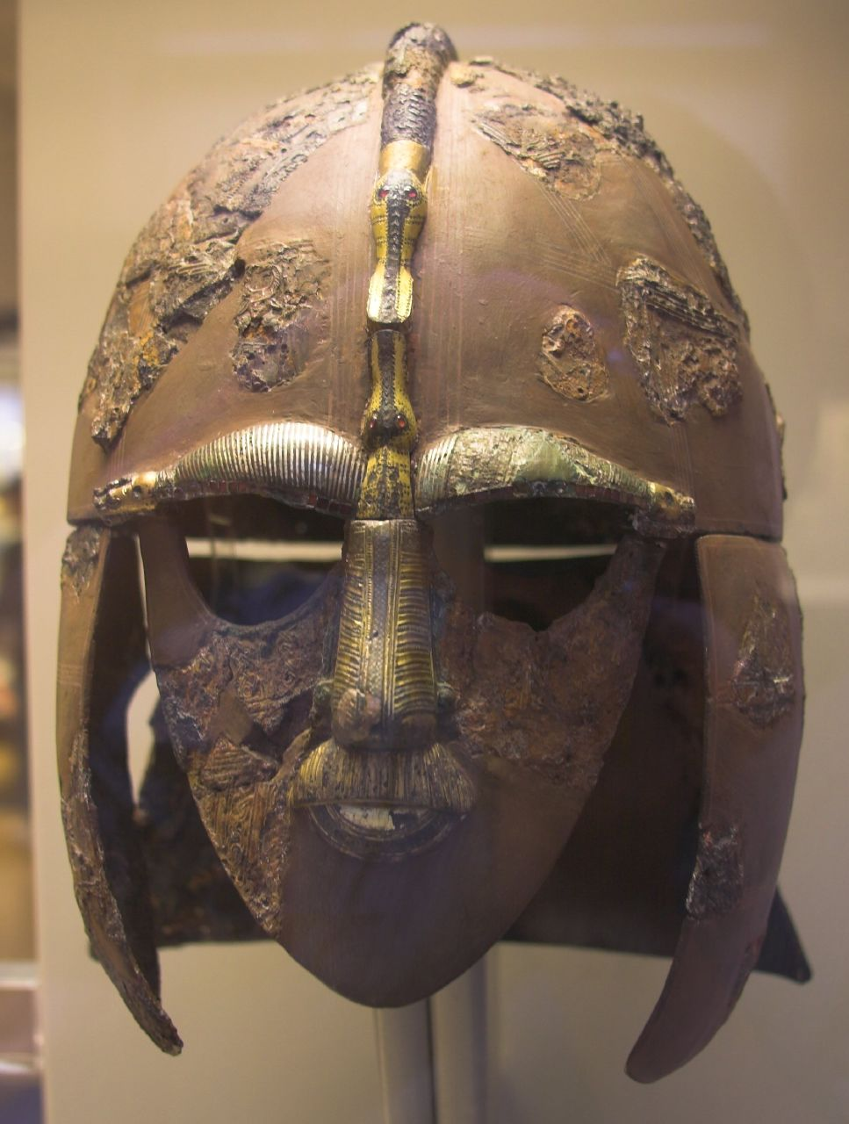
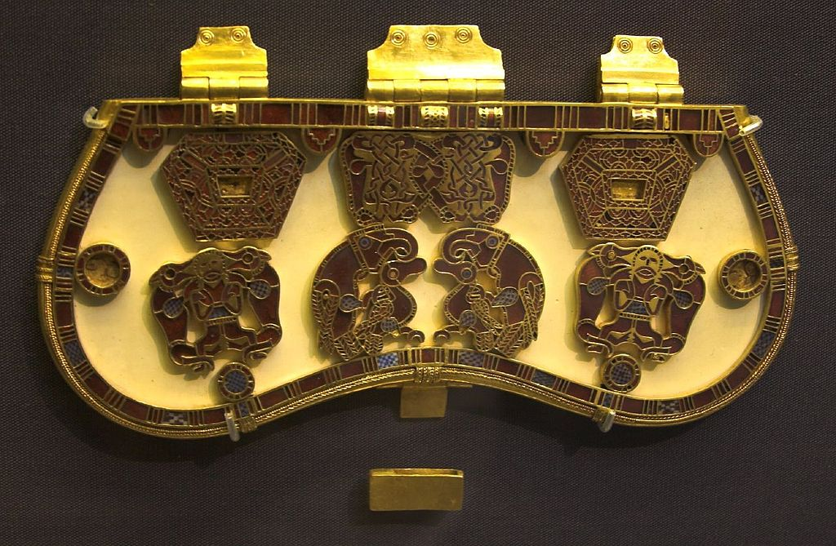
Object 1 Coins
The date tells us when the ship was buried.
Object 2 Hanging bowl
They were skilled using bronze and silver.
Object 3 Helmet
They were warriors and fighters.
Object 4 Purse Lid
They used precious metals like gold.
Object 5 Shoulder Clasp
They were skilled craftsmen.
Object 6 Silver Spoons
They were Christians.
What the objects at Sutton Hoo tell us.
Sutton Hoo Object 1
Sutton Hoo Object 4
A purse lid.
It was made of bone or ivory with gold hinges. It is decorated with pictures of birds and animals. The purse held gold coins.
Sutton Hoo Object 2
Sutton Hoo Object 3
38
Sutton Hoo Object 5
Sutton Hoo Object 6
What do the objects found in the Sutton Hoo burial ship tell us about the Anglo-Saxons?
The objects found at Sutton Hoo tell us a lot about Anglo-Saxon life. Look at the objects, describe what they are and then decide what they can tell us about the Anglo-Saxons and how they lived.
Sutton Hoo Object 6
Silver Spoons
These are silver spoons with writing on them. Spoons like these were given as a christening present.
Sutton Hoo Object 3
A Warrior Helmet
It was made of iron and covered in bronze foil. It had a bird-shaped nose, moustache and eyebrows.
Sutton Hoo Object 1
Gold Coins
The coins had a cross on the back and were made between 605 AD and 615 AD in France.
Sutton Hoo Object 2
Hanging Bowl
This is the bottom of a bowl used for cooking. It was made of bronze and covered in silver.
Sutton Hoo Object 5
A carved shoulder clap.
It would fit onto leather clothing and is decorated with garnets and coloured glass.
There are many other things you could have said about the Sutton Hoo objects.
Sutton Hoo Object 4

Slide 9
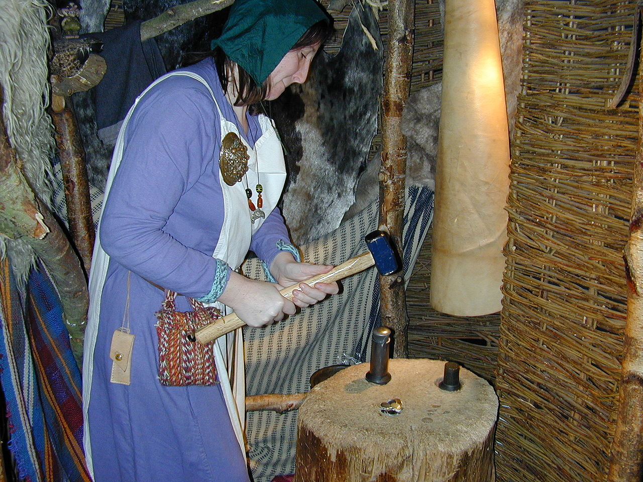
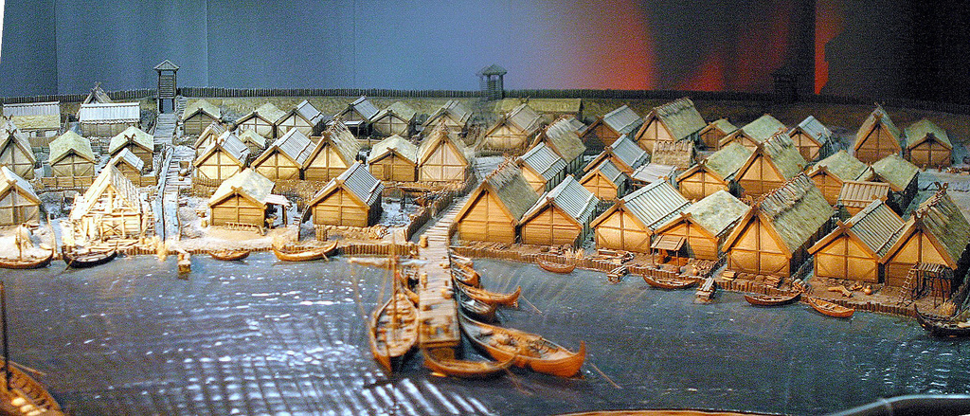


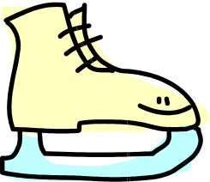
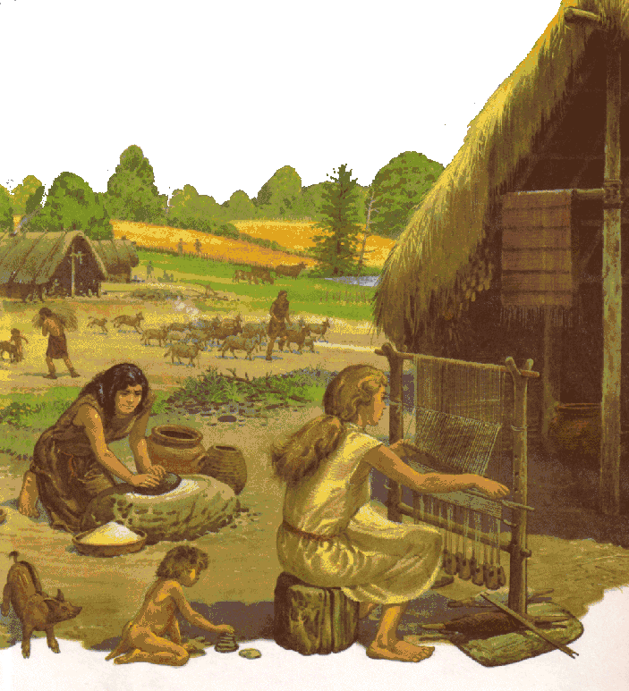
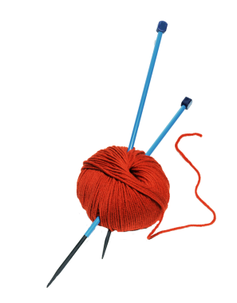
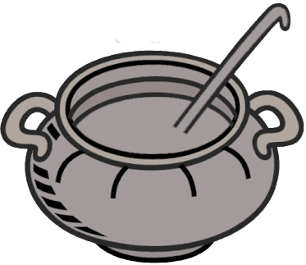
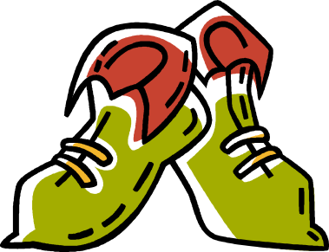
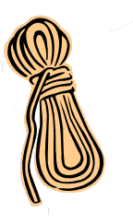


What was found at Jorvik?
47
Cloth
Knitting needles
Comb
Food
Shoes
Bone ice skates
Coins
Bowls
Rope
Anglo-Saxons and Vikings
The Same but Different: 2 Settlements
The Viking objects found at Jorvik have been put in a museum called the Jorvik Viking Centre. You can visit it to see what it was really like in Viking times.
A model of a Viking town.
Both the Anglo-Saxons and Vikings lived in villages in the countryside. Villages were small, with just a few houses. They were farmers. They farmed the land and lived off the food they grew and the animal they kept.
An Anglo-Saxon village.
A
B
A Viking
town.
Jorvik, A Viking Town
The Viking town we know most about was called Jorvik. Jorvik is the Viking name for York. In 1977, archaeologists discovered part of a Viking town in York. The Romans had built a town here and new buildings were built over it. Jorvik was a busy town where people came to buy and sell things. The things archaeologists found have helped us find out more about life of the Vikings.
A town or village?
But
The Vikings built towns to sell the things they made.
Towns were much bigger than a village with more houses.
Towns had markets and became busy trading centres.
Towns were usually built near a river or near the sea.
Some Vikings wanted to sell the things they made and built towns.
Jorvik Viking Centre
A coiner is stamping metal to make coins [money].
The Invaders History Interactive©

Slide 10
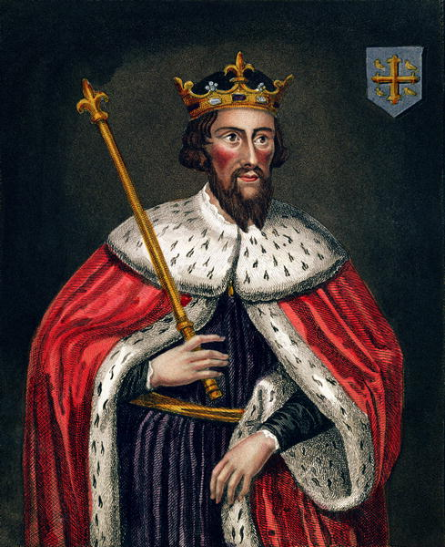
Problems for King Alfred
Why was Alfred called ‘the Great’?
Defences
Alfred made the army and towns stronger.
Churches
He rebuilt churches in stone & trained the priests.
Education
Alfred wanted people to be able to read and write.
Laws
He made people follow one set of good laws.
53
The defences in Wessex were not very strong.
After defeating the Vikings, there were many problems for Alfred.
Alfred’s army and navy were not big enough.
The Vikings had destroyed many churches.
Alfred was not sure if the Vikings would keep their promise.
King Alfred of Wessex
King Alfred was known as Alfred the Great.
The Invaders History Interactive©

