Slide 1
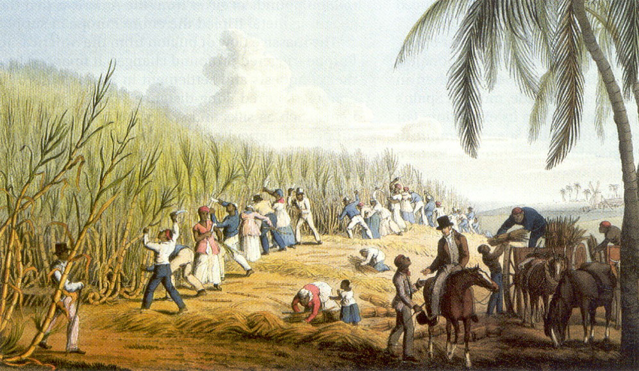

KEY STAGE 3 HISTORY
INTERACTIVE
TRANSATLANTIC
SLAVE TRADE
Why was slavery abolished in the British Empire in 1833?

Slide 2
History Interactive
Teaching and Learning Resources
These are sample slides.
There are no audio, document links or internet links in this sample.
See all of our resources at
www.historyinteractive.co.uk
History Interactive Teaching and Learning © 2013

Slide 3
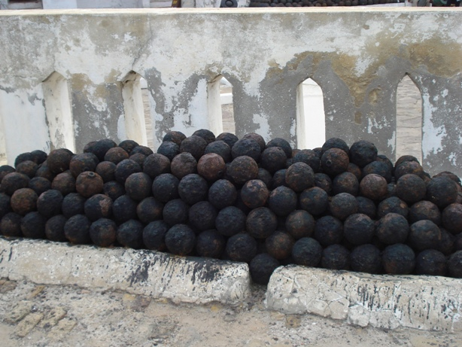
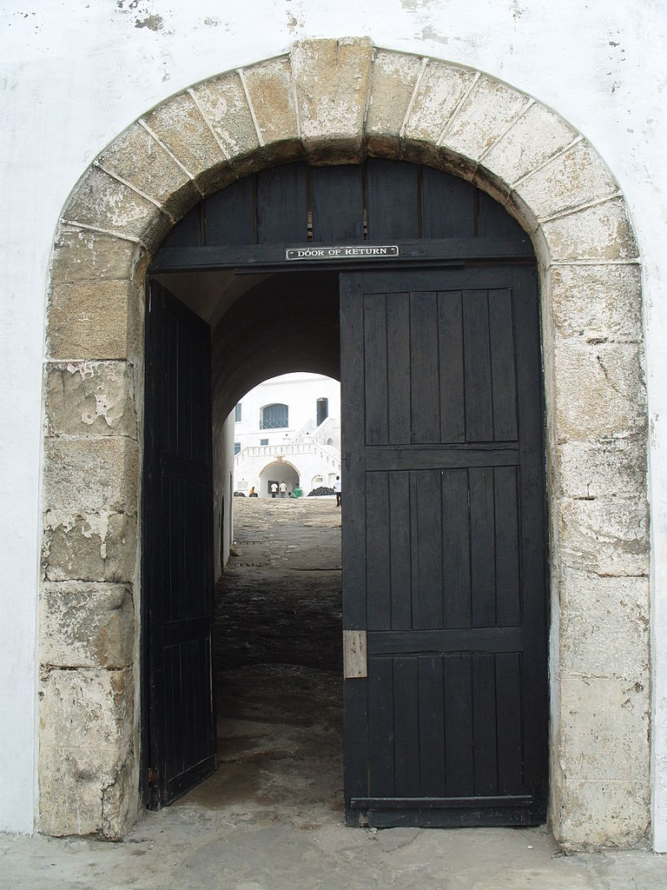
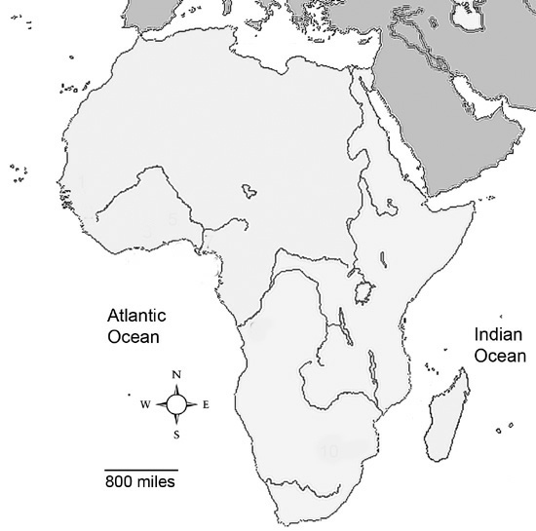
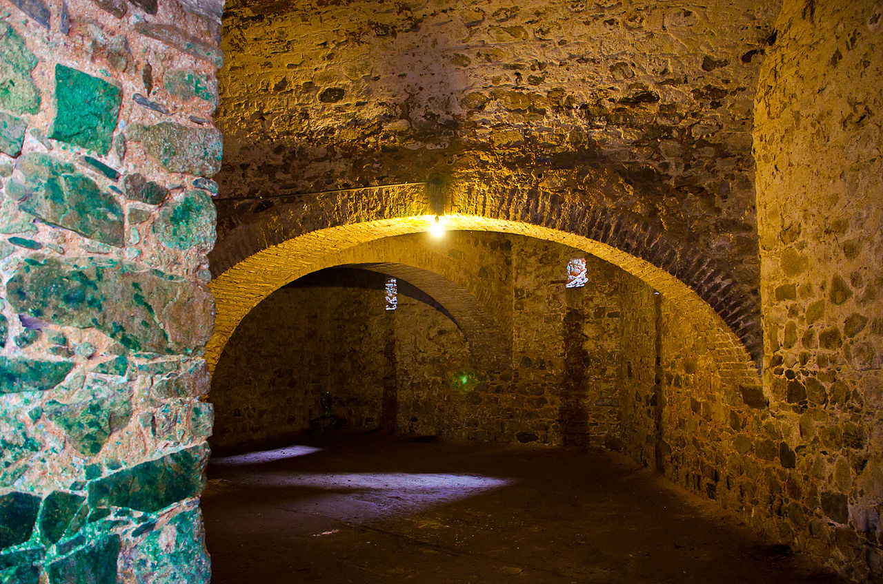
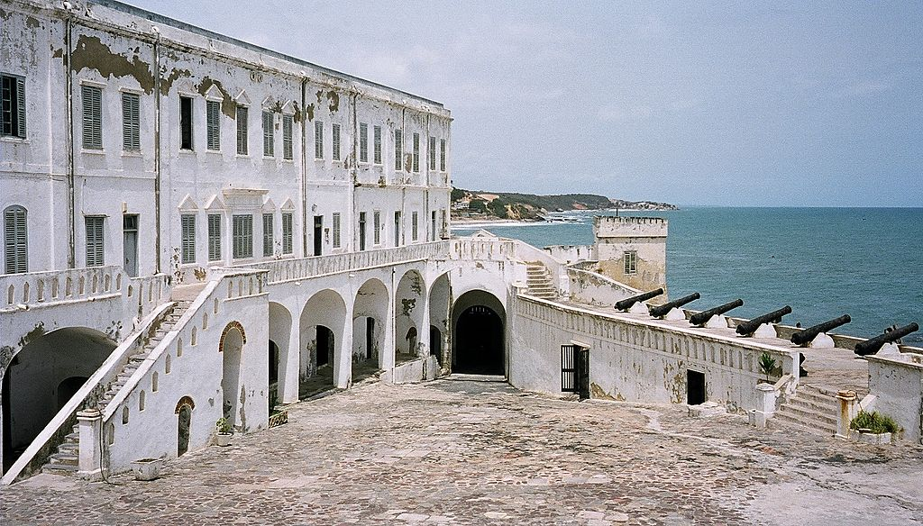
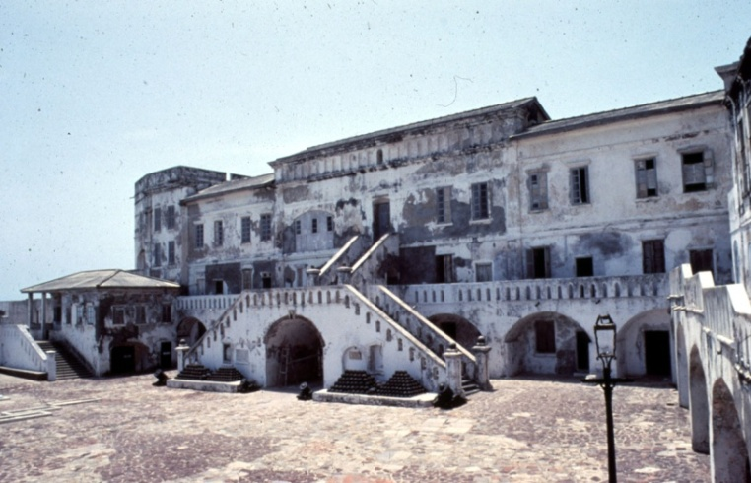
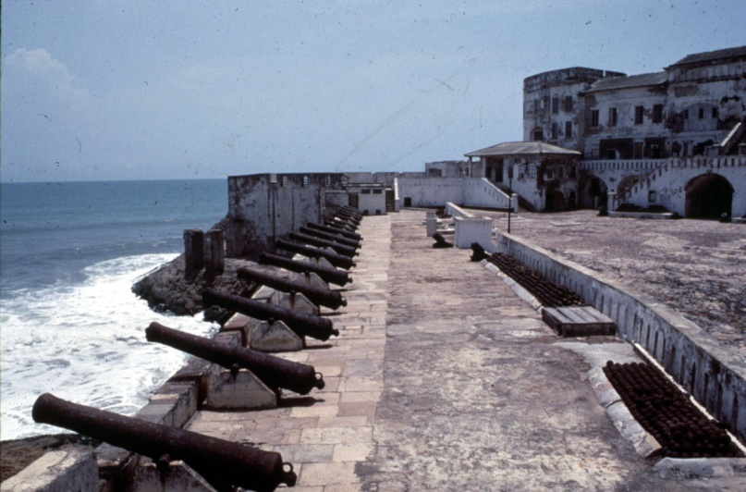
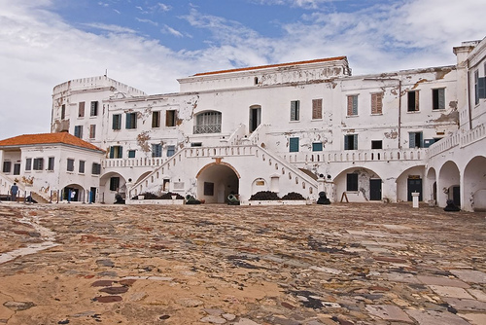
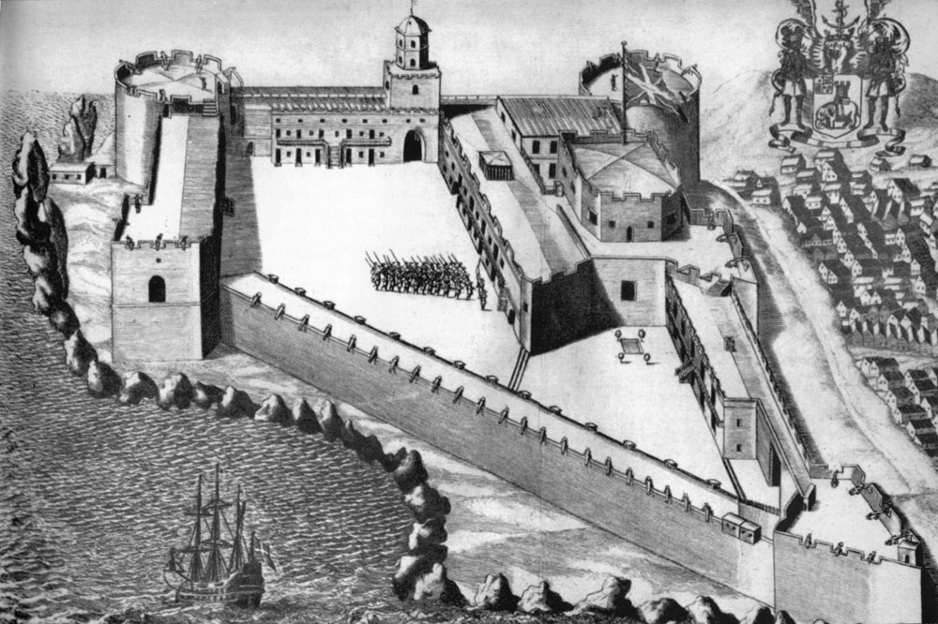



Cape Coast Castle today
FORTS and TRADING
9
Cape Coast Castle was a fort where slaves were kept before being shipped to the Americas.
Forts were built along the African coast.
Cannon balls used to defend Cape Coast Castle.
One of the cells at Cape Coast Castle where were slaves were imprisoned.
The ‘door of no return’ at Cape Coast Castle through which the slaves left the castle when they were shipped away. It was not possible for any of them to ever return to their homeland.
The Dutch, British, French and others who came to trade in Africa very soon realised that there was only one very profitable thing in Africa - slaves.
As more and more trading took place between Africans and Europeans, places were needed where they could process and store the goods obtained from Africa before shipping them off to their home ports. They built factories. These were heavily fortified against attacks, not only from the Africans themselves, but from other European nations and pirates who often found that these factories were an easy target. As a result, these factories were given name castles or forts and became heavily armed against attack. These forts were where slaves were kept before being shipped across the Atlantic . Almost 10 million Africans arrived in the Americas.
Cape Coast Castle today
Ghana
AFRICA
Cape Coast Castle
There were approximately 60 forts or castles on Ghana's west coast during the transatlantic slave trading days. Cape Coast Castle was one of the most famous of these forts. It was built in the 1400s and became one of the main holding places for slaves being shipped to the Americas.
Cape Coast Castle today
Key Stage 3
Interactive Slave Trade
Cape Coast Castle 1500s

Slide 4
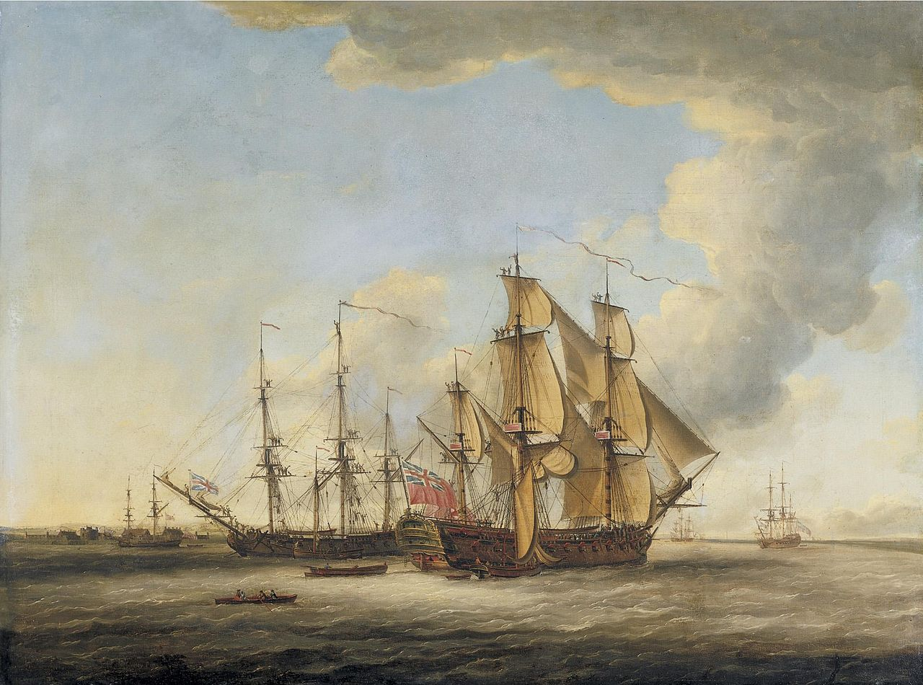
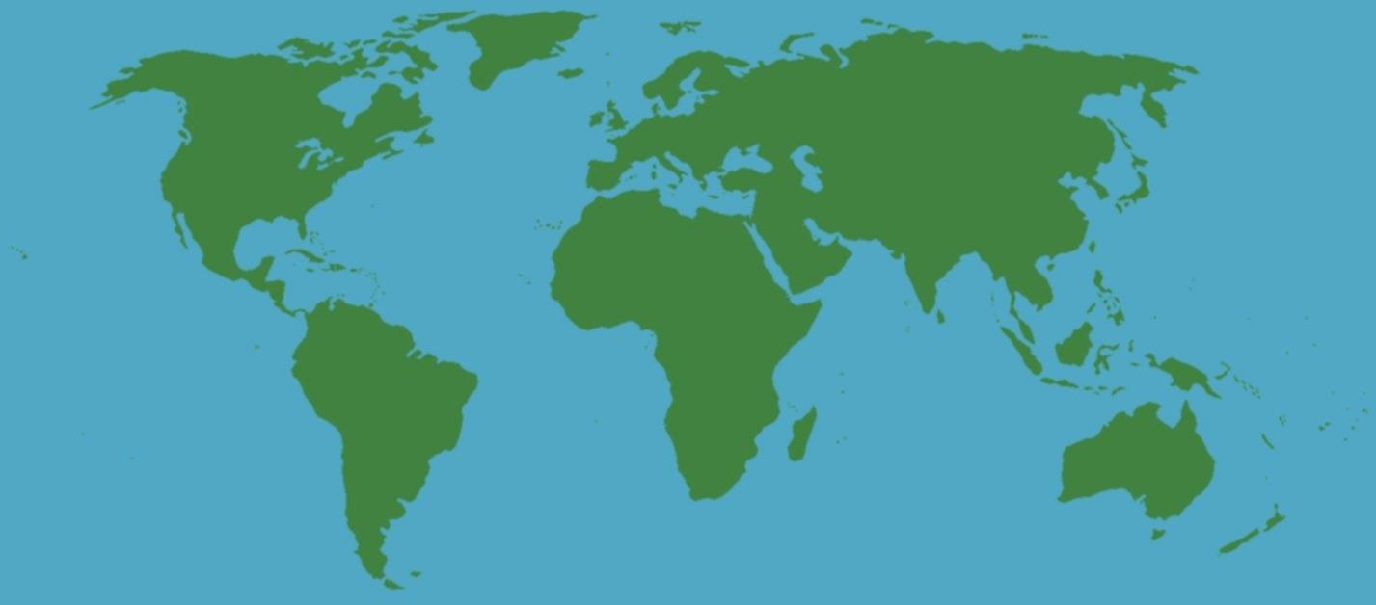

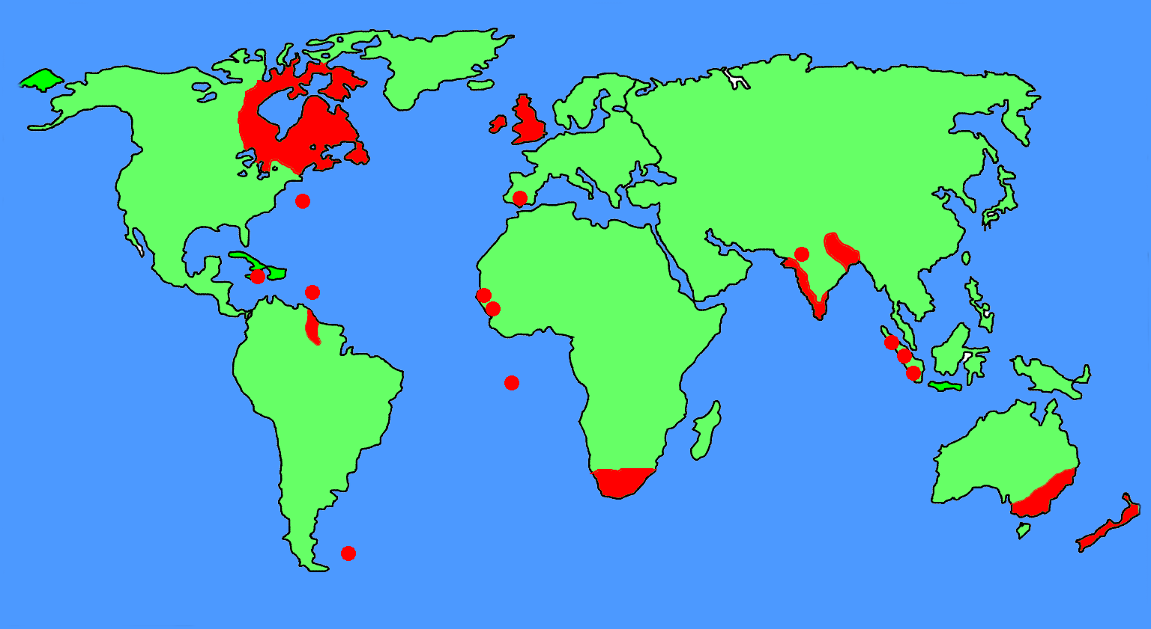
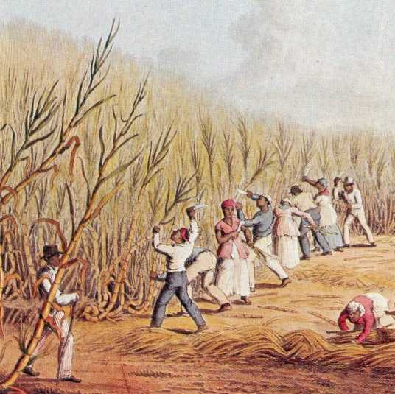
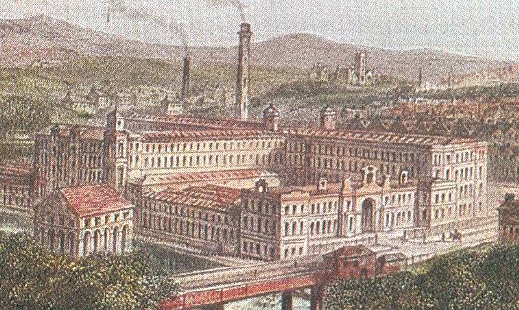









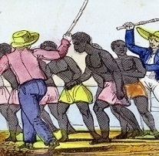
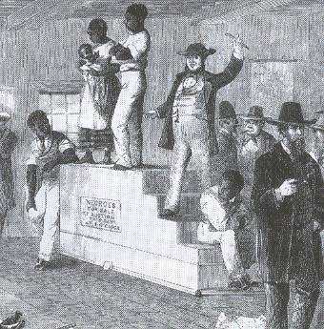
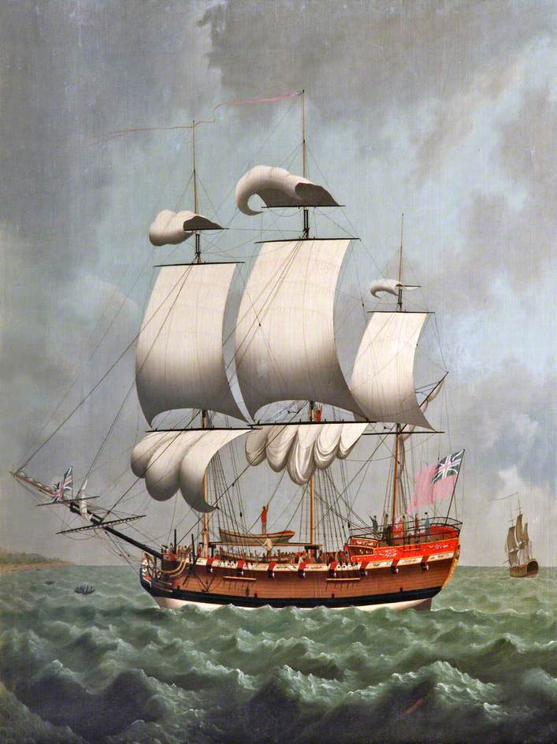
THE TRADE TRIANGLE
Britain’s trade and her Empire in 1800
13
Raw Materials
In 1713, Britain was given the right to supply 4,800 slaves a year to the Spanish colonies in South America.
North
America
Britain was in a good position to get involved in the slave trade because she had some of the best ships in the world. By 1800 60% of slaves were carried in British ships.
SLAVES WERE USED
ON PLANTATIONS, GROWING SUGAR, TOBACCO, COTTON.
England
Manufactured Goods
Europe
Britain and Trade
Between 1750 and 1900 Britain became a powerful trading nation. As trade with other countries grew, Britain built new ships and ports. Ports such as London, Bristol, Liverpool and Hull were the busiest in the world. Britain also expanded her Empire. Britain’s new colonies produced many goods that were in demand around the world.
Canada
BRITAIN MADE HUGE PROFITS FROM SELLING GOODS FROM THE COLONIES.
The Africans who were captured were part of a trade system known as the Trade Triangle. This animation explains how it worked. The animation will begin on your next click.
USA
Atlantic
Ocean
Slaves
India
Atlantic
Ocean
China
The demand for the goods produced in Britain’s colonies grew. More workers were needed to make these goods.
West Indies
Africa
Africa
South America
South America
SLAVES WERE KEPT IN TERRIBLE CONDITIONS ON THE SLAVE SHIPS.
Australia
SLAVE TRADERS THEN SOLD THE SLAVES TO PLANTATION OWNERS
British merchants saw the opportunity to turn the slave trade into a profitable business.

Slide 5

21
THE MIDDLE PASSAGE
Question: How reliable is this source about conditions on a slave ship?
Source 2
“…frequently finds several dead; and among the men, sometimes a dead and living slave fastened by their irons together. When this is the case, they are brought upon the deck, and being laid on the grating, the living slave is disengaged, and the dead are thrown overboard”
Alexander Falconbridge. He was a British surgeon on several slave ships.
Question: How reliable is this source about conditions on a slave ship?
Source 2
“…frequently finds several dead; and among the men, sometimes a dead and living slave fastened by their irons together. When this is the case, they are brought upon the deck, and being laid on the grating, the living slave is disengaged, and the dead are thrown overboard”
Alexander Falconbridge. He was a British surgeon on several slave ships.
KEY SKILLS 1
RELIABILITY
HOW TO ANSWER THE QUESTION
Reliability means, can you trust this source? Remember to give reasons why the source might be reliable and unreliable.
Comment on the date, author, what the source says and why the source might have been written. Did the author witness the events he describes? You can judge if a source is reliable by testing it against your own knowledge. [What you know about the Middle Passage.]
Key Stage 3
Interactive Slave Trade

Slide 6
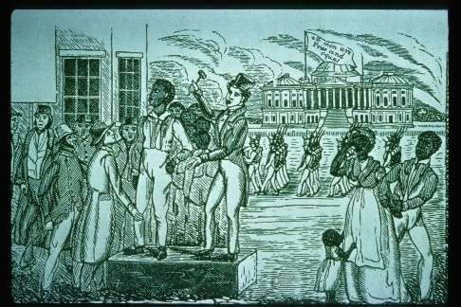

A SLAVE AUCTION
27
Buyers inspected the slave.
Slaves were sold to the highest bidder.
Families were often separated.
After the slaves had been sold, the money was used to buy sugar, rum, tobacco, coffee and cotton from America. These precious goods were taken to Britain where they were sold for much higher prices. The owners of the ships and cargo made a fortune.
Other slaves wait to be sold.
Key Stage 3
Interactive Slave Trade

Slide 7
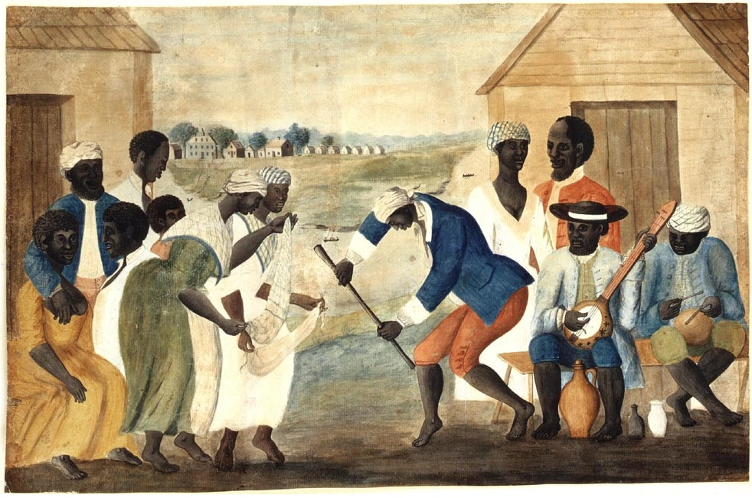
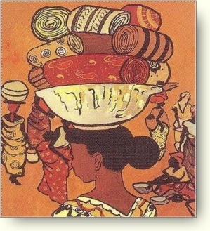
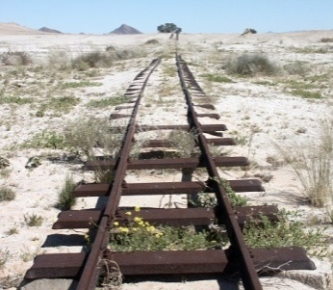
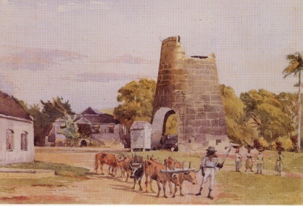
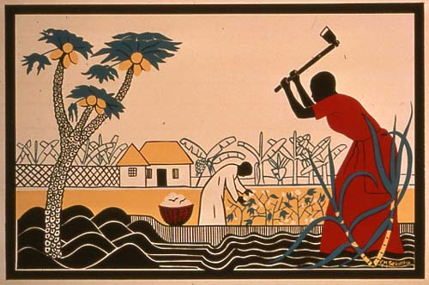
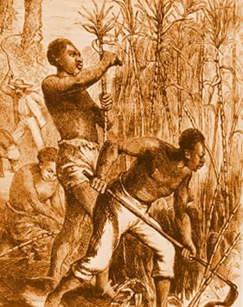
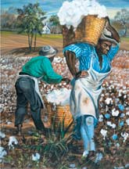
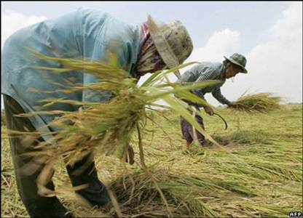

Even though life on the plantations was very hard, slaves did find some time to enjoy themselves. In this picture, slaves dance to the sound of a banjo and drums.
29
WHAT WORK DID SLAVES DO ON THE PLANTATIONS?
Washing clothes
Building railways
Working on farms
Building canals
Work done by slaves
Cotton picking
Cutting sugar cane
Planting rice
Key Stage 3
Interactive Slave Trade

Slide 8
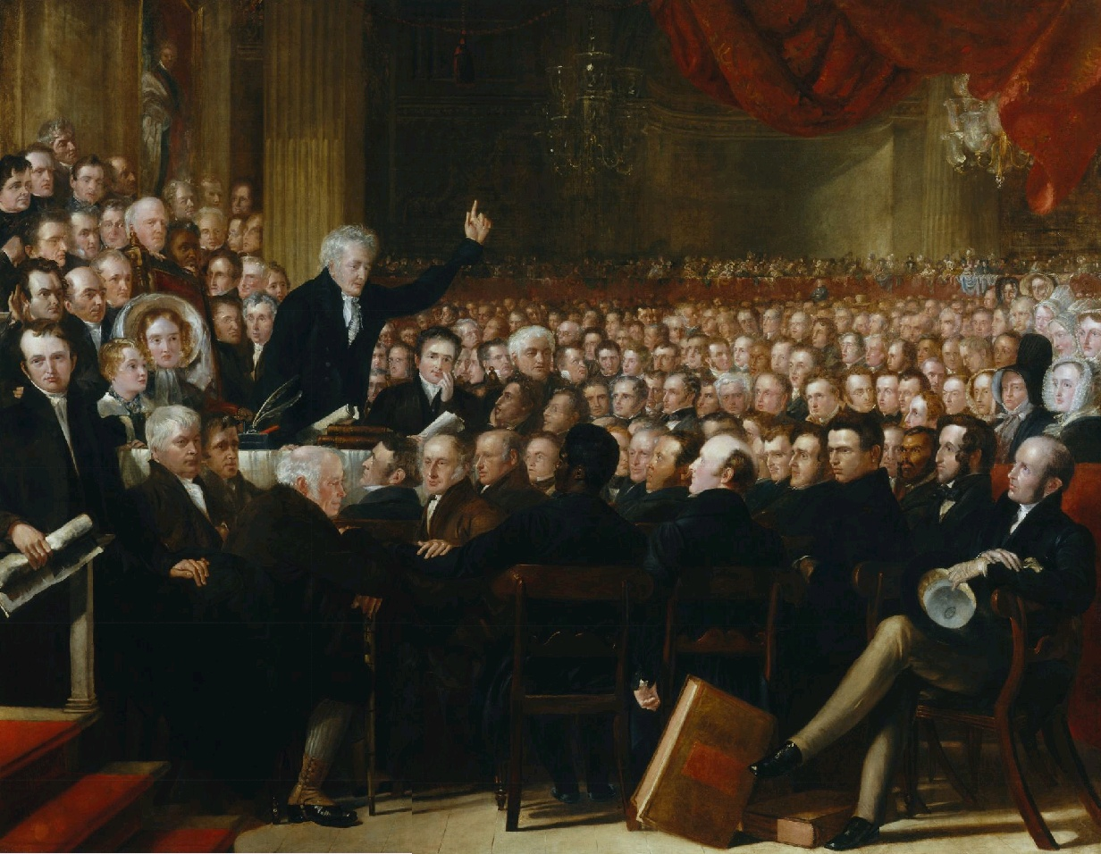
Made speeches in parliament and wrote letters to MPs.
They told the stories of slaves and their brutal treatment.
They posted leaflets and pamphlets.
They stopped buying goods made by slaves.
The abolitionists had the support of the Church.
This is a painting of an anti-slavery meeting in 1830.
ABOLITION
35
As the slave trade grew, more and more people began to show their concerns about the brutality of the system. After 1780, the slave trade faced organised opposition from a very determined abolition campaign.
Anti-slave campaigners held public meetings to make people aware of the horrors of the slave trade. Many people were keen to attend meetings organised by abolitionists. John Newton, the captain of a slave ship, realised that the slave trade was wrong and became a priest. He spoke at many of these meetings. Other speakers included Thomas Clarkson and Granville Sharp, and the former slave Olaudah Equiano. Abolitionist used many different methods to convince people that slavery was wrong. They wrote anti-slavery books and made posters and pamphlets. They also presented their arguments to parliament. The first anti-slavery law was the Abolition of the Slave Trade Act in 1807. Although this act stopped slaves being carried in British ships, it did not end slavery. It was not until Parliament passed the Slavery Abolition Act in 1833 that all slaves in the British Empire got their freedom. The British government paid compensation to the slave owners.
How did the abolitionists try to end the slave trade?
Key Stage 3
Interactive Slave Trade

